Slide 1
Structure of Liberty
F.H. Buckley, Scalia Law School
fbuckley@gmu.edu, fhbuckley.com

Slide 2
The Intellectual Origins of the Republic
It wasn’t only about ideas, however…

Slide 3
Don Lutz’s list of who the Founders were reading
The Bible
Montesquieu
Sir William Blackstone
John Locke
David Hume
Plutarch
Cesare Beccaria
John Trenchard and Thomas Gordon (Cato’s Letters)

Slide 4
Samuel anoints King Saul

Slide 5
Jean-Louis David, The Lictors bring the bodies of his sons to Brutus (1789)

Slide 6
Montesquieu

Slide 7
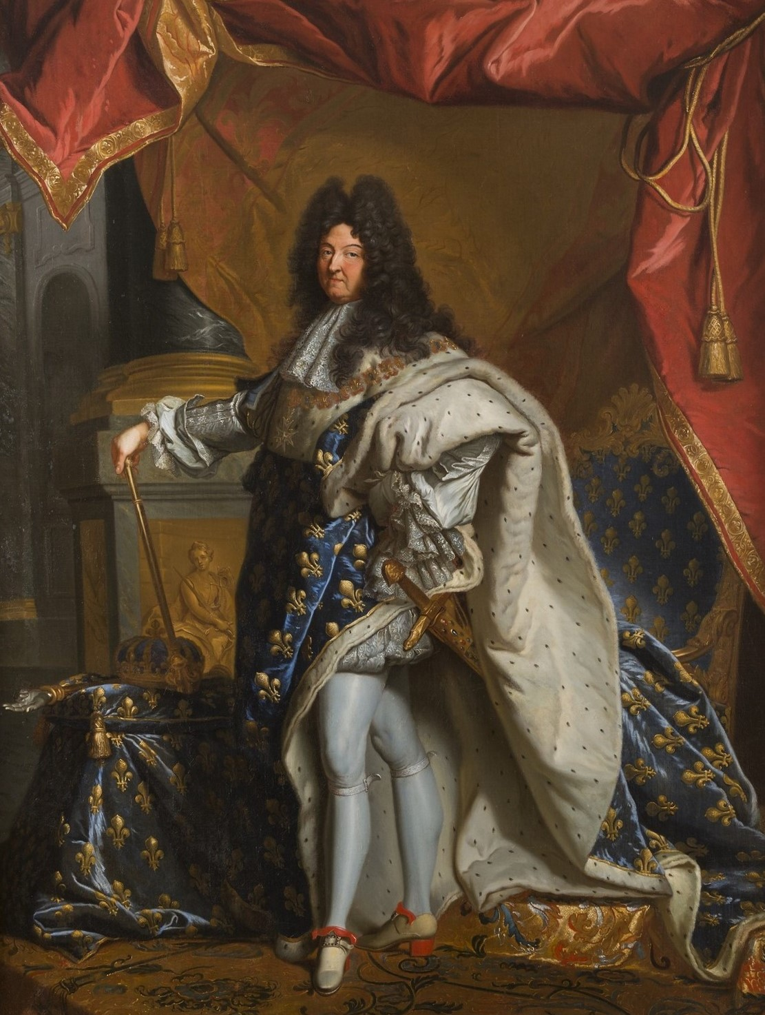
France vs. Britain

Slide 8
The King-in-Parliament

Slide 9
Separation of Powers

Slide 10
Where the executive assumes the legislative power

Slide 11
Where the executive assumes the judicial power

Slide 12
“This beautiful system was invented first in the woods”

Slide 13
What’s the optimal size of a country?

Slide 14
Montesquieu
Small is beautiful?

Slide 15
Daniel Boone leads settlers through the Cumberland Gap to Kentucky, 1775

Slide 16
David Hume What was his plan of government? “either by a dissolution of some old government, or by the combination of men to form a new one, in some distant part of the world”

Slide 17
Filtration
Protector
Senators
100 counties
10,000 parishes

Slide 18
Hume: Why is Bigness Goodness?

Slide 19
The Articles of Confederation

Slide 20
The Articles of Confederation
Interstate commerce?

Slide 21
The Articles of Confederation
Taxation?

Slide 22
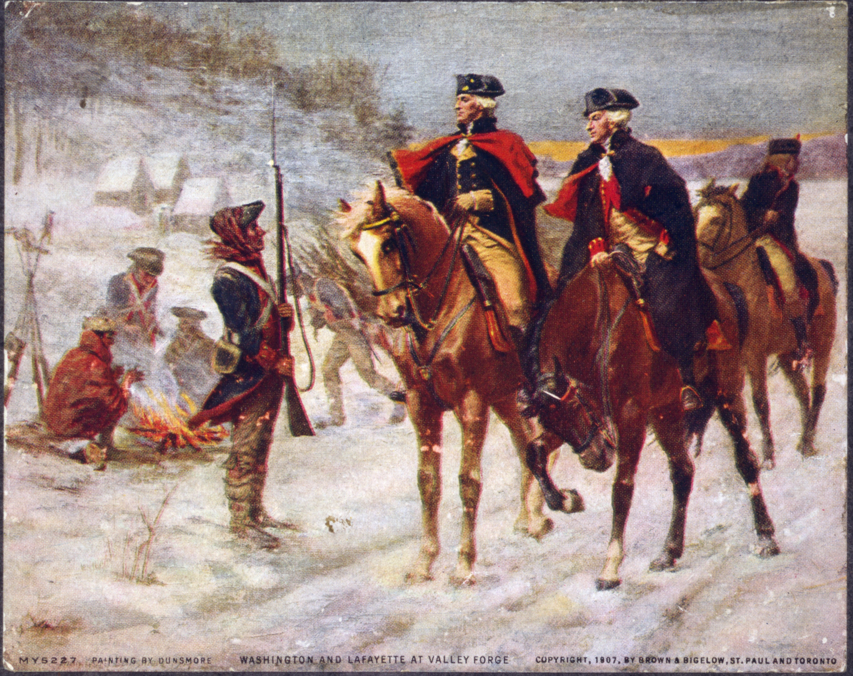
Valley Forge, 1777-78
How are federal taxes levied?

Slide 23
The Newburgh Mutiny, 1783

Slide 24
Society of the Cincinnati

Slide 25
The Articles of Confederation
How can it be amended?

Slide 26
The Articles of Confederation
The Virginia-Maryland Compact?

Slide 27
The Alexandria Conference

Slide 28
The Annapolis Conference

Slide 29
Congress authorizes the Constitutional Convention, Feb. 21, 1787
“That it be recommended to the states composing the Union that a convention of representatives from the said states respectively be held at__________on__________for the purpose of revising the Articles of Confederation and perpetual Union between the United States of America and reporting to the United States in Congress assembled and to the states respectively such alterations and amendments of the said Articles of Confederation as the representatives met in such convention shall judge proper and necessary to render them adequate to the preservation and support of the Union.”

Slide 31
Treaty of Paris, 1783

Slide 32
Article 4:
It is agreed that creditors on either side shall meet with no lawful impediment to the recovery of the full value in sterling money of all bona fide debts heretofore contracted.
Article 5:
It is agreed to earnestly recommend it to the legislatures of the respective states to provide for the restitution of all estates, rights, and properties, which have been confiscated belonging to real British subjects;

Slide 33
Northwest Territories, 1787

Slide 34
Northwest Ordinance
Art. 6. There shall be neither slavery nor involuntary servitude in the said territory, otherwise than in the punishment of crimes whereof the party shall have been duly convicted: Provided, always, That any person escaping into the same, from whom labor or service is lawfully claimed in any one of the original States, such fugitive may be lawfully reclaimed and conveyed to the person claiming his or her labor or service as aforesaid

Slide 35
Northwest Ordinance
Art. 3. Religion, morality, and knowledge, being necessary to good government and the happiness of mankind, schools and the means of education shall forever be encouraged. The utmost good faith shall always be observed towards the Indians; their lands and property shall never be taken from them without their consent; and, in their property, rights, and liberty, they shall never be invaded or disturbed, unless in just and lawful wars authorized by Congress; but laws founded in justice and humanity, shall from time to time be made for preventing wrongs being done to them, and for preserving peace and friendship with them.

Slide 36
Who wasn’t in Philadelphia

Slide 37
Jefferson in Paris 1784-89

Slide 38
John Adams A Defense of the Constitutions (1787)

Slide 39
John Adams A Defense of the Constitutions (1787)
https://www.youtube.com/watch?v=KyrWdwW89FU&t=7s

Slide 40
Patrick Henry: “I smell a rat”

Slide 41
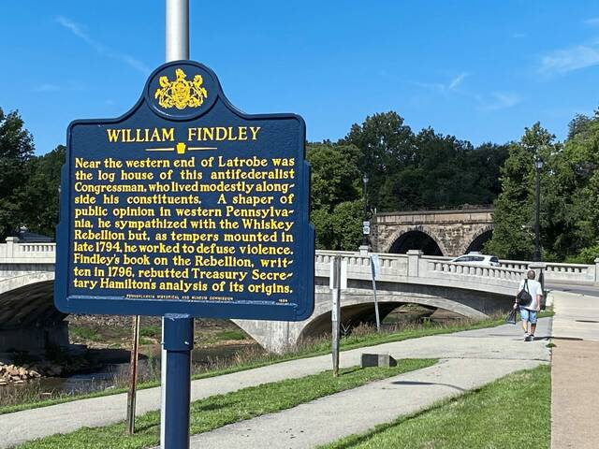
William Finlay

Slide 42
Washington and Billy Lee

Slide 43
Gouverneur and Roger Morris

Slide 46
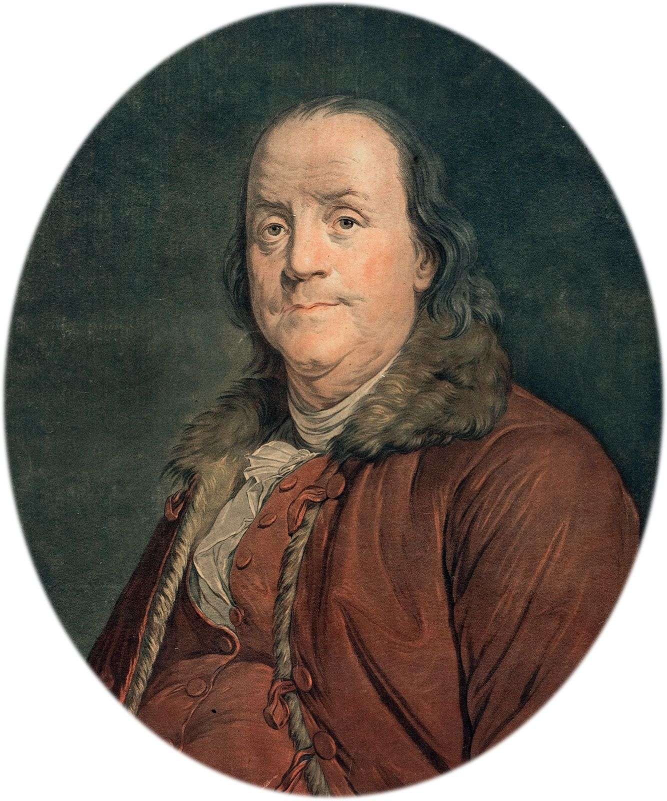
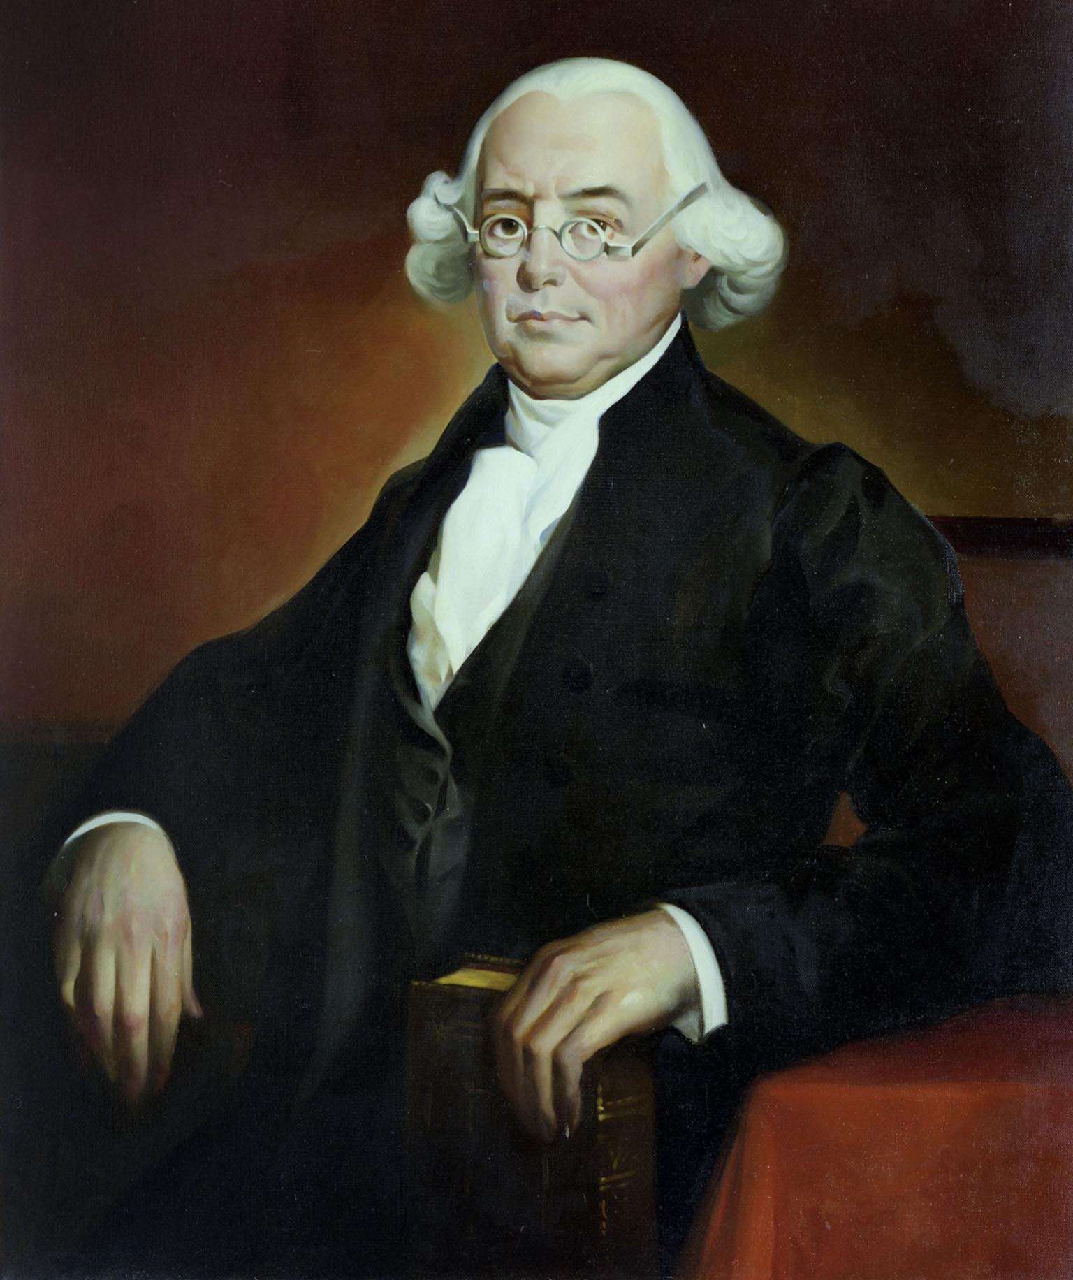
Mason, Franklin, James Wilson

