Slide 1
Structure of Liberty
F.H. Buckley, Scalia Law School
fbuckley@gmu.edu, fhbuckley.com

Slide 2
Housekeeping
Required Materials
Office Hours

Slide 3
Housekeeping
What are you looking for in the course?

Slide 4
The Course
Class participation 33%
Paper 67%

Slide 5
Housekeeping
Paper 5,000 to 10,000 words, due on May 10, 2024,
With a special emphasis on the Framers’ debates
Topics:
The Delegates?
Separation of Powers?
The Presidency?
Slavery?
Secession?
Virtue Politics?

Slide 6
Why read the Framers
A ripping good yarn
A key to understanding the Constitution
Political Theory

Slide 7
The key to understanding the Constitution
Original Intent
Original Public Meaning

Slide 8
The historiographical sin of anachronism
The Whig Theory of History: Herbert Butterfield
Charles Beard and Marxism
The 1619 Project: Nikole Hannah-Jones

Slide 9
Getting inside their minds
R.G. Collingwood on the study of history
E.g., What drove Mason round the bend

Slide 10
Madison’s Notes vs. The Federalist Papers
A selling document by the losers
Not read outside NY
Disappears till Charles Beard discovered it

Slide 11
Explaining the Revolution
https://www.youtube.com/watch?v=E6caJv__WSM

Slide 12
The 1774 Quebec Act

Slide 13
U.S. 1787

Slide 14
Somerset’s Case, 1773
Lord Mansfield: The state of slavery is of such a nature, that it is incapable of being introduced on any reasons … but only by positive law. … It is so odious, that nothing can be suffered to support it, but positive law. Whatever inconveniences, therefore, may follow from this decision, I cannot say this case is allowed or approved by the law of England; and therefore the black must be discharged.

Slide 15
Lord Dunmore’s Proclamation 1775

Slide 16
The rise to self-government
Population US in 1776: 4 million
Population Canada 1867: 4 million
Population Australia 1901: 4 Million

Slide 17
The Virginia Constitution of 1776

Slide 18
Dueling Interpretations of the Revolution
Locke
Republican Virtue: Bailyn, Wood, Pocock

Slide 19
Sir Robert Walpole

Slide 20
Walpole Ministry, 1721-42
The South Sea Bubble 1720
Placemen and Patronage

Slide 21
The Country Party Cato’s Letters and Viscount Bolingbroke
Democratic
Virtuous Government and Corruption
Agrarian Virtue and Finance Capitalism
Wealth and Luxury

Slide 22
Sources of Virtue
The Virtue of the Many: Country Party
The Virtue of the Few
Doing without virtue: the “Madisonian Constitution”

Slide 23
Sources of Virtue
The Virtue of the Many: Country Party

Slide 24
Siena in 1300 Piazza del campo and Palazzo publico

Slide 25
Lorenzetti

Slide 26
Lorenzetti, Effects of Good Government

Slide 27
Lorinzetti, Bad Government

Slide 28
Lorinzetti, Good Government

Slide 29
Lorinzetti, Good Government

Slide 30
Lorinzetti, Good Government

Slide 31
The Country Party in America
The Founders: Washington, Jefferson, Adams
Andrew Jackson
Frederick Jackson Turner and the Frontier Thesis
William Jennings Bryant
Today?

Slide 32
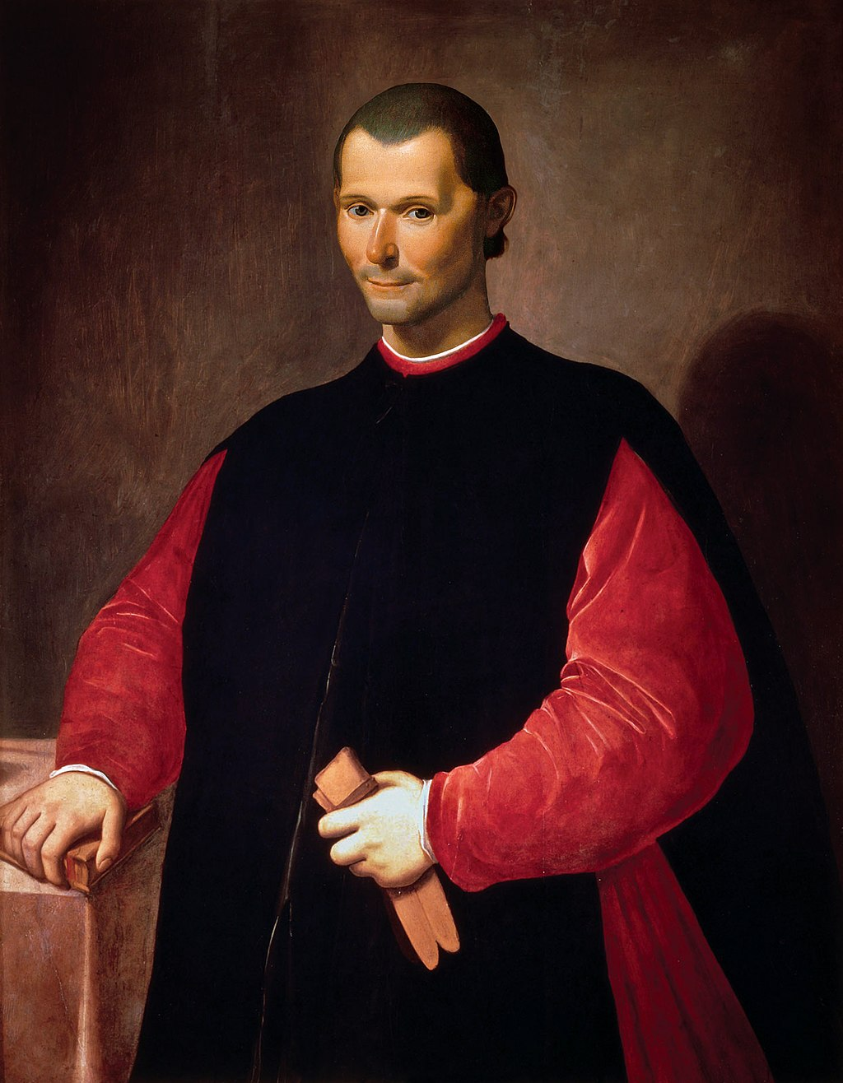
The Court Party Lorenzo de’ Medici and Machiavelli

Slide 33
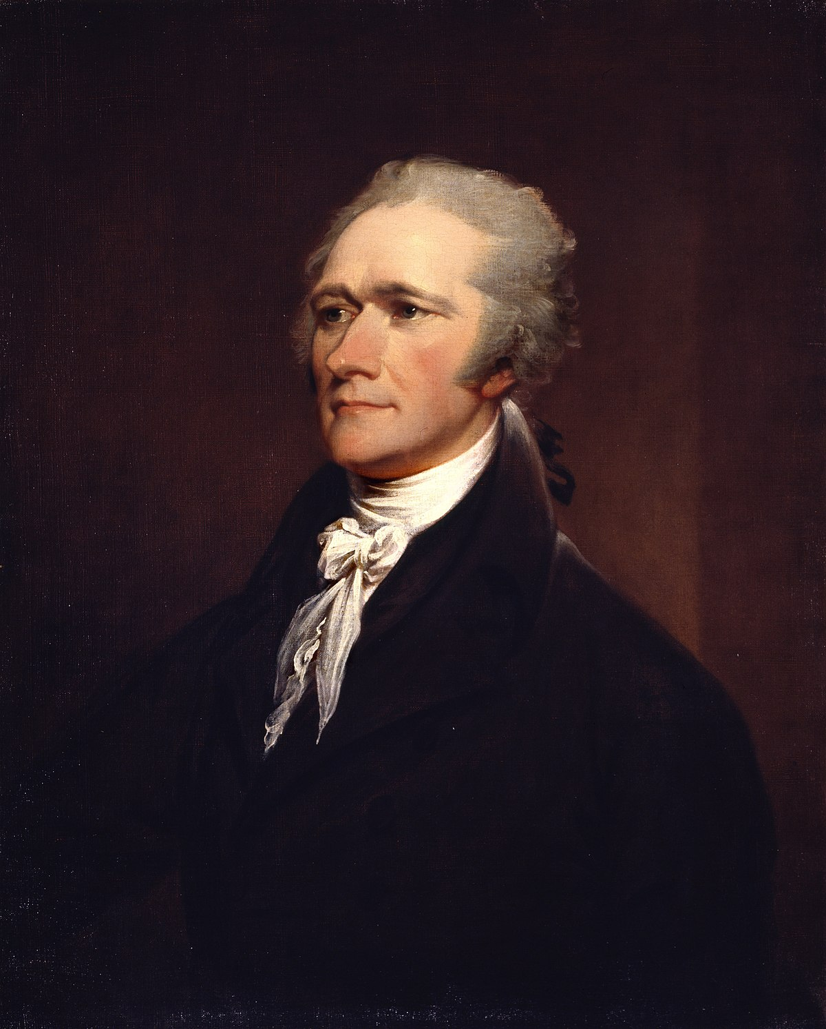
The Court Party in 1787 Madison and Hamilton

Slide 34
Revolutionary Mobs

Slide 35
Shay’s Rebellion, 1786-87

Slide 36
What is the Court Party Today?

Slide 37
What is the Court Party Today?

