Slide 1
George Mason School of Law
Contracts II
Capacity
F.H. Buckley
fbuckley@gmu.edu

Slide 2
What does it mean to choose badly?
  Contract Law Illegality
    Full capacity and full information, but yet unenforceable
  The high tide of Millian liberalism
    Sir George Jessell
    ”Rights are Trumps”

Slide 3
Would the following agreements be enforced?
  Not to get an abortion?
  To give up the possibility of divorce?
  Never to buy a gun?
  Never to vote?
  “unalienable rights”

Slide 4
What does it mean to choose badly?
  Capacity and Consent
    Self-defeating Choices
    “I wanted x but somehow I chose not-x”

Slide 5
What does it mean to choose badly?
  Capacity
    I lacked the ability to chose rationally (i.e., to advance my interests)

Slide 6
Economists have a narrow definition of rationality
Pareto: With full capacity, free bargaining makes people better off…
Provided that we assume that their choices satisfy the assumptions of rational choice

Slide 7
Rational Choice: Six Assumptions
Full Information (later)
  No mistakes
  No misrepresentations
  And no informational asymmetries

Slide 8
Rational Choice: Six Assumptions
Full Information
Choices Are Freely Made (later)
  No duress
  Unconscionability?

Slide 9
Rational Choice: Six Assumptions
Full Information
Choices Are Freely Made
Non-satiation
  More is always better

Slide 10
Non-satiation: B > A
Good 1
More is always better
B
A
0
Good 2

Slide 11
Non-satiation: B > A
Good 1
More is always better
B
YB
YA
A
YB > YA
0
Good 2
XA
XB
XB > XA

Slide 12
Rational Choice: Six Assumptions
Full Information
Choices Are Freely Made
Non-satiation
Completeness or comparability

Slide 13
Comparability:
No incommensurabilities
No black holes

Slide 14
Rational Choice: Six Assumptions
Full Information
Choices are Freely Made
Non-satiation
Completeness or comparability
No third-party effects (externalities)

Slide 15
What happens
if third parties can’t be joined?
Paretian norms don’t work if Coasian bargains are impossible
External Costs and Tort Law

Slide 16
But nearly everything has third party effects…
Do we then abandon the concept of efficiency?
A more relaxed standard: Kaldor-Hicks efficiency
A transformation is Kaldor-Hicks efficient when the winners could compensate the losers (“Potential Pareto-Efficiency”) and satisfy Paretian standards

Slide 17
Explaining Kaldor-Hicks:
C is Pareto-inferior to A
Moving from A to C makes Mary worse off
Bess
A
•
C
•
Mary

Slide 18
But C is Kaldor-Hicks Efficient to A
1. At C Bess is on IC and better off than she is at A on IA
Bess
A
•
C
•
I_{C}
I_{A}
Mary

Slide 19
C is Kaldor-Hicks Efficient to A
2. At C Bess could give up CB roses to Mary to move to B and be on IB, where Bess would be better off than she was on IA
Bess
A
•
B
C
•
•
I_{B}
I_{C}
I_{A}
Mary

Slide 20
C is Kaldor-Hicks Efficient to A
3. At B Mary would be no worse off than at A.
Bess
A
•
B
C
•
•
I_{B}
I_{C}
I_{A}
Mary

Slide 21
Kaldor-Hicks Efficiency
C is Pareto-inferior to A but Bess could make it Pareto-superior by transferring wealth to Mary
Bess
A
•
B
C
•
•
I_{B}
I_{C}
I_{A}
Mary
“Potential Pareto-superiority”

Slide 22
Examples of Kaldor-Hicks Efficiency
Relaxing a tariff that costs consumers $10B and gives producers and additional $1B
Bankruptcy causes a loss of $1M to shareholders and a benefit of $10M to creditors

Slide 23
Rational Choice: Six Assumptions
Full Information
Choices are Freely Made
Non-satiation
Completeness or comparability
No third party effects (externalities)
Perfect rationality

Slide 24
Perfect Rationality: Transitivity
If A is preferred to B and B is preferred to C, then A is preferred to C
  A}B, B}C ⇒A}C

Slide 25
Why Indifference Curves can’t touch
Good 1
B
YB
YA
A
YB } YA
0
Good 2
XA
XB
XB } XA

Slide 26
Violation of Transitivity
Indifference curves can’t touch
Good 1
If a ~ c and c~ b,
then a ~ b.
But b > a, so b } a
A violation of transitivity
•
b
a
•
•
c
Good 2
0

Slide 27
InTransitive Preferences?
I prefer Biden to Trump
I prefer Trump to Robert Kennedy
I prefer Robert Kennedy to Biden

Slide 28
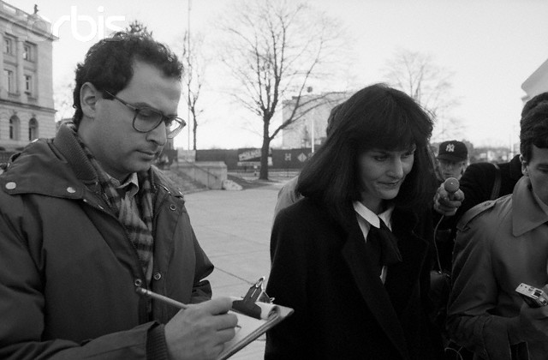
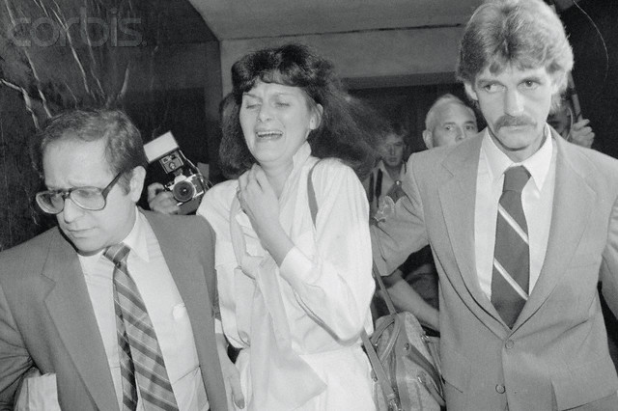
But just who is irrational here?
Any intransitive preferences here?

Slide 29
Relaxing the rationality assumption:
Capacity and Paternalism
Suppose that, lacking perfect rationality, we knew that our choices might harm us.
Might we not, in such cases, wish to let the paternalist choose for us?

Slide 30
Relaxing the rationality assumption:
Paternalism
The standard cases
  Minors
  Mental defectives
  Inebriatated, drugged…

Slide 31
Capacity: Minors
Restatement § 12(1): No one can be bound by contract who has not legal capacity to incur at least voidable contractual duties. Capacity to contract may be partial and its existence in respect of a particular transaction may depend upon the nature of the transaction or upon other circumstances.
(2) A natural person who manifests assent to a transaction has full legal capacity to incur contractual duties thereby unless he is
(a) under guardianship, or
(b) an infant, or
(c) mentally ill or defective, or
(d) intoxicated

Slide 32
Restatement § 14: Infants
Unless a statute provides otherwise, a natural person has the capacity to incur only voidable contractual duties until the beginning of the day before the person's eighteenth birthday.

Slide 33
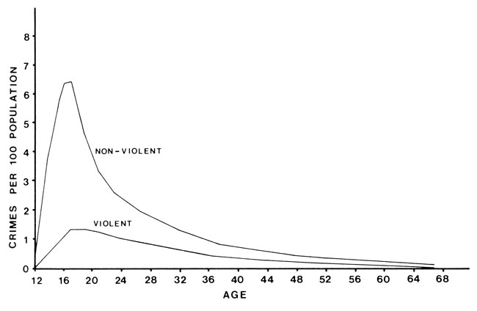
Minors: What’s wrong with this picture?
The standard cases
  Minors
  Mental defectives
  Inebriatated, drugged…

Slide 34
Infants: Kiefer at 509
What happened?
What is an emancipated minor?

Slide 35
Bright-line Rules
What about the mature 16-year-old?
  Or the married person under the age of majority?
Or the immature 25-year-old?

Slide 36
Infants: Kiefer
Did the Δ know that the Π was a minor?
  Should the Δ have known?

Slide 37
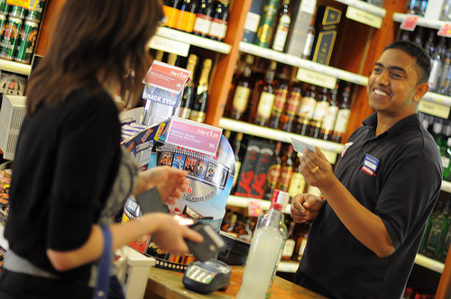
Infants: Kiefer
Did you never get carded?

Slide 38
Infants: Kiefer
Did the Δ know that the Π was an emancipated minor?
  Contrast Restatement §15 on merchant protection

Slide 39
Restatement § 15: Mental Illness
  15. A person incurs only voidable contractual duties by entering into a transaction if by reason of mental illness or defect
  (a) he is unable to to understand in a reasonable manner the nature and consequences of the transaction, or
  (b) he is unable to act in a reasonable manner in relation to the transaction and the other party has reason to know of his condition.
  Why a difference?

Slide 40
Infants: Kiefer
What if the infant had lied about his age?
  Wisconsin Loan at 467

Slide 41

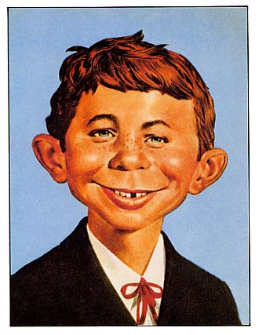
Infants: Kiefer
What if the infant had lied about his age?

Slide 42
Infants: Kiefer
What about the age of majority clause in the contract?
  Why did the court say that this did not provide evidence of an intent to defraud?
    What is scienter?
    Why no reliance by the merchant?

Slide 43
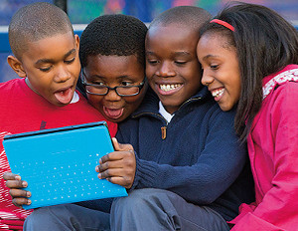
What about internet purchases?

Slide 44
Merchant Protection
If the contract is properly disaffirmed by the minor, who is liable for depreciation?
  Halbman at 514
  Doenges-Long v. Gillen at 515

Slide 45
Affirming the Contract
What if the minor doesn’t disaffirm the contract on reaching the age of majority?
  Bobby Floars at 516

Slide 46
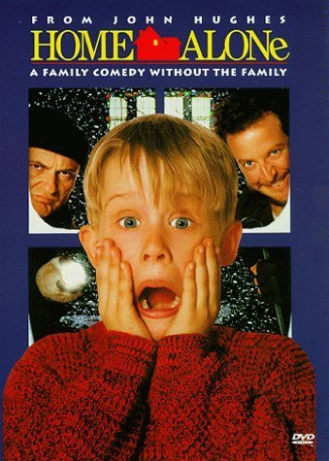
Why an exception for necessities?

Slide 47
Why an exception for necessities?
Are cars necessities?

Slide 48
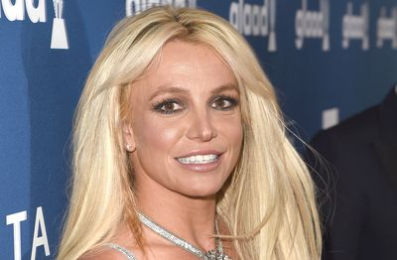
Capacity: The Mentally Ill
Restatement § 12(1): No one can be bound by contract who has not legal capacity to incur at least voidable contractual duties. Capacity to contract may be partial and its existence in respect of a particular transaction may depend upon the nature of the transaction or upon other circumstances.
(2) A natural person who manifests assent to a transaction has full legal capacity to incur contractual duties thereby unless he is
(a) under guardianship, or
(b) an infant, or
(c) mentally ill or defective, or
(d) intoxicated

Slide 49
Mental Illness
§ 15(1). A person incurs only voidable contractual duties by entering into a transaction if by reason of mental illness or defect
  (a) he is unable to understand in a reasonable manner the nature and consequences of the transaction, or
  (b) he is unable to act in a reasonable manner in relation to the transaction and the other party has reason to know of his condition.
  Merchant protection

Slide 50
Mental Illness
§ 15(2). Where the contract is made on fair terms and the other party is without knowledge of the mental illness or defect, the power of avoidance under Subsection (1) terminates to the extent that the contract has been so performed in whole or in part or the circumstances have so changed that avoidance would be unjust. In such a case a court may grant relief as justice requires.
Double protection for merchant

Slide 51
Faber at 519
What happened?

Slide 52
Faber
Standards of Incompetency
  Capacity to understand: Paine v. Aldrich
  Loss of Control due to insane impulse in Newton v. Mutual Benefit
  Capacity to form a rational judgment or correct conclusions

Slide 53
Faber
What about merchant protection?
Which party was in the better position to cure the problem?

Slide 54
Faber
How would you have applied Restatement § 15(1)(b)?
A person incurs only voidable contractual duties by entering into a transaction if by reason of mental illness or defect
  (a) he is unable to understand in a reasonable manner the nature and consequences of the transaction, or
  (b) he is unable to act in a reasonable manner in relation to the transaction and the other party has reason to know of his condition.

Slide 55
Is Faber consistent with Uribe at 478?
Should the Δ have been on notice?
Casebook: “Do you get the sense that the law has not kept pace with modern developments in psychiatry..”

Slide 56
Uribe at 523
Suppose the contract had been set aside
  How might this change the advice you’d give a client who buys from an elderly seller?
  “Elderlaw”

Slide 57
Intoxicated Persons
Restatement § 16. A person incurs only voidable contractual duties by entering into a transaction if the other party has reason to know that by reason of intoxication (a) he is unable to understand in a reasonable manner the nature and consequences of the transaction, or (b) he is unable to act in a reasonable manner in relation to the transaction.

Slide 58
Intoxicated Persons
Restatement § 16. A person incurs only voidable contractual duties by entering into a transaction if the other party has reason to know that by reason of intoxication (a) he is unable to understand in a reasonable manner the nature and consequences of the transaction, or (b) he is unable to act in a reasonable manner in relation to the transaction.
Recall Lucy v. Zehmer

Slide 59
George Mason School of Law
Contracts II
Capacity
F.H. Buckley
fbuckley@gmu.edu

Slide 60
Behavioral Law-and-Economics
The evidence from cognitive psychologists
Weakness of the will
The Counter-revolution
  Gerd Gigerenzer
  The Paternalist’s Biases
  The value of autonomy

Slide 61
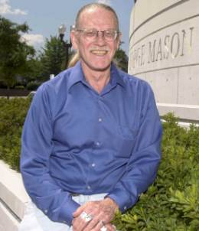
Behavioral Law-and-Economics
Some readings
Vern Smith, Nobel Address 2002
Gigerenzer, Adaptive Thinking (2000)
Sunstein, Behavioral Law and Economics (2000)

Slide 62
Infants, Mental defectives, drunks…
Who are we forgetting?

Slide 63
Paternalism’s questionable history
So you want to help victims? How about…
Restrictions on women
Slavery

Slide 64
The New Paternalism
Unlike the old Paternalism, the new Paternalism does not discriminate

Slide 65
The New Paternalism:
When might our desires misfire?
When might we agree to let the Paternalist second-guess our decisions?
  Judgment Biases: Because we miscalculate what is good for us
  Akrasia: Because we lack the strength of will to pursue what we know is good for us

Slide 66
Judgement Biases
Do we always calculate correctly?
  We would have to be monsters of calculation

Slide 67
Laplace’s Demon
An intellect which at a certain moment would know all forces that set nature in motion, and all positions of all items of which nature is composed, if this intellect were also vast enough to submit these data to analysis, it would embrace in a single formula the movements of the greatest bodies of the universe and those of the tiniest atom.
For such an intellect nothing would be uncertain and the future just like the past would be present before its eyes.

Slide 68
Cognitive Paternalism:
Judgment Biases
Even if our heuristics and hunches are satisfactory in average cases, they seem to mislead in anomalous cases.
The case of judgment biases: The cognitive paternalist would de-bias us.

Slide 69
Our brains are not wired like supercomputer
Instead, we get through life by relying on heuristics or mental shortcuts:
  Intuitions
  Hunches
  Emotions
And these can mislead: Judgment Biases

Slide 70
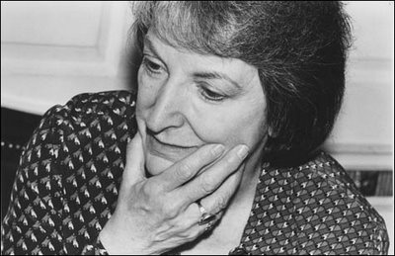
Paternalism: Some Judgment Biases
The Availability Bias
  Pauline Kael on the 1972 election

Slide 71

Paternalism: Some Judgment Biases
The Self-serving Bias
  We process away any negative comments about ourselves, and relish positive ones.

Slide 72
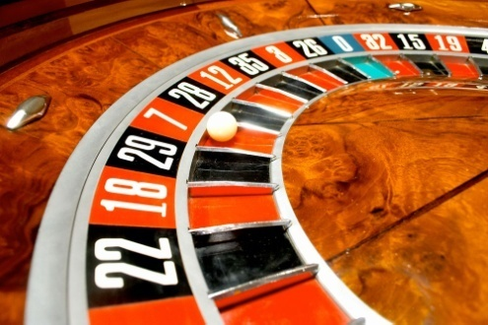
Paternalism: Some Judgment Biases
The Anchoring Bias
  I spin a roulette wheel and it comes up 25. Now I ask you how many African members there are in the UN

Slide 73
Paternalism: Some Judgment Biases
The Anchoring Bias
  I spin a roulette wheel and it comes up 25. Now I ask you how many African members there are in the UN
  I spin and it comes up 65. I ask a different group of people.

Slide 74
Paternalism: Some Judgment Biases
The Gambler’s Fallacy
  You are at a casino. At the roulette table, the numbers are either red or black. Black has come up six times in a row. What is the probability that it will come up red on the next turn? (Assume a fair table.)

Slide 75
Paternalism: Some Judgment Biases
The Gambler’s Fallacy
  You are at a casino. At the roulette table, the numbers are either red or black. Black has come up six times in a row. What is the probability that it will come up black on the next turn? (Assume a fair table.)
  50%. (You thought the table had a memory?)

Slide 76
Paternalism: Some Judgment Biases
The Hindsight Bias
  You watch a 5-3 baseball game, two men on. Your team is ahead. Your pitcher (ERA of 2.11) has given up two walks in the bottom of the ninth. Should the manager take him out?

Slide 77
Paternalism: Some Judgment Biases
The Hindsight Bias
  You watch a baseball game. The pitcher (ERA of 2.11) has given up two walks in the eighth inning. The manager leaves him in.
  The next batter up hits a home run. They win 6-5.
  “Idiot!,” you say. “I would have taken the pitcher out.”

Slide 78
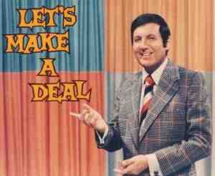
Paternalism: Some Judgment Biases
Probability Theory: Monty Hall

Slide 79

Paternalism: Some Judgment Biases
Probability Theory: Monty Hall
You’re a participant in a game show, facing three doors.
Monty tells you that,
behind one of three doors,
there is a new car, which you’ll get to keep if you pick the right door. The other two doors have goats behind them.
Let’s say you pick door 3.

Slide 80
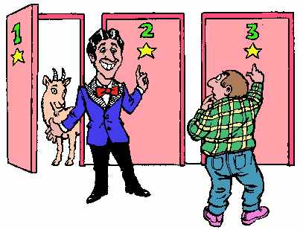
Paternalism: Some Judgment Biases
Probability Theory: Monty Hall
Monty tells you that,
behind one of three doors,
there is a new car, which you’ll get to keep if you pick the right door. The other two doors have goats behind them.
Let’s say you pick door 3.
Monty knows the door behind which the prize is hidden. He now says “I’m going to help you. I’m going to tell you that the prize is not behind door 1.
Do you stay with door 3
or do you switch to door 2?

Slide 81
Paternalism: Some Judgment Biases
Probability Theory: Monty Hall
Stay or switch?

Slide 82
Paternalism: Some Judgment Biases
Probability Theory: Monty Hall
You should always switch.
The probability associated with each door was 1/3. When Monty opened door 1, he did not change the 1/3 probability associated with door 3.
The probabilities sum to 1, so the probability associated with door 2 must be 2/3.

Slide 83
Paternalism: Some Judgment Biases
Do we always calculate correctly?
  Not according to empirical psychologists
  And does this open the door to cognitive paternalists?

Slide 84
Paternalism: Some Judgment Biases
Do we underestimate small probability, high magnitude events?
  Mandatory catastrophic medical insurance

Slide 85
The Counter-revolution
The defense of heuristic thinking: Gerg Gigerenzer
Learning
Market Processes
The Paternalist’s Judgment Biases

Slide 86
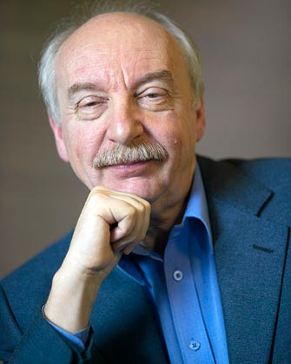
Are our heuristics dumb?
Gigerenzer’s fast and frugal heuristics
Gerd Gigerenzer

Slide 87
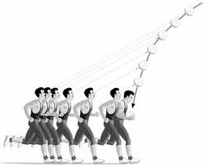
Are our heuristics dumb?

Slide 88
Are our heuristics dumb?
Gigerenzer’s fast and frugal heuristics
  Which city has more people:
    Sydney or Melbourne?

Slide 89
Are our heuristics dumb?
Gigerenzer’s fast and frugal heuristics
  Which city has more people:
    San Antonio or Dallas

Slide 90
Are our heuristics dumb?
Gigerenzer’s ecological rationality: how well do our heuristics fit in the world we inhabit.
  Who cares if they go wrong in a psychological test if they on average serve us well?
  How did you learn how to drive?

Slide 91

The Enteric Brain
91
Notes:
91

Slide 92
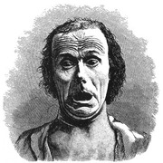
The defense of Heuristics:
Moral Heuristics?
  Our reaction to evil is unthinking and immediate.
    We don’t have to calculate cost vs benefit
    Our moral judgments are coded with an emotional response
92
Notes:
92

Slide 93
Learning
Are some biases corrected through learning
  How to hit a curve ball.

Slide 94
Market Processes
  Would inefficient heuristics tend to get excluded in markets?

Slide 95
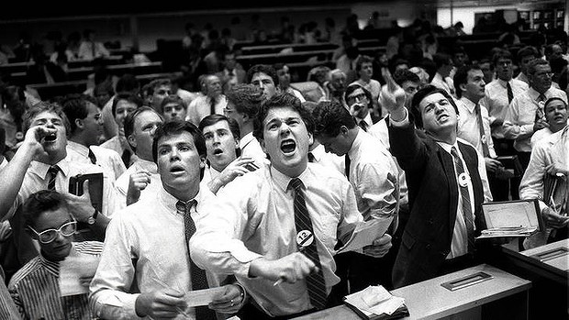
Or not?

Slide 96
What does it mean to choose badly?
  Self-defeating Choices
      Capacity and Paternalism
        Juddgment Biases
        Akrasia: Weakness of the Will

Slide 97
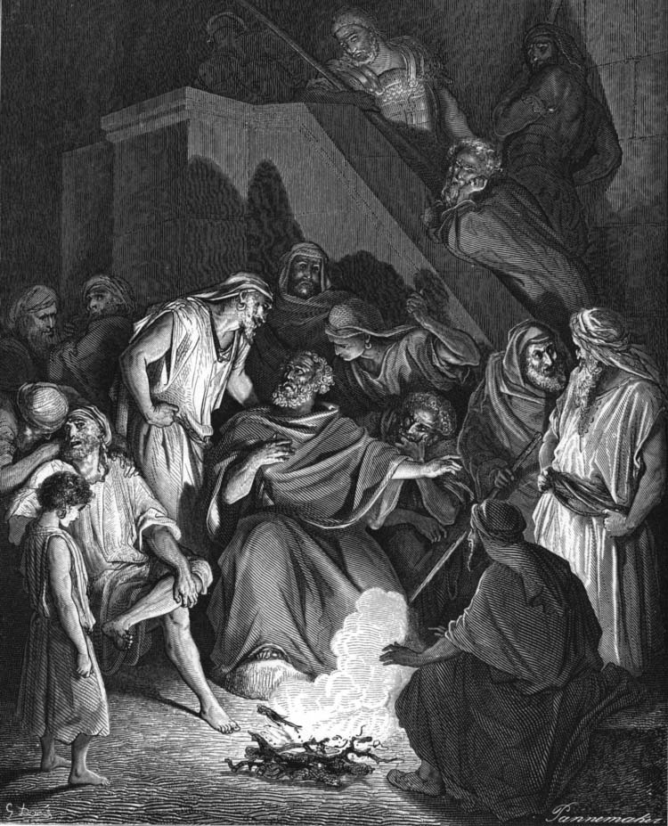
What is Akrasia:
The “non-ruled”
Doré, Weak-willed St. Peter
Denies Christ for the third time

Slide 98
Varieties of Akrasia
Overwhelming Passion
Self-deception
Discounting the future
The Divided Self
Reversal of preferences (?)

Slide 99
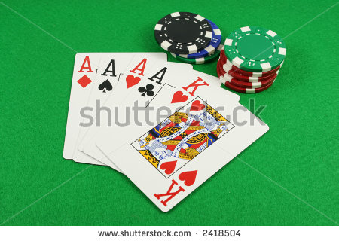
1. Overwhelming passion: The Gambler

Slide 100
1. Overwhelming passion: The Gambler
I believed in my system ... within a quarter of an hour
I won 600 francs. This whetted my appetite.
Suddenly I started to lose, couldn't control myself
and lost everything. After that I ... took my last money,
and went to play ... I was carried away by this
unusual good fortune and I risked all 35 napoleons
and lost them all. I had 6 napoleons d'or left to pay
the landlady and for the journey. In Geneva I pawned my watch.
When I see the green baize spread before me…
F.M. Dostoyevsky

Slide 101
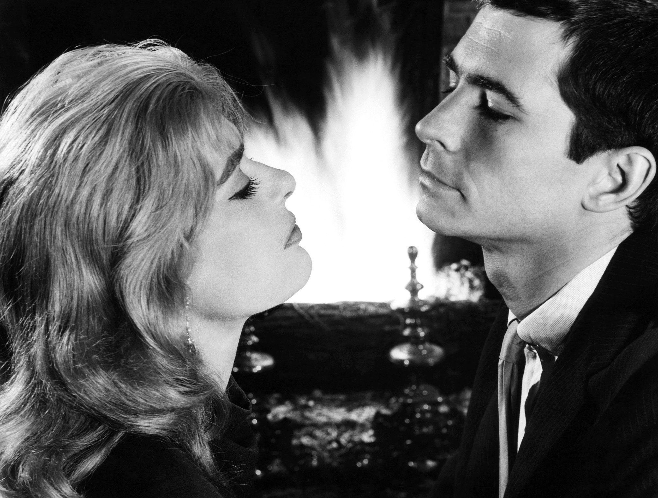
1. Overwhelming passion: The Gambler
Phaedra (1962)

Slide 102
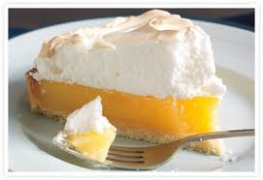
2. Self-deception
I’m going to have just
one piece of the pie.
No way will I eat
the whole thing!
102
Notes:
102

Slide 103
3. Discounting the Future
You have a choice between immediate consumption and saving for deferred consumption. How do you decide?
103
Notes:
103

Slide 104
3. Discounting the Future
You have a choice between immediate consumption and saving for deferred consumption. How do you decide?
  Do you prefer today’s person to that of tomorrow?
104
Notes:
104

Slide 105
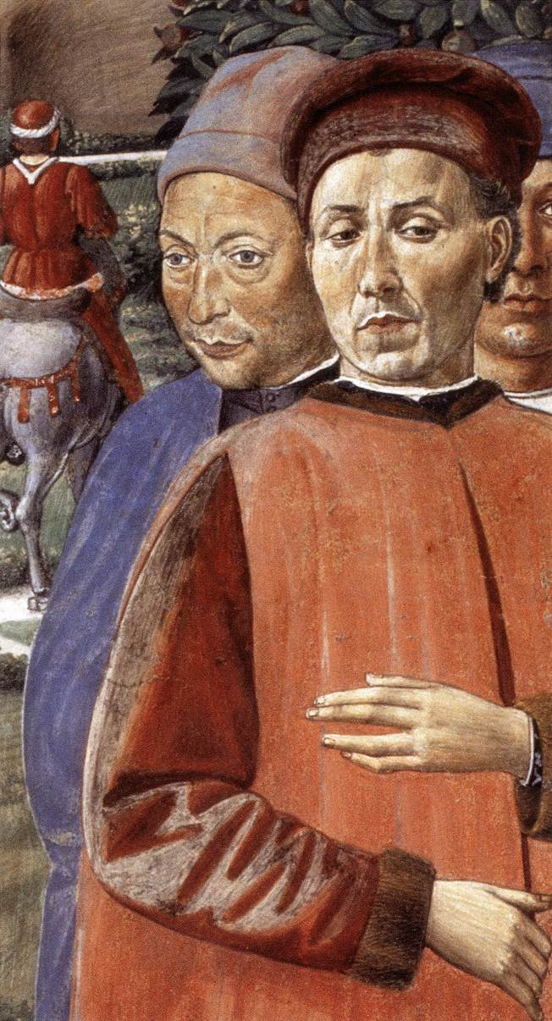
4. The Divided Self
I was neither wholly willing not wholly unwilling. So I was in conflict with myself and was dissociated from myself.
Gozzoli, St. Augustine
departing for Milan
105
Notes:
105

Slide 106
5. Reversal of preferences
Is this really self-deception?
106
Notes:
106

Slide 107
Is a legal remedy warranted?
  The possibility of bad faith by the paternalist
  The paternalist’s informational problem
  Self-help and self-binding
  The value of autonomy

Slide 108
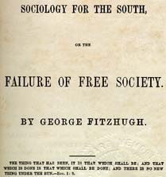
1. Bad Faith

Slide 109
2. The state’s informational problem
What about the Paternalist’s judgment biases?
  The hindsight bias and negligence liability
  The anchoring bias and inefficient pollution regulations.

Slide 110
2. The state’s informational problem
Is addiction per se bad?
  Might it ever make sense ex ante to become an addict?

Slide 111
Gary Becker:
Rational and irrational addiction
Utility
Preferences for
commodities over time
0
Time
Addiction: the more you consume,
The more you want
Gary Becker, Accounting for Tastes (1996)

Slide 112
Gary Becker:
Rational and irrational addiction
Over time the preference
for classical music increases
—but this is a benign addiction
Utility
B
classical music
0
A
Time
Subject suffers from “withdrawal”
if music taken away from him
Gary Becker, Accounting for Tastes (1996)

Slide 113
Gary Becker:
Rational and irrational addiction
Utility
B
classical music
0
A
Time
C
coffee
Unlike classical music, there comes a time when
the subject would like to stop drinking coffee.
Though he finds he cannot do so, his ex ante
decision to start drinking coffee is still rational

Slide 114
Gary Becker:
Rational and irrational addiction
Utility
B
classical music
0
A
Time
C
coffee
D
hard drugs
Ex ante, the decision to start
taking hard drugs is irrational

Slide 115
2. The state’s informational problem
Can the state distinguish between rational and irrational addiction?

Slide 116
3. Self-help
If we might be weak-willed, can we address the problem without the help of legal barriers?
  Social sanctions
  Self-binding

Slide 117
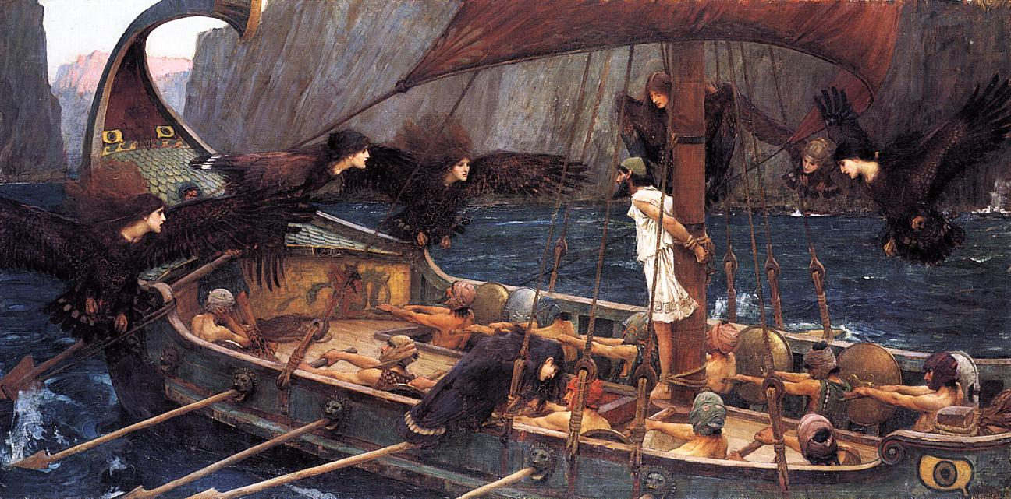
Self-binding as a response to akrasia
Jon Elster, Ulysses and the Sirens (1984)

Slide 118
Examples of self-binding
Marriage
Home purchases

Slide 119
4. The value of autonomy
Even if autonomy is merely a means, things can matter as means.
  The abstract value of freedom
Autonomy strengthens self-control

