Slide 1
George Mason School of Law
Contracts I
N. Distributorships
F.H. Buckley
fbuckley@gmu.edu

Slide 2
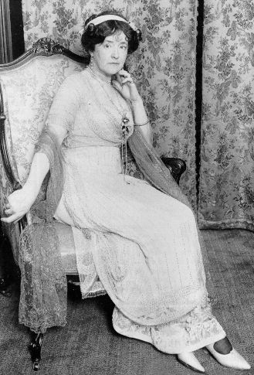
Distributorships Wood v. Duff-Gordon p. 373
Lady Duff Gordon

Slide 3
Wood v. Duff-Gordon
Wood to have the exclusive right to market her clothes or endorsements
In return to receive one-half of all “profits and revenues”
One year term, renewable unless cancelled on 90 days notice

Slide 4
Wood v. Duff-Gordon
What’s the argument that this isn’t a binding contract?

Slide 5
Wood v. Duff-Gordon
Is this a binding contract?
Does it lack consideration?
What if Wood did nothing?

Slide 6
Wood v. Duff-Gordon
Is this a binding contract?
Cardozo: decries a “primitive age of formalism”
What is the canonical take-away line?

Slide 7
Wood v. Duff-Gordon
Is this a binding contract?
The whole writing may be “an instinct with an obligation imperfectly expressed” to use reasonable efforts
The Moorcock: Bowen L.J.: imply a term to give business efficacy to an agreement

Slide 8
Wood v. Duff-Gordon
What is the economic rationale for implying duties by the distributor?

Slide 9
Wood v. Duff-Gordon
What is the economic rationale for implying duties by the distributor?
What is Wood’s incentive to make contract-specific investments absent a binding contract

Slide 10
Wood v. Duff-Gordon
How would you formulate the duties of the parties, as a matter of legal drafting?

Slide 11
Wood v. Duff-Gordon
How would you formulate the duties of the parties, as a matter of legal drafting?
Good faith by Duff-Gordon
Best efforts by both

Slide 12
George Mason School of Law
Contracts I
N. Distributorships
F.H. Buckley
fbuckley@gmu.edu

Slide 13
Today
Distributorships: Just what is the agent bound to do
Joint Ventures: Same question
Employment Contracts
Limits on discretion re termination
Non-competes
Contract Modification

Slide 14
Good faith
UCC § 2-205. Every contract imposes upon each party a duty of good faith and fair dealing in its performance and enforcement."

Slide 15
Best efforts
UCC § 2-306(2) A lawful agreement by either the seller or the buyer for exclusive dealing in the kind of goods concerned imposes unless otherwise agreed an obligation by the seller to use best efforts to supply the goods and by the buyer to use best efforts to promote their sale.

Slide 16
Bloor v. Falstaff 375
What was the deal?

Slide 17
Bloor v. Falstaff
Falstaff buys all Ballantine assets except the brewery for $4M plus a royalty of 50 cents on each barrel of Ballantine sold over a 6 yr. period
Buyer to use best efforts to promote and maintain a high volume of sales
Buyer to pay $1.1M per year if it substantially discontinues selling Ballantine

Slide 18
Bloor v. Falstaff
Why structure it that way?
What are the alternatives?

Slide 19
Bloor v. Falstaff
Falstaff’s history with the Ballantine brand

Slide 20
Bloor v. Falstaff
Falstaff's history with the Ballantine brand
Brieant: nonfeasances and misfeasances
Falstaff stressed profit at the expense of volume.
Falstaff put more effort into the Falstaff brand

Slide 21
Bloor v. Falstaff
Falstaff to use “best efforts to promote and maintain a high volume”
Was this a drafting problem?
Or did they get it just right?

Slide 22
Bloor v. Falstaff
Can you articulate a standard by which best efforts can be judged?
What would be excessive?

Slide 23
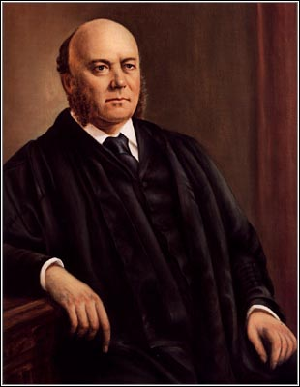
Bloor v. Falstaff
Can you articulate a standard by which best efforts can be judged?
What would be excessive?
Friendly: “Even without the best efforts clause, Falstaff would have been bound to make a good faith effort to see that substantial sales of Ballantine products were made”

Slide 24
Bloor v. Falstaff
Can you articulate a standard by which best efforts can be judged?
What would be excessive?
Friendly: Profit uber alles was the problem
Hunh?!?

Slide 25
Bloor v. Falstaff
How to establish what is the right amount of effort to require of Falstaff in pushing Ballantine beer?

Slide 26
Bloor v. Falstaff
How to establish what is the right amount of effort to require of Falstaff in pushing Ballantine beer?
The case is made easier by the finding that Falstaff maximized Falstaff profits and not the joint venture’s profits

Slide 27
Bloor v. Falstaff
Would you expect that the parties would want to bargain for sales efforts that would exceed what Falstaff would expend had it a 100 % equity stake in the Ballantine brand?

Slide 28
Bloor v. Falstaff
An agency cost problem
Agents are hired by principals and may either confer benefits or costs on the principals

Slide 29
Agency Costs
The agent (Falstaff) has to decide how much money to spend on marketing the principal’s (Ballantine) beer

Slide 30
Agency Costs How much Ballantine beer to sell?
Vertical axis measures
how much to spend
on marketing the beer
$
Horizontal axis measures
the quantity of beer sold
Quantity of beer

Slide 31
Agency Costs
$
Assume a constant amount of revenue
for each case of Ballantine beer sold
Marginal Revenue

Slide 32
Agency Costs
$
Marginal Cost of Marketing
Marginal Revenue
Falstaff has to spend an increasing amount
on marketing for additional units of beer sold

Slide 33
Agency Costs
$
Marginal Cost of Marketing
Marginal Revenue
X
Optimal marketing and sales at Quantity X

Slide 34
Now what happens when revenues are shared with an agent?
$
Marginal Cost of Marketing
Marginal Revenue
X

Slide 35
The principal’s marginal revenue curve is lowered
$
Marginal Cost of Marketing
MR_{Falstaff+Ballantine}
The 50 cent tax
MR_{Falstaff}
X

Slide 36
So that Falstaff has an incentive to reduce marketing expenditures
$
Marginal Cost of Marketing
MR_{Falstaff+Ballantine}
MR_{Falstaff}
X*
X

Slide 37
Falstaff
Neither Falstaff nor Ballantine had perfect incentives
Ballantine has an incentive to spend too much and Falstaff too little.

Slide 38
Falstaff
If the goal is optimal joint production, how would you formulate the legal standard?

Slide 39
Agency Costs
$
Marginal Cost of Marketing
Marginal Revenue
X
Optimal marketing and sales at Quantity X

Slide 40
Agency Costs
If the goal is optimal joint production, how would you formulate the legal standard?
How would you draft Falstaff’s duties?

Slide 41
Agency Costs
If the goal is optimal joint production, how would you formulate the legal standard?
How would you draft Falstaff’s duties?
“best efforts” and “good faith”
“reasonable best efforts”
Non-discrimination

Slide 42
Responses to Agency Costs?
Legal standards (e.g., best efforts … [to maintain a high quantity of sales?)

Slide 43
Responses to Agency Costs?
Legal standards (e.g., best efforts)
Incentivize the parties
Cost-sharing
Sliding scale of profits

Slide 44
Responses to Agency Costs?
Legal standards (e.g., best efforts)
Incentivize the parties
Relational contracts

Slide 45
Responses to Agency Costs?
Legal standards (e.g., best efforts)
Incentivize the parties
Relational Contracts
Vertical Integration

Slide 46
Responses to Agency Costs?
Legal standards (e.g., best efforts)
Incentivize the parties
Relations and Iterated PD Games
Vertical Integration
Monitoring plus termination rights

Slide 47
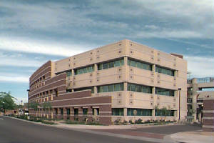
Termination Rights in Employment Contracts Wagenseller 389
Scottsdale Memorial Hospital

Slide 48
Wagenseller
Was she fired for reasonable cause under the English standard?
The English reasonable cause standard vs. the American “at will” standard

Slide 49
Wagenseller
Developing exceptions to the at will standard
The public policy exception
E.g., refusal to commit perjury

Slide 50
Wagenseller
Developing exceptions to the at will standard
Implied in fact promise of tenure
An implied promise to keep the employee on for a period of time

Slide 51
Wagenseller
Developing exceptions to the at will standard
Implied in fact promise of tenure as an evidentiary question
Is the firm’s personnel manual part of the contract?
Does it matter if this is signed?
Was reliance encouraged?

Slide 52
Wagenseller
Developing exceptions to the at will standard
“Good faith and fair dealing” implied at law?
Bad faith firing vs. no-cause firing

Slide 53
Wagenseller
Developing exceptions to the at will standard
An implied good faith covenant implied here—but then why didn’t plaintiff succeed?

Slide 54
Wagenseller
Developing exceptions to the at will standard
An implied good faith covenant implied here—but then why didn’t plaintiff succeed?
Suppose the hospital had told her that “we didn’t like how you behaved at the camping trip”?

Slide 55
Wagenseller
Which rule best protects employees?
English or American?

Slide 56
Wagenseller
Which rule best protects employees?
Should the parties be permitted to bargain for the employment regime they want? If not, why not?

Slide 57
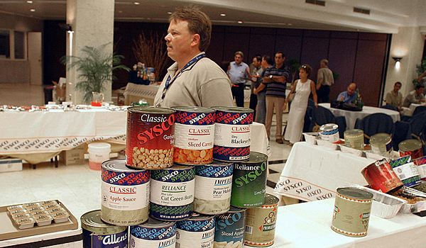
Termination Rights in Non-employment Contracts Sysco at 396

Slide 58
Sysco
What did the agreement say about termination rights?
Note the reference to Printing and Numerical

Slide 59
Sysco
Who were the parties and why did that matter?
Does Walker-Thomas apply in business relationships?

Slide 60
Termination Rights
Lady Duff-Gordon worries that her agent won’t do any work. So she proposes that she be given termination rights? Comment.

Slide 61
Are there limits to free choice?
Firing employees when this contravenes public policy
The nature of the parties and the language of the contract
Non-competes

Slide 62
Note the two-way play
The employer has a free hand to dismiss the employee under the at-will standard
The employee can resign any time

Slide 63
Note the two-way play
The employee can resign any time
Might the employer be unhappy with this?
Labor shortages
Firm-specific assets
Training
Proprietary info

Slide 64
Note the two-way play
The employee can resign any time
Bargaining around this
Compensation schemes
Non-competes

Slide 65
Non-competes: Farber at 407
Freedom of contract governed in Sysco. Why not in Farber?

Slide 66
Non-competes: Farber
What if we were talking about an accountant?
“the doctor-patient relationship is special”

Slide 67
Non-competes: Farber
What if we were talking about a development director?
Cf. Maltby at 415

Slide 68
Non-competes: Farber
Mobility Rights
Banned entirely in several states such as California
The Strategic Behavior problem

Slide 69
Restatement
Restatement 186: Covenants unreasonably in restraint of trade are not enforceable

Slide 70
Restatement
Restatement 186: Covenants unreasonably in restraint of trade are not enforceable
Ancilliary vs non-ancilliary?

Slide 71
Ancilliary Restraints on Trade
Restatement 188: If ancilliary to a valid contract, covenants in restraint of trade may be enforceable

Slide 72
Ancilliary Restraints on Trade
Restatement 187: If not ancilliary to a valid contract, covenants in restraint of trade deemed not enforceable

Slide 73
Contract Modification
As relational contracts are long term, conditions may change and prompt a modification of the agreement
Should there be any restrictions on this?

Slide 74
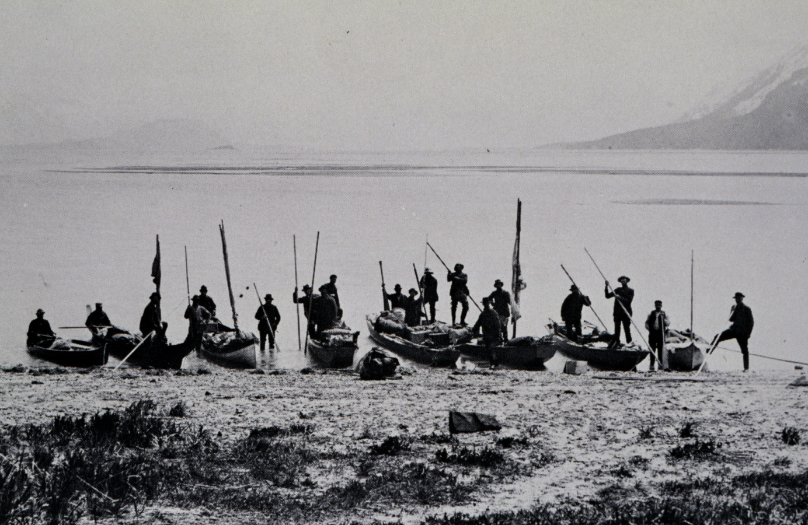
Alaska Packers 417
Pyramid Harbor AK

Slide 75
Alaska Packers
Will a promise to perform that which the promisor was already bound to do under a prior contract satisfy the consideration requirement?

Slide 76
Alaska Packers
The new approach:
Restatement § 175(1) If a party's manifestation of assent is induced by an improper threat by the other party that leaves the victim no reasonable alternative, the contract is voidable by the victim.

Slide 77
Alaska Packers
Restatement § 73. Performance of a legal duty owed to a promisor which is neither doubtful nor the subject of honest dispute is not consideration; but a similar performance is consideration if it differs from what was required by the duty in a way which reflects more than a pretense of bargain.

Slide 78
Alaska Packers
Restatement § 176(1)(d) A threat is improper if
(d) the threat is a breach of the duty of good faith and fair dealing under a contract with the recipient.

Slide 79
Alaska Packers
Restatement § 89 MODIFICATION OF EXECUTORY CONTRACT. A promise modifying a duty under a contract not fully performed on either side is binding (a) if the modification is fair and equitable in view of circumstances not anticipated by the parties when the contract was made; or (b) to the extent provided by statute; or (c) to the extent that justice requires enforcement in view of material change of position in reliance on the promise.

Slide 80
Alaska Packers
How would you decide Alaska Packers under these standards?

Slide 81
Alaska Packers
How would you decide Alaska Packers under these standards?
The finding of fact at p. 418

Slide 82
Alaska Packers
Qu. the changed circumstances under Angel v. Murray p. 421
Brighenti at 422

Slide 83
Alaska Packers
No modification clauses: Will they be enforced?
Cf. Restatement 311 comment a: “The parties to a contract cannot by agreement preclude themselves from varying their duties to each other by subsequent agreement.”
Can one Congress bind a subsequent Congress?

Slide 84
Are Termination Agreements different?
El Paso Natural Gas p. 425

Slide 85
UCC 2-209
Reserved for Contracts II

Slide 86
What are the drafting choices where good faith is required throughout?
Relational contracting
Vertical integration
Termination rights
Good Faith policing by the courts?

Slide 87
Eli Lilly at 428

