Slide 1
George Mason School of Law
Contracts I
M. Requirements and Output Contracts
F.H. Buckley
fbuckley@gmu.edu

Slide 2
Indefiniteness
Why leave a term open
Didn’t occur to one
The informational problem and the impossibility of a Complete Contingent Contract
Uncertain outcomes

Slide 3
Indefiniteness
The bar in classical common law
The court won’t make the contract for the parties
How Art. 2 might change things: 2-305, 2-306

Slide 4
Output and Requirements Contracts: Quantity is indefinite
UCC § 2-306(1) A term which measures the quantity by the output of the seller or the requirements of the buyer means such actual output or requirements as may occur in good faith, except that no quantity unreasonably disproportionate to any stated estimate or in the absence of a stated estimate to any normal or otherwise comparable prior output or requirements may be tendered or demanded.

Slide 5
Output and Requirements Contracts
Output contract: buyer agrees to purchase seller’s entire output

Slide 6
Output and Requirements Contracts
Requirements contract: seller agrees to sell as much of his product as buyer requires
6

Slide 7
Output and Requirements Contracts
Supplier sells output
Supplier
Customer
Customer buys
requirements

Slide 8
Output and Requirements Contracts
Why enter into such agreements?
Output contract: supplier locks in and can safely bulk up on inventory and fire the sales department

Slide 9
Output and Requirements Contracts
Why enter into such agreements?
Requirements contract: buyer assures himself of supply, fires the purchasing department
9

Slide 10
Requirements Contracts
Risks to supplier
What if market price > contract price
Market @ 120, contract @100
Supplier would like to sell at 120 but is bound to sell at 100

Slide 11
Requirements Contracts
Risks to supplier:
What if cost of production > contract price
Cost @120, contract @100

Slide 12
Requirements Contracts Price fluctuations and the Incentives of the Parties
 | Contract Price > Market Price
Supplier | Supplier wants to sell as much as he can
Buyer

Slide 13
Requirements Contracts Price fluctuations and the Incentives of the Parties
 | Contract Price > Market Price
Supplier | Supplier wants to sell as much as he can
Buyer | Buyer wants to buy as little as he can

Slide 14
Requirements Contracts Price fluctuations and the Incentives of the Parties
 | Contract Price > Market Price | Market Price > Contract Price
Supplier |  | Supplier wants to sell as little as he can
Buyer

Slide 15
Requirements Contracts Price fluctuations and the Incentives of the Parties
 | Contract Price > Market Price | Market Price > Contract Price
Supplier |  | Supplier wants to sell as little as he can
Buyer |  | Buyer wants to buy as much as he can

Slide 16
Eastern at 317

Slide 17
Eastern
Requirements contract where Gulf was to supply jet fuel to Eastern, as required by Eastern

Slide 18
Eastern
Requirements contract where Gulf was to supply jet fuel to Eastern
Price adjustment clause : Gulf to pass on 50% of the increase in West Texas Sour

Slide 19
So what happened to oil prices in 1974?

Slide 20
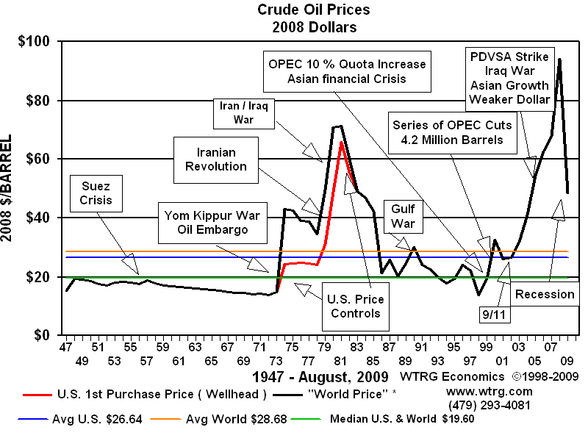
So what happened to oil prices in 1974?

Slide 21
Eastern Air Lines Timeline
1970: OPEC formed
“the handwriting was on the wall”

Slide 22
Eastern Air Lines Timeline
August 15, 1971: Nixon announces price controls to combat inflation

Slide 23
Eastern Air Lines Timeline
August 15, 1971: Nixon announces price controls to combat inflation
June 27, 1972: Contract signed

Slide 24
Eastern Air Lines Timeline
August 15, 1971: Nixon announces price controls to combat inflation
June 27, 1972: Contract signed
Oct. 6, 1973: Yom Kippur War
Defcom III: Air Force ready to scramble in 15 minutes

Slide 25
Eastern Air Lines Timeline
August 15, 1971: Nixon announces price controls to combat inflation
June 27, 1972: Contract signed
Oct. 6, 1973: Yom Kippur War
Oct. 17, 1973: Arab members of OPEC announce an oil embargo on the US
Lines at the gas station

Slide 26
Eastern Air Lines Timeline
August 15, 1971: Nixon announces price controls to combat inflation
June 27, 1972: Contract signed
Oct. 6, 1973: Yom Kippur War
Oct. 17, 1973: Arab members of OPEC announce an oil embargo on the US
Nov 27, 1973: Emergency Petroleum Allocation Act with two-tier pricing—which raises prices for new oil

Slide 27
Eastern Air Lines
So why didn’t the price adjustment clause cover the increase?
Based on West Texas Sour (domestic)
The Nixon administration permitted higher prices to the extent that new oil was produced.

Slide 28
So what happened to oil prices in 1974?

Slide 29
Requirements Contracts Price fluctuations and the Incentives of the Parties
 | Contract Price > Market Price | Market Price > Contract Price
Supplier |  | Gulf wants out
Buyer |  | Eastern wants to enforce contract

Slide 30
Eastern Air Lines
How do courts handle the uncertainty problem under UCC 2-306?
“in good faith, except that no quantity unreasonably disproportionate to any stated estimate or in the absence of a stated estimate to any normal or otherwise comparable prior output or requirements may be tendered or demanded”

Slide 31
Eastern Air Lines
What is the uncertainty problem?
And how do courts handle it under UCC 2-306?
Example of good faith and bad faith variations at 352

Slide 32
Eastern Air Lines
Overinvestment: was Eastern using too much fuel?
What is fuel freighting?
Was this post contractual opportunism

Slide 33
Eastern Air Lines
Who was in the best position to solves the informational problem?

Slide 34
Eastern Air Lines
Who might have predicted the Yom Kippur War?

Slide 35
Eastern Air Lines
Who was behaving opportunistically?
Undersupply: Was Gulf looking for an excuse to get out of the contract?

Slide 36
Eastern Air Lines
Who was behaving opportunistically?
Cf. Orange and Rockland at p. 364
What are signs of bad faith?
36

Slide 37
Eastern Air Lines
Who was behaving opportunistically?
Cf. Southwest Natural Gas at p. 360
What was the good faith explanation for the change in purchases?
37

Slide 38
Empire Gas 354
What was the contract? And why did American Bakeries enter into it?

Slide 39
What happened to oil prices in 1979-80?

Slide 40
Empire Gas
Which might explain American Bakeries’ projected switch from gas to propane (and then back again)

Slide 41
What happens when the market price falls?
 | Contract Price > Market Price | Market Price > Contract Price
Supplier | Empire Gas wants to enforce
Buyer | American Bakeries wants out

Slide 42
Empire Gas
What was the contract?
Does the buyer owe good faith duties not to underconsume?

Slide 43
Empire Gas
Under- and over- not symmetrical per Posner
But requirements contracts are not option contracts

Slide 44
Empire Gas
Posner’s good faith duties:
Buyer can cancel if a change in his business makes the contract too costly
Southwest Natural Gas at 329

Slide 45
Empire Gas
But here:
No reason given by buyer
No change in fleet of trucks
No business emergency

Slide 46
Requirements Contracts
 | Contract Price > Market Price | Market Price > Contract Price
Supplier | Wants to enforce: Empire Gas | Wants out: Eastern Airlines
Buyer | Wants out: Empire Gas | Wants to enforce: Eastern Airlines

Slide 47
Output Contracts
Output contract: buyer agrees to purchase seller’s entire output

Slide 48
Output Contracts
 | Contract Price > Market Price | Market Price > Contract Price
Supplier | Woo-hoo!!!!
Buyer

Slide 49
Output Contracts
 | Contract Price > Market Price | Market Price > Contract Price
Supplier
Buyer | Wants out

Slide 50
Output Contracts
 | Contract Price > Market Price | Market Price > Contract Price
Supplier |  | Wants out
Buyer

Slide 51
Output Contracts
 | Contract Price > Market Price | Market Price > Contract Price
Supplier
Buyer |  | Woo-hoo!!!!

Slide 52
Output Contracts Cost to Seller
 | Contract Price > Cost | Cost > Contract Price
Supplier |  | Wants out
Buyer

Slide 53
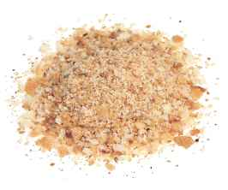
Output Contracts: Feld v. Levy p. 364
Bakery Levy Distributor Feld
Bread crumbs

Slide 54
Output Contracts: Feld v. Levy
A renewable contract with six months cancellation rights in which Levy agrees to sell all its bread crumbs to Feld
Levy discovers that the marginal cost exceeds the contract price and cancels

Slide 55
Output Contracts: Feld v. Levy
Held: It would be bad faith for Levy to stop crumb production just because their profits aren't as high as they expected, but it would be good faith for Levy to stop crumb production if they incurred losses from such production that were "more than trivial".

Slide 56
Output Contracts: Feld v. Levy
Does it make sense to require the baker to lose money?

Slide 57
Output Contracts: Feld v. Levy
Does it make sense to require the baker to lose money?
Is there something troubling about the numbers?

Slide 58
Output Contracts: Feld v. Levy

Slide 59
Output Contracts: Feld v. Levy
What if the baker could sell elsewhere for $1.50/lb.?
Do you think this might do something to his reported costs, if this affords him an out?

Slide 60
Output Contracts: Feld v. Levy
What do you think of the casebook’s suggestion that a price adjustment clause be based on the supplier’s costs plus a reasonable profit?

Slide 61
Output Contracts: Feld v. Levy
How is this case like Empire Gas?

Slide 62
Output Contracts: Feld v. Levy
Can a buyer in a requirements contract purchase zero quantities?
Empire Gas

Slide 63
Output Contracts: Feld v. Levy
Can a buyer in a requirements contract purchase zero quantities?
Empire Gas
Can a seller in an output contract sell zero quantities?
Feld v. Levy

Slide 64
Does good faith mean something different from disproportionate quantities?
UCC § 2-306(1) A term which measures the quantity by the output of the seller or the requirements of the buyer means such actual output or requirements as may occur in good faith, except that no quantity unreasonably disproportionate to any stated estimate or in the absence of a stated estimate to any normal or otherwise comparable prior output or requirements may be tendered or demanded.

Slide 65
Does good faith mean something different from disproportionate quantities?
Give me an example where 306(1) is met because the change in quantities was in good faith

Slide 66
Does good faith mean something different from disproportionate quantities?
Give me an example where 306(1) is not met because, even though there was no change in quantities, the party was in bad faith

