Slide 1
George Mason School of Law
Contracts I
L. Post-contractual Opportunism
© F.H. Buckley
fbuckley@gmu.edu

Slide 2
The Reliance Problem
You and I contemplate a joint venture which, if successful, promises $10M in profits for each of us.
To see if the deal is worthwhile, you must build a prototype for $50,000. If I decide not to do the deal, the prototype is worthless.
Assume I can’t specify ex ante what counts as a permissible rejection.

Slide 3
The Reliance Problem
You and I contemplate a joint venture which, if successful, promises $10M in profits for each of us.
To see if the deal is worthwhile, you must build a prototype for $50,000. If I decide not to do the deal, the prototype is worthless.
Are you at risk of a shakedown here?

Slide 4
Some jargon to explain the problem
Asset specificity
Bilateral (Situational) Monopolies
Post-contractual Opportunism

Slide 5
Asset specificity
Asset specificity: An asset’s worth depends on who owns it

Slide 6
Children as asset specific to their parents

Slide 7
Asset specificity
Asset specificity in bargaining: The bargaining surplus can be exploited only by the parties

Slide 8
Asset specificity and Bilateral Monopoly
Bilateral (Situational) Monopolies
A monopoly is owned by one party only
A bilateral monopoly is an asset jointly shared
E.g., An asset specific contractual surplus

Slide 9
Bilateral Monopolies and Opportunism
Post-contractual Opportunism
Post-contractual: arising after formation of the contract
Opportunism: cheating and getting away with it

Slide 10
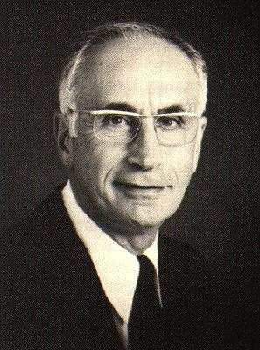
Post-contractual opportunism
Armen Alchian et al.
21 J.L.E. 297(1978)
10

Slide 11
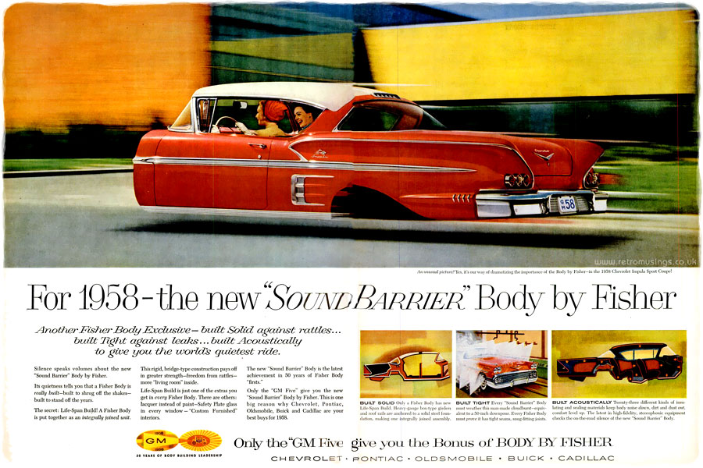
Post-contractual opportunism “Body by Fisher”
11

Slide 12
Post-contractual opportunism
Distinguish three cases:
Zero reliance and no costs to a break-up

Slide 13
Zero reliance and no costs to a break-up
In some relationships, no one invests anything
Jean-Paul Belmondo,
Jean Seberg,
Breathless (1960)
Jean-Luc Godard

Slide 14
Post-contractual opportunism
No possibility of opportunism where no break-up costs

Slide 15
Post-contractual opportunism
Distinguish three cases:
Zero reliance and no costs to a break-up
Equal reliance on both side and equal break-up costs

Slide 16
No opportunism if equal break-up costs
Mutually
Assured
Destruction
Dr Strangelove

Slide 17
Mutually assured destruction
Player 2
 | Cooperate | Defect
Cooperate | 0,0 | -∞, -∞
Defect | -∞, -∞ | -∞, -∞

Slide 18
Post-contractual opportunism
Distinguish three cases:
Zero reliance and no costs to a break-up
Equal reliance on both side
Asymmetric break-up costs

Slide 19
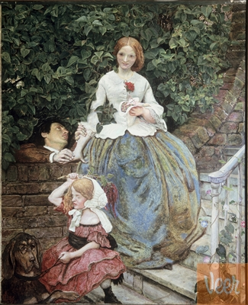
Asymmetric break-up costs and Opportunism
Where only one
person invests, the
other has a
threat advantage
Ford Maddox Brown, Stages of Cruelty

Slide 20
Why is Opportunism a problem?
Ex post a fairness issue when the opportunistic person uses his position to gain an unbargained-for advantage:
20

Slide 21
Why is Opportunism a problem?
Ex ante an efficiency problem of under-investment
If a bargainer expects to be treated opportunistically after entering into a contract, he won’t enter into a contract
21

Slide 22
Is that the story of Red Owl at 317
Chilton WI, Pop. 2600

Slide 23
Opportunism in Franchise Contracts
Why was Red Owl adamant about a personal investment by Hoffman?

Slide 24
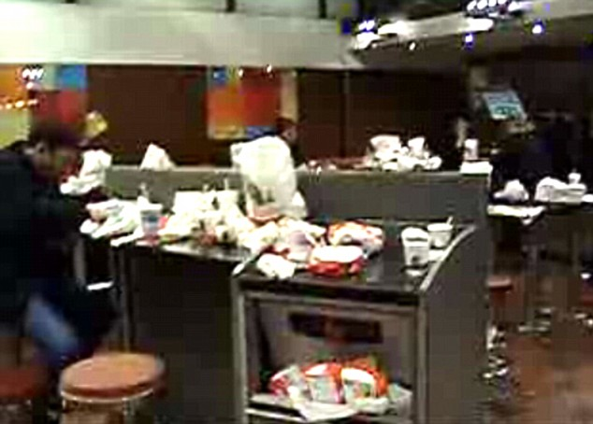
Opportunism in Franchise Contracts
The Free-riding problem
What’s the
individually rational
amount to spend
on cleaning services?

Slide 25
Opportunism in Franchise Contracts
Was Red Owl in bad faith?
Did Red Owl up the ante from the $18,000 investment?
And if it did?

Slide 26
Opportunism in Franchise Contracts
Is this how the financials looked?
Assets Liabilities
70,500 52,500
Equity
18,000

Slide 27
Opportunism in Franchise Contracts
Was there a contract?
“Get your money together and we are set”

Slide 28
Opportunism in Franchise Contracts
Estoppel: Was there a promise?
“the record discloses a number of promises and assurances”

Slide 29
Opportunism in Franchise Contracts
Negligent misrepresentation?

Slide 30
Opportunism in Franchise Contracts
How would you expect franchisors to react to Red Owl?

Slide 31
Opportunism in Franchise Contracts
How would you expect franchisors to react to Red Owl?
Non-liability agreements?

Slide 32
Opportunism in Franchise Contracts
How would you expect franchisors to react to Red Owl?
Non-liability agreements?
If statutory, exit from state?
Brickley et al., The Economic Effects of Franchise Termination Laws, 34 J.L. & ECON. 101 (1991)

Slide 33
Opportunism in Franchise Contracts
How would you expect franchisors to react to Red Owl?
Non-liability agreements?
Exit from state?
Only deal with sure things?

Slide 34
Opportunism in Franchise Contracts
How would you expect franchisors to react to Red Owl?
Non-liability agreements?
Exit from state?
Only deal with sure things?
Equal investments?

Slide 35
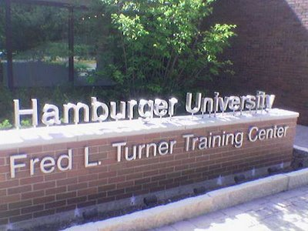
What if both parties invest equally?
Hamburger U. as a risk-sharing strategy

Slide 36
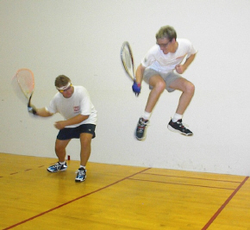
Mooney v. Craddock p. 329

Slide 37
Mooney v. Craddock
Who was in the best position to judge the health club’s chances of success?
Did the landlord act opportunistically? Did the tenant?
Is “Let’s go” a promise?

Slide 38
Indefinite Agreements
Why leave a term open?

Slide 39
Indefinite Agreements
Why leave a term open
Didn’t occur to one

Slide 40
Indefinite Agreements
Why leave a term open
Didn’t occur to one
The informational problem and the impossibility of a Complete Contingent Contract

Slide 41
Indefinite Agreements
Why leave a term open
Didn’t occur to one
The informational problem and the impossibility of a Complete Contingent Contract
Don’t want to block progress on negotiations

Slide 42
Indefinite Agreements
Why leave a term open
Didn’t occur to one
The informational problem and the impossibility of a Complete Contingent Contract
Don’t want to block progress on negotiations
Uncertain outcomes

Slide 43
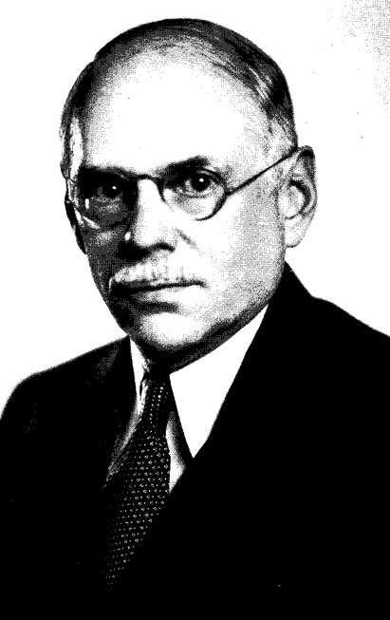
Risk and Uncertainty
Frank Knight, Risk, Uncertainty and Profit

Slide 44
Risk as probabilistic

Slide 45
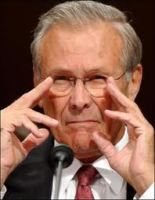
Uncertainty
[
There are known knowns; there are things we know we know.
We also know there are known unknowns; that is to say we know there are some things we do not know.
But there are also unknown unknowns – the ones we don't know we don't know.
Don Rumsfeld

Slide 46
Indefinite Agreements
So terms may be left blank
Should a court then refuse to enforce an agreement because of indefiniteness?

Slide 47
Kantsevoy v. Lumen at 34
Why were the claims in contract and promissory estoppel rejected
“We can create an equity ownership package”
“the exact value would have to wait”
Did the court have enough information to fix a price?
Was there a course of performance?

Slide 48
Kantsevoy v. Lumen at 34
Why were the claims in contract and promissory estoppel rejected
“We can create an equity ownership package”
What would restitutionary relief look like?

Slide 49
Agreements to agree
See Shepard at 332

Slide 50
Corthell at 42
Why a different result?

Slide 51
Whatever the intention, uncertainty may doom the contract
Restatement § 33(1) Even though a manifestation of intention is intended to be understood as an offer, it cannot be accepted so as to form a contract unless the terms of the contract are reasonably certain.

Slide 52
But what about gap-filling?
Restatement § 204. SUPPLYING AN OMITTED ESSENTIAL TERM. When the parties to a bargain sufficiently defined to be a contract have not agreed with respect to a term which is essential to a determination of their rights and duties, a term which is reasonable in the circumstances is supplied by the court.

Slide 53
Formation in the UCC: 2-204
(1) A contract for sale of goods may be made in any manner sufficient to show agreement, including conduct by both parties which recognizes the existence of such a contract.
(2) An agreement sufficient to constitute a contract for sale may be found even though the moment of its making is undetermined.
(3) Even though one or more terms are left open a contract for sale does not fail for indefiniteness if the parties have intended to make a contract and there is a reasonably certain basis for giving an appropriate remedy.

Slide 54
Open Price Terms in the UCC
UCC § 2-305(1) The parties if they so intend can conclude a contract for sale even though the price is not settled. In such a case the price is a reasonable price at the time of delivery if
(a) nothing is said as to price; or
(b) the price is left to be agreed by the parties and they fail to agree; or
(c) the price is to be fixed in terms of some agreed market or other standard as set or recorded by a third person or agency and it is not so set or recorded.

Slide 55
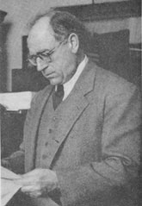
The UCC and Uncertainty
Karl Llewellyn’s “situation sense”
Kleinschmidt at 333

Slide 56
UCC 2-305
§ 2-305. Open Price Term. (1) The parties if they so intend can conclude a contract for sale even though the price is not settled. In such a case the price is a reasonable price at the time for delivery if (a) nothing is said as to price; or (b) the price is left to be agreed by the parties and they fail to agree; or (c) the price is to be fixed in terms of some agreed market or other standard as set or recorded by a third person or agency
(4) Where, however, the parties intend not to be bound unless the price be fixed or agreed and it is not fixed or agreed there is no contract.

Slide 57
Wagner at 44
What made this a UCC Art. 2 transaction?
UCC 2-102: “This Article applies to transactions in goods”

Slide 58
Wagner
What was the agreement?

Slide 59
Wagner
What was the agreement?
Minimum quantities each year
Price to be negotiated
Wagner’s reliance expenses of $900,000
An action for lost profits during the initial five-year term

Slide 60
Wagner
What was to happen if the parties didn’t agree on a price?
And how did the court get around 2-305(4)?
Does this take priority over 2-305(1)?

Slide 61
Wagner
What if the plaintiff had sought a renewal of the contract?

Slide 62
Wagner
Can you distinguish Joseph Martin at 46?

Slide 63
Wagner
Can you distinguish Joseph Martin?
An option to renew at annual rentals to be agreed on
An action to extend the lease

Slide 64
Wagner at 37
Can you distinguish Joseph Martin?
An option to renew at annual rentals to be agreed on
Does this come down to sales vs. leases? And if so, why might sales be different?

Slide 65
Gap-filling
We settle on a price for a car but not on the time of delivery?

Slide 66
Gap-filling
We settle on a price for a car but not on the time of delivery?
UCC §§ 2-309. The time for shipment or delivery or any other action under a contract if not provided in this Article or agreed upon shall be a reasonable time.

Slide 67
Gap-filling
We settle on a price for a car but don’t specify where delivery is to take place?

Slide 68
Gap-filling
We settle on a price for a car but don’t specify where delivery is to take place?
UCC §§ 2-308. Unless otherwise agreed (a) the place for delivery of goods is the seller's place of business or if he has none his residence; but (b) in a contract for sale of identified goods which to the knowledge of the parties at the time of contracting are in some other place, that place is the place for their delivery

Slide 69
General Principles of Gap-Filling
When should a court gap-fill and when not?

Slide 70
Indefinite Agreements
When should a court gap-fill and when not?
The court’s informational problem, as compared to that of the parties
Cf. United Press at 333

Slide 71
Indefinite Agreements
When should a court gap-fill and when not?
The court’s informational problem
The parties’ transaction cost problem
Cf. Alter at 334

Slide 72
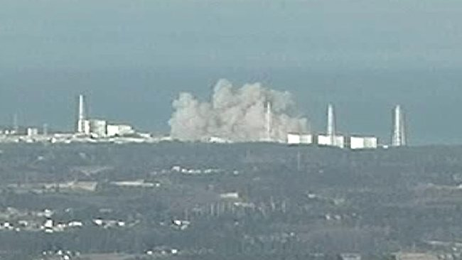
An atomic plant? What could go wrong?
72

Slide 73
Transaction costs and the difference in perspectives
The parties look
forward, the courts
look back

Slide 74
The difference in perspectives
The Court ex post is better able to know what the value of the inventions are in Corthell at 42

Slide 75
Indefinite Agreements
When should a court gap-fill and when not?
The court’s informational problem
The parties’ transaction cost problem
An Art II transaction?

Slide 76
Indefinite Agreements
When should a court gap-fill and when not?
The court’s informational problem
The parties’ transaction cost problem
An Art II transaction?
The conduct of the parties

Slide 77
The conduct of the parties
UCC 2-204(1) A contract for sale of goods may be made in any manner sufficient to show agreement, including conduct by both parties which recognizes the existence of such a contract.

Slide 78
Agreements to Agree and the Leval Test
We saw the Second Circuit’s more liberal standard in Adjustrite at 228

Slide 79
Brown v. Cara 337
Was the MOU a binding agreement?
Cara Brown
100 Jay Street, Brooklyn

Slide 80
Brown v. Cara 307
The Memorandum of Understanding
MOU: The parties will “work together to develop,
build, market and manage” the property
Brown to front development costs of $175K
The parties intend to “enter into a formal contract shortly”

Slide 81
Brown v. Cara
What was missing from the MOU?

Slide 82
Brown v. Cara
What was missing from the MOU?
Zoning approval?
Financing and construction contracts
Architectural plans
Equity stakes
What happened after the $175,000

Slide 83
Brown v. Cara
Why did Cara back off the deal?
And just what part of town was this?

Slide 84
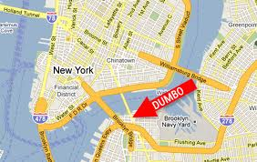
Brown v. Cara
Why did Cara back off the deal?
And just what part of town?

Slide 85
Brown v. Cara: What happened to the area?
Dumbo in the 1980s

Slide 86
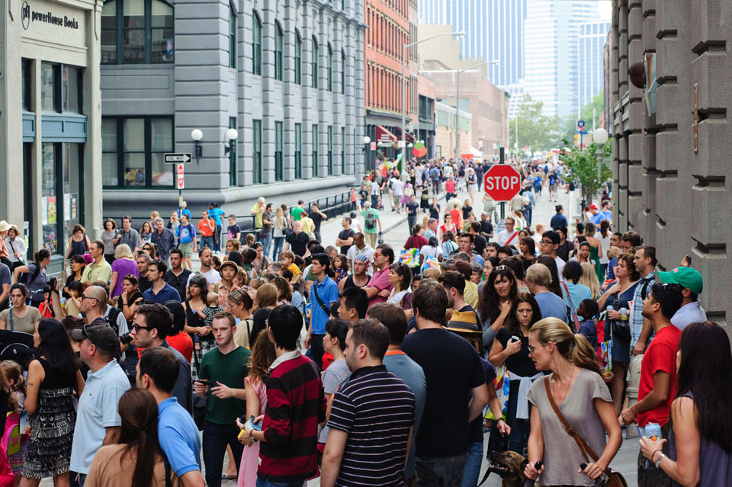
Brown v. Cara: What happened to the area?
Dumbo today
Dumbo has emerged as one of New York City's premier arts districts, with a cluster of for-profit art galleries and such not-for-profit institutions as the St. Ann's Warehouse and the A.I.R. Gallery. Chef Jacques Torres opened a chocolate factory in Dumbo in December 2000.

Slide 87
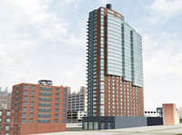
Brown v. Cara: What happened to 100 Jay?
Rising 33 stories alongside the Manhattan Bridge, J Condo is Brooklyn’s premiere luxury residential building.
As the tallest building in Dumbo, J Condo adds an easily recognizable icon to the Brooklyn skyline with its dramatic curved, sail-like façade of floor to ceiling windows that maximizes the building’s abundant natural light and offers magnificent panoramic views of Manhattan, Brooklyn, the East River, and New York Harbor.

Slide 88
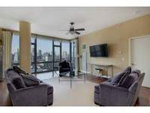
Brown v. Cara: What happened to 100 Jay?
Does this suggest why the deal didn’t happen?
3 bedroom for $2.5M
100 Jay
88

Slide 89
Brown v. Cara
What is the difference between Leval’s Type I and Type II agreements?

Slide 90
Brown v. Cara
Badges of Type I agreements?

Slide 91
Brown v. Cara
Badges of Type I agreements?
No express denial of an agreement
Partial performance
All material terms agreed to
Not an agreement of a kind usually committed to writing

Slide 92
Brown v. Cara
Badges of a Type II agreement?

Slide 93
Brown v. Cara
Badges of a Type II agreement?
An intention to be bound
Too uncertain for a Type I agreement
Some partial performance
The context?

Slide 94
Brown v. Cara
How binding are the good faith duties?
What would bad faith look like here?

Slide 95
Good faith?
What does a good faith Type II negotiation mean?
UCC 1-201(20) “Good faith means …honesty in fact and the observance of reasonable commercial standards of fair dealing”

Slide 96
Arcadian Phosphate at 341-42
Consistent with Brown?
How is the language different?
The appreciation of changed market condition?
Part performance?

Slide 97
Various Possibilities
A fully binding agreement (Type I)
Not binding in any way
Good faith duties to negotiate (Type II) with an enforceable agreement
Good faith duties with reliance damages
Quasi-contract

