Slide 1
George Mason School of Law
Contracts I
K. Preliminary Negotiations
© F.H. Buckley
fbuckley@gmu.edu

Slide 2
Relational Contracts
Should different principles apply when business parties propose to enter into a long-term relationship?

Slide 3
Relational Contracts
Should different principles apply when business parties propose to enter into a long-term relationship?
Corporations
Business Corporations Act
Non-profit Corporations Act
Close Corporations Act
LLCs

Slide 4
Relational Contracts
But generaly no statutory default rules for contractual arrangements
Joint ventures
Distributorships
Long-term supply and requirements contracts
Employment Contracts
Franchise Laws

Slide 5
Relational contracts as different in kind from one-shot transactions
Relations are seen as semi-permanent
A lengthier process of negotiation where it may be difficult to identity the moment at which contractual duties arise
The object of exchange is not easily quantified
Trust becomes more important
5

Slide 6
But what about Iterated PD Games?
Axelrod, The Evolution of Cooperation (1984)
Tit-for-tat as a dominant strategy for iterated PD games
Telser, A Theory of Self-enforcing agreements, 53 J. Bus. 27 (1980)
6
Notes:
6

Slide 7
Relational contracts as different in kind from one-shot transactions
A lengthier process of negotiation
where it may be difficult to identity
the moment at which contractual duties arise:
The preliminary agreement problem
7

Slide 8
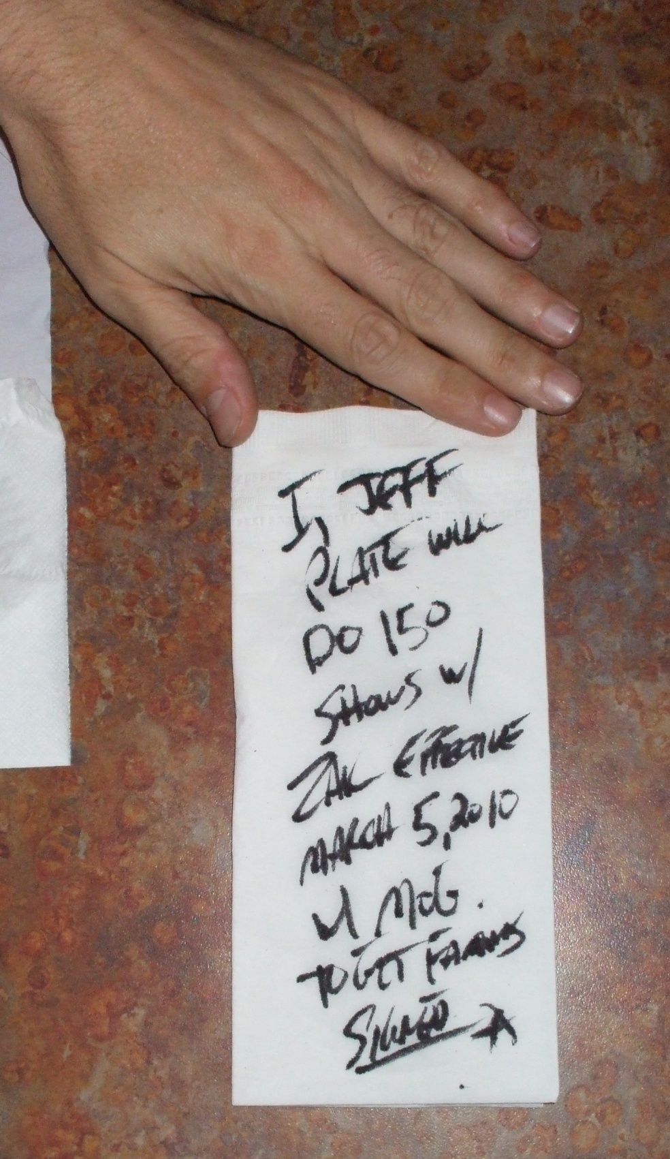
Preliminary Agreements How deals begin…

Slide 9
Preliminary Agreements Assume both parties sign the following:
“This letter is to memorialize our agreement in which you will ship 1,000 widgets from Los Angeles to my address by Monday next for $5,000.”
What’s left out?

Slide 10
Preliminary Agreements Assume both parties sign the following:
Things left out:
Who pays for shipping and how is this to be done?
When does risk pass?
Implied warranties as to quality
When is payment due?
When does the duty to ship arise?

Slide 11
Preliminary Agreements
Statutory implied terms under Art. II
Quality warranties
Duty to ship, pay
Passing of risk

Slide 12
Preliminary Agreements
Restatement § 33(2) The terms of a contract are reasonably certain if they provide a basis for determining the existence of a breach and for giving an appropriate remedy.

Slide 13
Preliminary Agreements
What if important terms are left out but the parties specify: “This constitutes a binding contract between us”

Slide 14
Preliminary Agreements
Restatement § 33(1) Even though a manifestation of intention is intended to be understood as an offer, it cannot be accepted so as to form a contract unless the terms of the contract are reasonably certain.

Slide 15
Preliminary Agreements
Restatement § 33(3) The fact that one or more terms of a proposed bargain are left open or uncertain may show that a manifestation of intention is not intended to be understood as an offer or as an acceptance.

Slide 16
Preliminary Agreements
What if they add: “No binding contract between us will exist until we have executed a final agreement”?

Slide 17
Preliminary Agreements
§21. INTENTION TO BE LEGALLY BOUND. Neither real nor apparent intention that a promise be legally binding is essential to the formation of a contract, but a manifestation of intention that a promise shall not affect legal relations may prevent the formation of a contract.

Slide 18
Preliminary Agreements
Restatement § 26. PRELIMINARY NEGOTIATIONS. A manifestation of willingness to enter into a bargain is not an offer if the person to whom it is addressed knows or has reason to know that the person making it does not intend to conclude a bargain until he has made a further manifestation of assent.

Slide 19
Preliminary Agreements
What if they add: “We agree that this letter agreement will be reduced to a binding definitive agreement”?

Slide 20
Preliminary Agreements
What if they add: “We agree that this letter agreement will be reduced to a binding definitive agreement”?
Recall Ciaramella (220) and Adjustrite (228)

Slide 21
Preliminary Agreements
Restatement § 27. Manifestations of assent that are in themselves sufficient to conclude a contract will not be prevented from so operating by the fact that the parties also manifest an intention to prepare and adopt a written memorial thereof,

Slide 22
Preliminary Agreements
Restatement § 27. Manifestations of assent that are in themselves sufficient to conclude a contract will not be prevented from so operating by the fact that the parties also manifest an intention to prepare and adopt a written memorial thereof, but the circumstances may show that the agreements are preliminary negotiations.

Slide 23
Coley v. Lang at 312

Slide 24
Coley v. Lang
Lang shares
Coley
Asset sale to IASCO
(old IAS shareholders)
IAS Inc.

Slide 25
Coley v. Lang
What in Heaven’s name was the purpose of the deal?

Slide 26
Coley v. Lang
The Deal…
On or before [17 days later] this letter agreement will be reduced to a definitive agreement binding upon all of the parties
Until then Coley can bid on behalf of IAS [?]

Slide 27
Coley v. Lang
The Deal…
Did the parties intend that the contract would be binding as of Sept. 1?
What was Coley’s argument about things left out of the agreement?

Slide 28
Coley v. Lang
The Deal…
Can you think of a reason why Coley might have wanted out?

Slide 29
Coley v. Lang
The Deal…
Does the court have enough information about the details of the deal to award specific performance?

Slide 30
Coley v. Lang
Is this a suitable case for promissory estoppel?

Slide 31
Coley v. Lang
Is this a suitable case for promissory estoppel?
No “definite and substantial” reliance over 18 days

Slide 32
Coley v. Lang
Qu. the current version of Restatement § 90(1)
A promise which the promisor should reasonably expect to induce action or forbearance on the part of the promisee or a third person and which does induce such action or forbearance is binding if injustice can be avoided only by enforcement of the promise. The remedy granted for breach may be limited as justice requires.

Slide 33
Coley v. Lang
Supposing you didn’t want litigation. How would you draft the agreement if you don’t want a binding contract?

Slide 34
Coley v. Lang
Supposing you didn’t want litigation. How would you draft the agreement if you don’t want a binding contract?
The parties understand that this is not a binding agreement and that no liability will arise until a definitive agreement is signed.

Slide 35
Coley v. Lang
Supposing you didn’t want litigation. How would you draft the agreement if you don’t want a binding contract?
The parties understand that this is not a binding agreement and that no liability will arise until a definitive agreement is signed.
Restatement § 21: “a manifestation of intention that a promise shall not affect legal relations may prevent the formation of a contract.”

Slide 36
Coley v. Lang
Supposing you didn’t want litigation. How would you draft the agreement if you want a binding contract?

Slide 37
Coley v. Lang
Supposing you didn’t want litigation. How would you draft the agreement if you want a binding contract?
The parties understand that this is a binding agreement and that failure to sign a definitive agreement will give rise to liability.

