Slide 1
George Mason School of Law
Contracts I
J. Material Benefits and Irrevocable Offers
F.H. Buckley
fbuckley@gmu.edu

Slide 2
Distinguish four kinds of duties
Things you should do even if you don’t promise (e.g., pay taxes)
Things you should do because you promised to do so, and provided consideration
Things you should do because you promised, and the promisee has relied, and 90(1) is triggered
Things you should do because you ought to do them and have promised to do so, notwithstanding the absence of consideration or promisee reliance

Slide 3
Distinguish four kinds of duties
Things you should do because you ought to do them and have promised to do so, notwithstanding the absence of consideration or promisee reliance
Gifts to charities: restatement 90(2)
The Material Benefits Rule

Slide 4
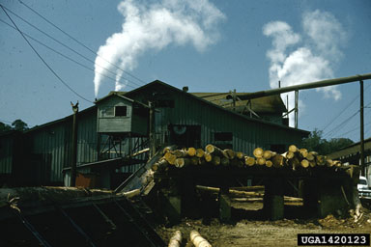
The Material Benefits Rule
Webb v. McGowin p. 214
W.T. Smith Lumber Co., Chapman AL

Slide 5
The Material Benefits Rule
Webb v. McGowin
Treat this as a contracts case. Is there a consideration problem?

Slide 6
The Material Benefits Rule
Webb v. McGowin
Treat this as a contracts case. Is there a consideration problem?
The past consideration rule

Slide 7
The Material Benefits Rule
Webb v. McGowin
Treat this as a promissory estoppel issue. Was there promisee reliance here?

Slide 8
The Material Benefits Rule
Webb v. McGowin
So what’s the basis for a remedy?

Slide 9
The Material Benefits Rule
Webb v. McGowin
Recall Bailey v. West
Is Webb a suitable case for relief in quasi-contract?
If so, why?

Slide 10
The Material Benefits Rule
Webb v. McGowin
Describe the hypothetical bargain, if we could have frozen time before Webb diverted the block?

Slide 11
The Material Benefits Rule
Webb v. McGowin
What did the promise add?

Slide 12
Restatement § 86 Promise for Benefit Received
§ 86(1) A promise made in recognition of a benefit previously received by the promisor from the promisee is binding to the extent necessary to prevent injustice.

Slide 13
Restatement § 86 Promise for Benefit Received
§ 86(1) A promise made in recognition of a benefit previously received by the promisor from the promisee is binding to the extent necessary to prevent injustice.
§ 86(2) A promise is not binding under Subsection (1)
(a) if the promisee conferred the benefit as a gift or for other reasons the promisor has not been unjustly enriched; or
(b) to the extent that its value is disproportionate to the benefit

Slide 14
The Material Benefits Rule
Webb v. McGowin
Can you distinguish it from Mills v. Wyman at 214?
What about Boothe v. Fitzpatrick at 220

Slide 15
The Material Benefits Rule
Why do you think this is called the “material” benefits rule?

Slide 16
Restatement § 86 Promise for Benefit Received
§ 86(1) A promise made in recognition of a benefit previously received by the promisor from the promisee is binding to the extent necessary to prevent injustice.
(2) A promise is not binding under Subsection (1)
(a) if the promisee conferred the benefit as a gift or for other reasons the promisor has not been unjustly enriched; or
(b) to the extent that its value is disproportionate to the benefit

Slide 17
Pitching ideas: The double trust problem
Desny v. Billy Wilder at 215

Slide 18
Pitching ideas: The double trust problem
Could you make a contract before pitching the idea?
What about after pitching it?

Slide 19
Pitching ideas: The double trust problem
Could you make a contract before pitching the idea?
What about after pitching it?
the past consideration problem?
Consider the conditional promise made by the secretary

Slide 20
Pitching ideas: The double trust problem
Could you make a contract before pitching the idea?
What about after pitching it?
the past consideration problem?

Slide 21
Pitching ideas: The double trust problem
Could you make a contract before pitching the idea?
What about after pitching it?
the past consideration problem?
Consider the conditional promise made by the secretary

Slide 22
Irrevocable Offers
The consideration requirement amounts to a presumption against irrevocable offers
Why does this make sense?

Slide 23
Irrevocable Offers
Gold is now trading at $1500/oz. Would you pay for the right to buy gold for $2000/oz. in a year’s time?

Slide 24
Irrevocable Offers
What about options supported by consideration?
Restatement § 25. An option contract is a promise which meets the requirements for the formation of a contract and limits the promisor's power to revoke an offer.

Slide 25
Irrevocable Offers
When would it make sense to hold an offer irrevocable in the absence of consideration?

Slide 26
Irrevocable Offers
When would it make sense to hold an offer irrevocable in the absence of consideration?
Pre-contractual reliance expenditures
Firm Offers

Slide 27
Pre-contractual Reliance Expenditures
The Brooklyn Bridge example: p. 258

Slide 28
Reliance Expenditures
Revocation not effective after full performance of unilateral contract
Carlill
Lefkowitz
St Peter

Slide 29
Reliance Expenditures
But what about part performance?
Easy finding of acceptance and loss of revocation rights? Ever-Tite

Slide 30
Quick Acceptance: Restatement § 62(1)
Where an offer invites an offeree to choose between acceptance by promise and acceptance by performance, the tender or beginning of the invited performance or a tender of a beginning of it is an acceptance by performance.

Slide 31
Quick Acceptance: Restatement § 62(1)
Where an offer invites an offeree to choose between acceptance by promise and acceptance by performance, the tender or beginning of the invited performance or a tender of a beginning of it is an acceptance by performance.
But suppose the fellow on the Brooklyn Bridge turns around?

Slide 32
Reliance Expenditures
But what about part performance?
Option Contract: Restatement §§ 45(1), 87(2)

Slide 33
Option Contract: Restatement § 45(1)
Where an offer invites an offeree to accept by rendering a performance and does not invite a promissory acceptance, an option contract is created when the offeree tenders or begins the invited performance or tenders a beginning of it.

Slide 34
Option Contract: Restatement § 87(2)
An offer which the offeror should reasonably expect to induce action or forbearance of a substantial character on the part of the offeree before acceptance and which does induce such action or forbearance is binding as an option contract to the extent necessary to avoid injustice.

Slide 35
What does § 45(1) add to 87(2)?
45(1): Where an offer invites an offeree to accept by rendering a performance and does not invite a promissory acceptance, an option contract is created when the offeree tenders or begins the invited performance or tenders a beginning of it.
Unilateral contracts only

Slide 36
What does § 87(2) add to § 45(1)?
87(2): An offer which the offeror should reasonably expect to induce action or forbearance of a substantial character on the part of the offeree before acceptance and which does induce such action or forbearance is binding as an option contract to the extent necessary to avoid injustice.

Slide 37
What is the remedy?
Cf. Restatement § 87, Comment e
“Full scale enforcement is not necessarily appropriate.”

Slide 38
Construction Contracts
Client
General Contractor
Sub-contractor

Slide 39
Promisee Reliance: Options
Restatement 87(2): An offer which the offeror should reasonably expect to induce action or forbearance of a substantial character on the part of the offeree before acceptance and which does induce such action or forbearance is binding as an option contract to the extent necessary to avoid injustice.

Slide 40
Pavel v. Johnson p. 260

Slide 41
Pavel v. Johnson p. 236
NIH
PEI (Pavel/HVAC)
Johnson (Kick)

Slide 42
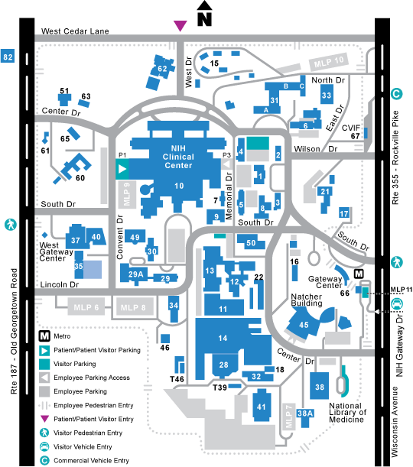
Pavel v. Johnson p. 236: Building 30

Slide 43
Pavel v. Johnson
Aug. 5: Subcontractor Johnson submits a $898K bid to Pavel for the HVAC work
Thereafter Pavel submits a $1.6M bid to NIH
Aug 26: PEI visits with Johnson

Slide 44
Pavel v. Johnson
Aug. 5: Subcontractor Johnson bids
Thereafter Pavel bids with NIH-August: PEI knows it is the winning bidder
Aug 26: PEI visits with Johnson
Aug. 26: Contractor Pavel asks Johnson for fresh bid breaking out Powers project
Sept. 1: Pavel “accepts” Johnson’s bid
Did that count as an acceptance?

Slide 45
Pavel v. Johnson
Sept. 1: Pavel “accepts” Johnson’s bid
Sept. 2: Johnson notes an error and seeks to withdraw bid
Subsequently Pavel finds a substitute subcontractor

Slide 46
Pavel v. Johnson
Should the subcontractor be held to have made an irrevocable offer?

Slide 47
Pavel v. Johnson
Should subcontractors be held to have made an irrevocable offer?
No: Baird v. Gimbel (Learned Hand)
Is the contractor without any remedy?

Slide 48
Pavel v. Johnson
Should subcontractors be held to have made an irrevocable offer?
Yes: Drennan v. Star Paving (Traynor)
Is reliance necessary—or should it be presumed?

Slide 49
Promisee Reliance: Options
Restatement 87(2): An offer which the offeror should reasonably expect to induce action or forbearance of a substantial character on the part of the offeree before acceptance and which does induce such action or forbearance is binding as an option contract to the extent necessary to avoid injustice.

Slide 50
Pavel v. Johnson
Should subcontractors be held to have made an irrevocable offer?
Baird v. Gimbel (Learned Hand)
Drennan v. Star Paving (Traynor)
How is the Pavel approach unlike either of these?

Slide 51
Pavel v. Johnson
Should subcontractors be held to have made an irrevocable offer?
When might this be unfair to the subcontractor?

Slide 52
Pavel v. Johnson
Should subcontractors be held to have made an irrevocable offer?
When might this be unfair to the subcontractor?
The contractor shops around?
Is that really a clean hands matter? Or does it go to reliance?
Lapse of time and absence of notice to subcontractor
Extremely low bid by subcontractor

Slide 53
Firm Offers
What about cases where there is neither consideration nor reliance?

Slide 54
Firm Offers
Restatement § 87(1)(a) An offer is binding as an option contract if it is in writing and signed by the offeror, recites a purported consideration for the making of the offer, and proposes an exchange on fair terms within a reasonable time.

Slide 55
Firm Offers under the UCC
UCC § 2-205. An offer by a merchant to buy or sell goods in a signed writing which by its terms gives assurance that it will be held open is not revocable, for lack of consideration, during the time stated or if no time is stated for a reasonable time, but in no event may such period of irrevocability exceed three months; but any such term of assurance on a form supplied by the offeree must be separately signed by the offeror.

Slide 56
Firm Offers under the UCC
UCC § 2-205. An offer by a merchant to buy or sell goods in a signed writing which by its terms gives assurance that it will be held open is not revocable, for lack of consideration, during the time stated or if no time is stated for a reasonable time, but in no event may such period of irrevocability exceed three months; but any such term of assurance on a form supplied by the offeree must be separately signed by the offeror.

