Slide 1
George Mason School of Law
Contracts II
H. Statute of Frauds
F.H. Buckley
fbuckley@gmu.edu

Slide 2
The importance of a writing
Can a contract be enforced absent a writing: The Statute of Frauds
If there is a writing, can a court look beyond it to oral evidence: The Parol Evidence Rule

Slide 3
The Statute of Frauds: Why 1677?
Charles II

Slide 4
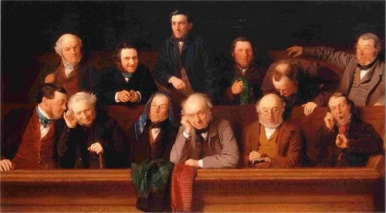
Defects in the law of evidence
Juries as fact-finders
Interested parties not admissible as witnesses

Slide 5
Why 1677?
Juries as fact-finders
Interested parties not admissible as witnesses
If that made the Statute of Frauds necessary then, why do we need it now?

Slide 6
What’s the purpose of the SoF?
McIntosh at 564

Slide 7
What’s the purpose of the SoF?
Evidentiary
Antifraud
7

Slide 8
What’s the purpose of the SoF?
Evidentiary
Antifraud
Cautionary
Reflects seriousness of contracting
8

Slide 9
What’s the purpose of the SoF?
Evidentiary
Antifraud
Cautionary
Reflects seriousness of contracting
Channeling
Distinguishing enforceable contracts
9

Slide 10
The Restatement’s sanction for non-compliance
Restatement § 110(1): not enforceable absent a written memorandum signed by the party to be charged

Slide 11
The UCCsanction for non-compliance
UCC § 2-201(1) Except as otherwise provided in this section a contract for the sale of goods for the price of $500 or more is not enforceable by way of action or defense unless there is some writing sufficient to indicate that a contract for sale has been made between the parties and signed by the party against whom enforcement is sought or by his authorized agent or broker.

Slide 12
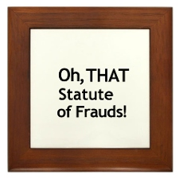
The problem: A trap for the unwary?
It nullifies false agreements
While nullifying what otherwise would be true agreements

Slide 13
The Statute of Frauds Restatement §110
(a) a contract of an executor or administrator to answer for a duty of his decedent;
(b) a contract to answer for the duty of another (the suretyship provision);
(c) a contract made upon consideration of marriage (the marriage provision);
(d) a contract for the sale of an interest in land (the land contract provision);
(e) a contract that is not to be performed within one year from the making thereof (the one-year provision).
(2) The following classes of contracts, which were traditionally subject to the Statute of Frauds, are now governed by Statute of Frauds provisions of the Uniform Commercial Code:
(a) a contract for the sale of goods for the price of $500 or more (Uniform Commercial Code § 2-201);
(c) a contract for the sale of personal property not otherwise covered, to the extent of enforcement by way of action or defense beyond $5,000 in amount or value of remedy (Uniform Commercial Code § 1-206).

Slide 14
Restatement §110 MY LEGS
M: consideration of marriage;
Y: not to be performed within one year;
L: sale of an interest in land;
E: a contract of an executor;
G: sale of goods for $500 or more;
S: a contract to answer for the duty of another (the suretyship provision)

Slide 15
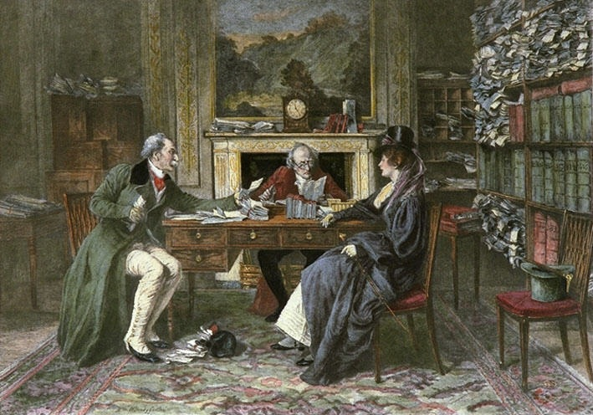
Marriage Settlements
The old action for breach of promise

Slide 16
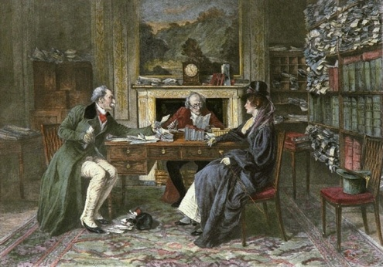
Marriage Settlements
A and B promise to marry and A reneges?

Slide 17
Marriage Settlements
Restatement § 124
Within the SoF if the consideration is a “marriage or a promise to marry” unless only “mutual promises of two persons to marry each other”

Slide 18
Promises not to be performed within One Year
Restatement § 110(1)(e)
What is the rationale for the rule?

Slide 19
How does the one-year rule work?
“Not to be performed within one year from the making thereof”
What does the Π have to assert to win in McIntosh at 515?

Slide 20
How does the one-year rule work?
“Not to be performed within one year from the making thereof”
What does the Π have to assert to win in McIntosh?
Not terminable at will, but for a fixed term
20

Slide 21
How does the one-year rule work?
“Not to be performed within one year from the making thereof”
What does the Π have to assert to win in McIntosh?
Not terminable at will, but for a fixed term
And what that term might be?
21

Slide 22
How does the one-year rule work?
“Not to be performed within one year from the making thereof”
What does the Π have to assert to win in McIntosh?
Not terminable at will, but for a fixed term
And what that term might be?
Gee, let’s say one year
22

Slide 23
How does the one-year rule work?
“Not to be performed within one year from the making thereof”
What does the Π have to assert to win in McIntosh?
Not terminable at will, but for a fixed term
What that term might be
But then Δ asserts the promise is not unenforceable by virtue of the Statute of Frauds
23

Slide 24
How does the one-year rule work?
“Not to be performed within one year from the making thereof”
It’s Oct. 8, 2023. I ask you to work for me from Nov. 1, 2024 until Nov. 1, 2025
24

Slide 25
How does the one-year rule work?
“Not to be performed within one year from the making thereof”
Restatement § 130(1) Where any promise in a contract cannot be fully performed within a year from the time the contract is made, all promises in the contract are within the Statute of Frauds until one party to the contract completes his performance.
25

Slide 26
How does the one-year rule work?
“Not to be performed within one year from the making thereof”
Restatement § 130(1) Where any promise in a contract cannot be fully performed within a year from the time the contract is made, all promises in the contract are within the Statute of Frauds until one party to the contract completes his performance.
26

Slide 27
How does the one-year rule work?
“Not to be performed within one year from the making thereof”
It’s Oct. 9, 2023. I ask you to repaint the ceiling of the Sistine Chapel, which likely will take five years.
27

Slide 28
How does the one-year rule work?
I ask you to repaint the ceiling of the Sistine Chapel, which likely will take five years.
Restatement § 130(1) Where any promise in a contract cannot be fully performed within a year from the time the contract is made
28

Slide 29
How does the one-year rule work?
“Not to be performed within one year from the making thereof”
I insure your house against fire for five years without a writing. It burns after three years.
29

Slide 30
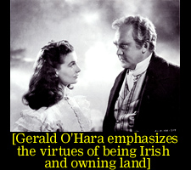
Land: 110(1)(d)
“Tis the only thing worth
fighting for, worth dying for”

Slide 31
Is land different?
What do real estate agents make you do if you want to buy a house?

Slide 32
Is land different?
What do real estate agents make you do if you want to buy a house?
Written offers throughout
Closing

Slide 33
Is land different?
Restatement § 125
“A promise to transfer to any person any interest in land”
Qu. Leaseholds? Cf. 125(4): Statutes in most states except from the land contract and one-year provisions of the Statute of Frauds short-term leases and contracts to lease, usually for a term not longer than one year.

Slide 34
Executors

Slide 35
Goods worth more than $500
Restatement § 110(2)(a) → UCC § 2-201
a contract for the sale of goods for the price of $500 or more is not enforceable by way of action or defense unless there is some writing sufficient to indicate that a contract for sale has been made between the parties and signed by the party against whom enforcement is sought or by his authorized agent or broker. A writing is not insufficient because it omits or incorrectly states a term agreed upon but the contract is not enforceable under this paragraph beyond the quantity of goods shown in such writing.

Slide 36
Goods worth more than $500
Restatement § 110(2)(a) → UCC § 2-201
a contract for the sale of goods for the price of $500 or more is not enforceable by way of action or defense unless there is some writing sufficient to indicate that a contract for sale has been made between the parties and signed by the party against whom enforcement is sought or by his authorized agent or broker. A writing is not insufficient because it omits or incorrectly states a term agreed upon but the contract is not enforceable under this paragraph beyond the quantity of goods shown in such writing.

Slide 37
Goods worth more than $500
Restatement § 110(2)(a) → UCC § 2-201
a contract for the sale of goods for the price of $500 or more is not enforceable by way of action or defense unless there is some writing sufficient to indicate that a contract for sale has been made between the parties and signed by the party against whom enforcement is sought or by his authorized agent or broker. A writing is not insufficient because it omits or incorrectly states a term agreed upon but the contract is not enforceable under this paragraph beyond the quantity of goods shown in such writing.

Slide 38
Suretyship (guarantor)
Seller of Ferrari
Idiot, Doting Parent Spendthrift Child
stands surety
38

