Slide 1
George Mason School of Law
Contracts I
H. Consideration
F.H. Buckley
fbuckley@gmu.edu

Slide 2
Some things left out from last day on 2-207
The scope of UCC Section 2
The role of free baragaining

Slide 3
UCC 2-105(1)
"Goods" means all things (including specially manufactured goods) which are movable at the time of identification to the contract of sale other than the money in which the price is to be paid, investment securities (Article 8) and things in action. "Goods" also includes the unborn young of animals and growing crops and other identified things attached to realty as described in the section on goods to be severed from realty

Slide 4
Can one bargain out of merchantability?
§ 2-314 (1). Unless excluded or modified, a warranty that the goods shall be merchantable is implied in a contract for their sale if the seller is a merchant with respect to goods of that kind.

Slide 5
Can one bargain out of 2-207? Does the proviso contemplate exit rights?
§ 2-207(1) A definite and seasonable expression of acceptance or a written confirmation which is sent within a reasonable time operates as an acceptance even though it states terms additional to or different from those offered or agreed upon, unless acceptance is expressly made conditional on assent to the additional or different terms.

Slide 6
UCC 2-207(3) What happens if the writings do not agree?
Conduct by both parties which recognizes the existence of a contract is sufficient to establish a contract for sale although the writings of the parties do not otherwise establish a contract. In such case the terms of the particular contract consist of those terms on which the writings of the parties agree, together with any supplementary terms incorporated under any other provisions of this Act

Slide 7
Does 2-207 apply to consumer contracts?
Can you distinguish Hill v. Gateway from Step-saver?

Slide 8
Canons of interpretation
The legislator does not speak in vain
Literal rule: words are to be interpreted literally
Mischief rule: A statute should be interpreted so as to address the mischief for which it was enacted.

Slide 9
The need for a consideration
We have capacity and consent—why doesn’t that suffice?
Restatement § 17(1)
The formation of a contract requires a bargain in which there is … a consideration

Slide 10
Why is it (or something like it) needed in all systems of law?
Common Law: consideration
Roman Law: Causa
Civil Law: cause
To understand the purpose, ask what it excludes

Slide 11
Six Questions
Defining Consideration: Benefit-Detriment and Bargain Tests
The Effect of a Seal
The Adequacy of Consideration and Nominal Consideration
Performance of Legal Obligations
The Past Consideration rule
The Relevance of Motive
“Mutuality of Obligation”

Slide 12
Defining consideration
Hamer v. Sidway at 43

Slide 13
Hamer v. Sidway at 43
The nephew was going to the dogs…

Slide 14
Hamer v. Sidway at 43
What is the point of the benefit-detriment standard?
The promisor can satisfy this with either a benefit to one party or a detriment to the other

Slide 15
Hamer v. Sidway at 43
What is the benefit-detriment standard?
Why does a benefit to the promisor (William Story) matter?

Slide 16
Hamer v. Sidway at 43
What is the benefit-detriment standard?
Why does a benefit to the promisor (William Story) matter?
Contracts as give ups and gets

Slide 17
Hamer v. Sidway at 43
What is the benefit-detriment standard?
Why does a detriment benefit to the promisee (the nephew) matter?

Slide 18
Hamer v. Sidway at 43
What kind of a detriment was needed in Hamer?

Slide 19
Hamer v. Sidway at 43
Restatement 71(3)(b). The performance may consist of … a forbearance
Need this be costly?

Slide 20
Hamer v. Sidway at 43
Did the nephew expect the promise to be legally binding?
Do you think the uncle meant the promise to be legally binding?

Slide 21
Hamer v. Sidway at 43
Restatement 71(3)(b). The performance may consist of … a forbearance
“Courts will not ask whether the thing which forms the consideration does in fact benefit the promisee or the third party, or is of any substantial value to anyone” Currie v. Misa, L.R. 10 Ex. 153 (1875)

Slide 22
Kirksey at 132
Why did Isaac invite Antillico to Talladega county?

Slide 23
Kirksey at 132
Why did Isaac invite Antillico to Talladega county?
A benefit to Isaac?

Slide 24
Kirksey at 132
Why did Isaac invite Antillico to Talladega county?
A detriment to Antillico?

Slide 25
Kirksey at 132
Why did Isaac invite Antillico to Talladega county?
Williston’s tramp at 134?

Slide 26
Kirksey at 132
Why did Isaac invite Antillico to Talladega county?
Williston’s tramp at 134?
Condition vs. Consideration

Slide 27
Kirksey at 132
Do you think Isaac intended legal liability?
Why might he have?
And why not?

Slide 28
St. Peter v. Pioneer at 45

Slide 29
St. Peter v. Pioneer
Why didn’t Pioneer’s restrict bank night to paying customers?

Slide 30
St. Peter v. Pioneer
How was the Π to accept?

Slide 31
St. Peter v. Pioneer
How was the Π to accept?
Unilateral and Bilateral contracts

Slide 32
St. Peter v. Pioneer
Can you articulate why the theatre might have wanted the promise to be binding?
Was there both a benefit and a detriment?

Slide 33
St. Peter v. Pioneer
“The requested acts were bargained for”
Restatement § 71:
(1) Any promise which is bargained for is consideration
(2) A performance or return promise is bargained for if it is sought by the promisor in exchange for his promise and is given by the promisee in exchange for that promise.

Slide 34
The Bargain Theory
How would you define bargains?
What is excluded
Was Hamer v. Sidway a bargain?

Slide 35
What if there’s no bargain: Gratuitous Promises
Uncle Ebenezer might want to bind himself? So how does he do so?

Slide 36
What if there’s no bargain: Gratuitous Promises
Actual gifts (as opposed to promises) are effective if:
Donative intent (animus donandi), and
Delivery by donor, and
Acceptance by donee

Slide 37
What if there’s no bargain: Gratuitous Promises
What constitutes delivery by donor?
Actual delivery of gift
Constructive delivery (e.g. key to car or house)
Deed of gift

Slide 38
Gratuitous Promises and Contracts under seal

Slide 39
The seal
Definition: Restatement § 96: “a manifestation in tangible and conventional form”
Effect of seal: Restatement § 95(1)(a): “binding without consideration if it is in writing and sealed”

Slide 40
The decay of formality

Slide 41
Abolition of seals
UCC 2-203
Abolition in half the states

Slide 42
Adequacy
Would courts ever look at an imbalance in the value of the respective considerations?

Slide 43
Aristotle on Corrective Justice
These names, both loss and gain, have come from voluntary exchange; for to have more than one's own is called gaining, and to have less than one's original share is called losing, e.g. in buying and selling and in all other matters in which the law has left people free to make their own terms; but when they get neither more nor less but just what belongs to themselves, they say that they have their own and that they neither lose nor gain.
Therefore the just is intermediate between a sort of gain and a sort of loss, viz. those which are involuntary; it consists in having an equal amount before and after the transaction.

Slide 44
Hamer v. Sidway at 43
Restatement 71(3)(b). The performance may consist of … a forbearance
“Courts will not ask whether the thing which forms the consideration does in fact benefit the promisee or the third party, or is of any substantial value to anyone” Currie v. Misa, L.R. 10 Ex. 153 (1875)

Slide 45
Adequacy
Restatement § 79. ADEQUACY OF CONSIDERATION. If the requirement of consideration is met, there is no additional requirement of
(a) a gain, advantage, or benefit to the promisor or a loss, disadvantage, or detriment to the promisee; or
(b) equivalence in the values exchanged

Slide 46
Wolford v. Powers 145
What was the consideration from the Wolfords?
Did anything change when Lehman executed a note?

Slide 47
“Be it ever so small” Sturlyn v. Albany at 146
Peppercorn theory: “Be it ever so small”
Sfreddo v. Sfreddo, 59 Va. App. 479 (2012)

Slide 48
“Be it ever so small” Sturlyn v. Albany at 146
Peppercorn theory: “The value of all things contracted for is measured by the appetite of the contractors, and therefore the just value is that which they contracted to give” Pollock (quoting Hobbes)

Slide 49
We saw subjective value before…
Bess
E
A
•
•
C
•
F
•
•
G
B
•
•
D
Mary
49
Notes:
49

Slide 50
Re Greene at 135
What did the agreement specify as the consideration?

Slide 51
Re Greene at 135
“for one dollar and other good and valuable consideration”
Why didn’t that work?

Slide 52
Re Greene at 135
“for one dollar and other good and valuable consideration”
Why didn’t that work?
What if they had added “the receipt and adequacy thereof is hereby acknowledged”
And provided a cheque for that amount?

Slide 53
Re Greene at 135
What about the fact that the contract was under seal?

Slide 54
Re Greene at 135
What do you think was going on here?

Slide 55
Adequacy vs. Nominal Consideration
Schnell v. Nell at 151
What was the consideration?

Slide 56
Schnell v. Nell at 146
A promise of $600 to honor wife’s promise in will consideration of:
Promise in will
one cent
love and affection for deceased wife

Slide 57
Schnell v. Nell at 146
So we don’t worry about inadequate consideration, but do worry about “nominal” consideration (?!?)

Slide 58
Batsakis at 143
Why did they structure the contract
as a loan of $2,000 at 8 per cent?

Slide 59
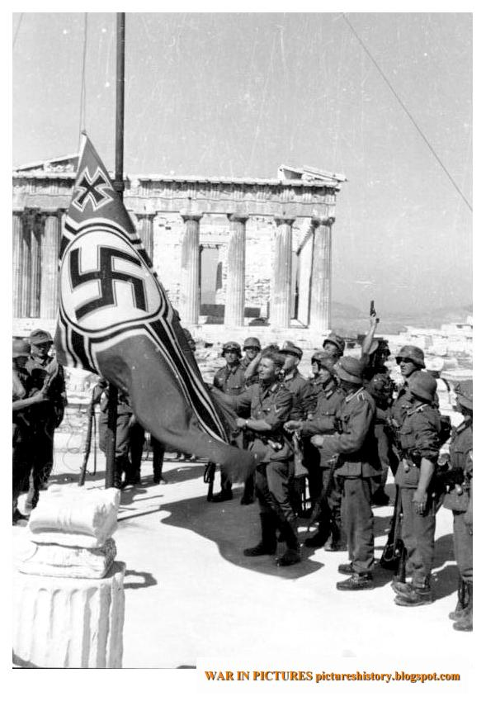
Batsakis at 143
25 days later
Athens, April 27 1942

Slide 60
Batsakis 139
Why did they structure the contract as a loan of $2,000 at 8 per cent?
Is there really a problem of adequacy here?

Slide 61
If it’s not about adequacy, what is the point of consideration?
Lon Fuller at 140

Slide 62
Lon Fuller on Consideration 140
The evidentiary function
Evidence of what?

Slide 63
Lon Fuller on Consideration
The evidentiary function
The deterrent function
a check against rash promises

Slide 64
Lon Fuller on Consideration
The evidentiary function
The deterrent function
The channeling function
“channels for the legally effective expression of intention”
Formalism

Slide 65
Formalism: What’s the point of…
Seals
Consideration
Writing and signatures

Slide 66
Lon Fuller on Consideration
Does all this simply come down to the intention to be legally bound?
Is that all there is?

Slide 67
Promises of a Reward
A reward is offered for apprehension of a thief, and an ordinary citizen catches the thief
Is there a consideration?

Slide 68
Performance of Prior Legal Obligation
A reward is offered for apprehension of a thief. In performance of his duties, a policeman catches the thief
Is there a consideration?

Slide 69
Performance of Prior Legal Obligation
Restatement §73. PERFORMANCE OF LEGAL DUTY. Performance of a legal duty owed to a promisor which is neither doubtful nor the subject of honest dispute is not consideration; but a similar performance is consideration if it differs from what was required by the duty in a way which reflects more than a pretense of bargain.

Slide 70
Performance of Prior Legal Obligation
Why is this a sensible policy?

Slide 71
What’s wrong with a public official charging for services?
I don’t get it…
Ex-Gov. Rod Blagojevich D-IL

Slide 72
What about the proviso?
Restatement §73. PERFORMANCE OF LEGAL DUTY. Performance of a legal duty owed to a promisor which is neither doubtful nor the subject of honest dispute is not consideration; but a similar performance is consideration if it differs from what was required by the duty in a way which reflects more than a pretense of bargain.

Slide 73
The past consideration doctrine
I volunteer to do some work for you, without pay. Subsequently you promise to make a gift to me. Can my prior work for you satisfy the consideration requirement?

Slide 74
Past Consideration Doctrine
Restatement 86(1) A promise made in recognition of a benefit previously received by the promisor from the promisee is binding to the extent necessary to prevent injustice.
(2) A promise is not binding under Subsection (1): (a) if the promisee conferred the benefit as a gift or for other reasons the promisor has not been unjustly enriched;

Slide 75
Past Consideration Doctrine
Restatement 82(1): A promise to pay all or part of an antecedent contractual … indebtedness is binding if the indebtedness is still enforceable

Slide 76
Past Consideration Doctrine
Restatement 82(1): A promise to pay all or part of an antecedent contractual … indebtedness is binding if the indebtedness is still enforceable or would be except for the effect of a statute of limitations

Slide 77
Past Consideration Doctrine
Restatement 83: An express promise to pay all or part of an indebtedness of the promisor discharged or dischargeable in bankruptcy proceedings brought before the promise is made, is binding

Slide 78
Does the promisee’s motive matter?
Williams v. Carwardine at 151
Why did she identify the murderer?

Slide 79
Does the promisee’s motive matter?
Parke J.: The jury will probably find that the £20 was not the motive. We may, I think, assume that it was not. The motive was the state of her own feelings. My opinion is, that the motive is not material.
What was her motive?

Slide 80
Does the promisee’s motive matter?
Timor mortis conturbat me
The status of dying declarations

Slide 81
Why does Restatement 81 make sense?
Restatement § 81(1). Consideration as Motive or Inducing Cause. The fact that what is bargained for does not of itself induce the making of a promise does not prevent it from being consideration for the promise.

Slide 82
Mutuality of Obligation
Either both are bound or neither is bound

Slide 83
Mutuality of Obligation
Either both are bound or neither is bound
Bilateral contracts, sed qu. unilateral contracts like Carlill

Slide 84
Mutuality of Obligation
See Restatement § 79: If the requirement of consideration is met, there is no additional requirement of (c) "mutuality of obligation."

Slide 85
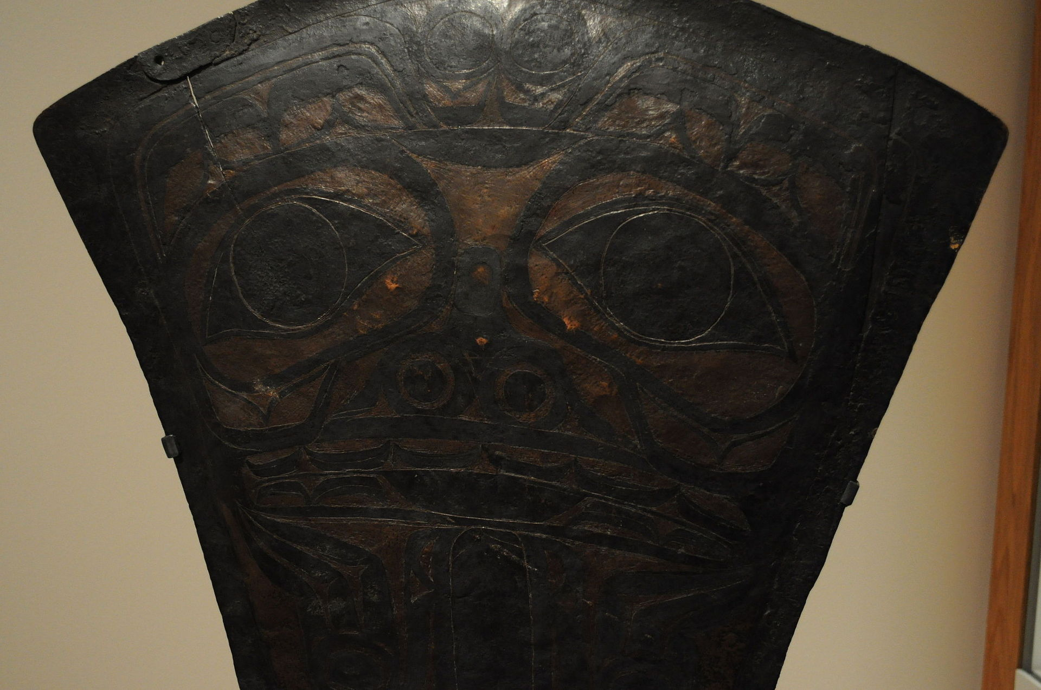
What about gift economies?
Haida Copper Shield, ca. 1870

Slide 86
Cooperation without Consideration?
It’s 1998. There are two plans for an online encyclopedia. One is Encarta, promoted by Microsoft, which hires editors. The other relies on individuals to submit entries for free…

