Slide 1
George Mason School of Law
Contracts I
E. Offer and Acceptance
F.H. Buckley
fbuckley@gmu.edu

Slide 2
Last Day
Rights crystalize when contracts are formed.
The crucial moment in Lucy v. Zehmer when the buyer pockets the writing, and the seller does not object

Slide 3
Today
Coordination games and promissory accidents
How the rules of offer and acceptance solve the coordination problem
Acceptances

Slide 4
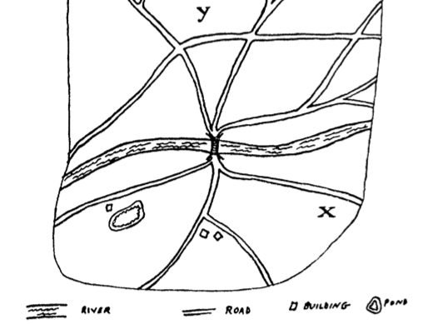
Coordination Games Pick a Focal Point to Meet

Slide 5
Another coordination game What side of the road to drive on? (does it matter so long as they agree?)
Player 2
 | Right | Left
Right | Happy, Happy | Death, Death
Left | Death, Death | Joy, Joy
Player 1

Slide 6
Promissory Accidents
Player 2
 | Thinks there’s a Promise | Rightly doesn’t think a Promise
Thinks there’s a Promise | 10, 10 | -10, 0
Rightly doesn't think a Promise | 0, -10 | 0, 0
Player 1

Slide 7
Two kinds of Promissory Accidents
False Positive
We assert something. Only it’s false.
The boy cries wolf. We believe him but it’s false.
The test says you have a disease, and you believe this, only you don’t have it

Slide 8
False Positive
We think we have a contract, only we don’t
Bailey v. West
Leonard v. Pepsico

Slide 9
Two kinds of Promissory Accidents
False Negative
You deny something. Only it’s true.
You think there is no wolf. Only there is.
The test says you don’t have the disease, only you do

Slide 10
False Negative
We don’t think we have a contract, only we do:
Lucy v. Zehmer

Slide 11
False positives and negatives
 | There is a Promise in fact | There isn’t a Promise in fact
Thinks there's a Promise | True Positive | False Positive
Doesn't think a Promise | False Negative | True Negative
Player 1

Slide 12
False positives and negatives
 | There is a Promise in fact | There isn’t a Promise in fact
Thinks there’s a Promise | True Positive | Bailey v. West, Pepsico
Doesn’t think a Promise | Lucy | True Negative
Player 1

Slide 13
Solving the coordination problem
We need clear rules that avoid bargaining accidents—like driving on the right
And we’d want the rules of offer and acceptance to provide the parties with suitable focal points where both know either that there is or isn’t an agreement

Slide 14
How to reduce promissory accidents? Offer and Acceptance
Restatement § 22(1). The manifestation of mutual assent to an exchange ordinarily takes the form of an offer or proposal by one party followed by an acceptance by the other party or parties.

Slide 15
Offers: An Objective test
Restatement § 24. An offer is the manifestation of willingness to enter into a bargain, so made as to justify another person in understanding that his assent to that bargain is invited and will conclude it.
Not the willingness but the manifestation thereof

Slide 16
Acceptance: An Objective test
Restatement § 50. Acceptance of an offer is the manifestation of assent to the terms thereof…
Not the assent but the manifestation thereof

Slide 17
How to reduce promissory accidents?
What if we could identify the party who could at least cost eliminate the accident?

Slide 18
How to reduce promissory accidents?
What if we could identify the party who could at least cost eliminate the accident?
Who was this in Bailey?

Slide 19
How to reduce promissory accidents?
What if we could identify the party who could at least cost eliminate the accident?
And in Zehmer?

Slide 20
What counts as an offer?
Offers to the Public: Offers vs. “Invitations to treat”
Unilateral contracts
Offers vs. “mere puffs”

Slide 21
Offers to the Public Courteen Seed v. Abraham 229
What did the flyer say?
F.o.b.?
C.i.f.?

Slide 22
Offers to the Public Courteen Seed v. Abraham
What did the flyer say?
“I am asking”
Could that have been accepted as an offer?

Slide 23
Offers to the Public Courteen Seed v. Abraham
What about the response to “wire firm offer”?
Could the offeree put the offeror to his election?

Slide 24
Offers to the Public Courteen Seed v. Abraham
The offeror as “master of the offer”

Slide 25
Offers to the Public Courteen Seed v. Abraham
Offer v. Invitation to treat
Why does the distinction make sense?
Christy hypothetical on page 236

Slide 26
Offers to the Public Courteen Seed v. Abraham
Offer v. Invitation to treat
Why does the distinction make sense?
Why should cheap talk be non-contractual?

Slide 27
Offers to the Public Fairmont v. Cruden-Martin 232
Can you distinguish this case?

Slide 28
Offers to the Public Fairmont v. Cruden-Martin
Can you distinguish this case?
“we quote you … for immediate acceptance”?

Slide 29
Lefkowitz 236
Offer or Invitation to Treat?

Slide 30
Lefkowitz
Do you see a problem with “worth to $100”?

Slide 31
Lefkowitz
What’s the relevance of the “house rule”?

Slide 32
Lefkowitz
Suppose that the Π had written to the Δ and said, “I accept”?
Could it be accepted in that way?

Slide 33
Lefkowitz
Suppose that the Π had written to the Δ and said, “I accept”?
Could it be accepted in that way?
Buyers could only accept by showing up with the $1.

Slide 34
Lefkowitz
Suppose that the Π had written to the Δ and said, “I accept”?
Corbin at 240: unilateral vs bilateral contracts—what is the difference?

Slide 35
Lefkowitz
Suppose that the Π had written to the Δ and said “I accept”?
Unilateral Contracts: Where the offeree can accept only by performance
Bilateral Contracts: The offeree accepts by return promise

Slide 36
Lefkowitz
In Lefkowitz, the store insisted on the offeree showing up at the store—hence a unilateral contract
And why did that matter to it?

Slide 37
Why is it so hard to get from one store to another at Pentagon Mall?
Pentagon City Mall

Slide 38
Carlill v. Carbolic Smoke Ball

Slide 39
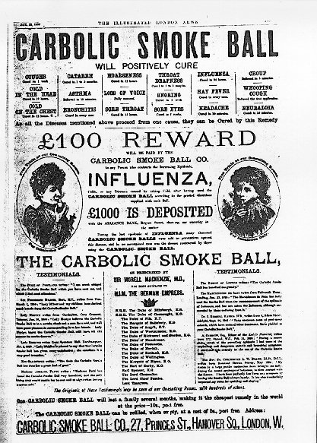
An offer to all the world?

Slide 40
A unilateral contract
It is not a contract made with all the world. There is the fallacy of that argument. It is an offer made to all the world, and why should not an offer be made to all the world which is to ripen into a contract with anybody who comes forward and performs the conditions? It is an offer to become liable to anyone, who before it is retracted performs the conditions. Per Bowen L.J.

Slide 41
A unilateral contract
This case is not like those cases in which you offer to negotiate, or you issue an advertisement that you have got a stock of books to sell or houses to let, in which case there is no offer to be bound by any contract.

Slide 42
A vagueness Problem?

Slide 43
Vagueness?
It seems to me that in order to arrive at this contract we must read it in its plain meaning as the public would understand it. It was intended to be issued to the public and to be read by the public. How would an ordinary person reading this document construe it upon the points which the defendant’s counsel has brought to our attention? It was intended unquestionably to have some effect, and I think the effect which it was intended to have was that by means of the use of the carbolic smoke ball the sale of the carbolic smoke ball should be increased.

Slide 44
Vagueness?
A plain person who read this advertisement would read it in this plain way, that if anybody after the advertisement was published used three times daily for two weeks the carbolic smoke ball and then caught cold, he would be entitled to the reward.

Slide 45
Vagueness?
Lindley, L.J., thinks that the contract would be sufficiently definite if you were to read it in the sense that the protection was to be warranted during a reasonable period after use. I have some difficulty myself on that point, but it is not necessary for me to develop it, because as I read the contract it covered the exact moment during which the disease here was contracted.

Slide 46
A “Mere Puff”
What’s a mere puff?

Slide 47
Mere puffs: Simple commendations do not oblige one

Slide 48
A mere puff?
It was intended unquestionably to have some effect…
It not only says the reward will be paid, but it says: “We have lodged £1,000 to meet it.” Therefore, it cannot be said that it was intended to be a mere puff.

Slide 49
No communication of acceptance?
Then it was said that there was no notification of the acceptance of the offer.

Slide 50
No communication of acceptance?
“The person who makes the offer may dispense with notice to himself if he thinks it desirable to do so.”
What would be the point?

Slide 51
No communication of acceptance?
If I advertise to the world that my dog is lost and that anybody who brings him to a particular place will be paid some money, are all the police or other persons whose business is to find lost dogs to be expected to sit down and write me a note saying that they have accepted my proposal?

Slide 52
No communication of acceptance?
And if the person making the offer expressly or impliedly intimates in his offer that it will be sufficient to act on the proposal without communicating acceptance of it to himself, and the offer is one which in its character dispenses with notification of the acceptance, then according to the intimation of the very person proposing the contract, performance of the condition is a sufficient acceptance.

Slide 53
Can you think of a reason why the Δ might WANT to assume liability?

Slide 54
The Law of Offers serves coordination goals
Must seem objectively like real offers
No secret reservations–Lucy v. Zehmer
More than invitations to treat--Courteen
Cannot be mere puffs--Carlill

Slide 55
Acceptances
Rest. § 22(1)
The manifestation of mutual assent to an exchange ordinarily takes the form of an offer or proposal by one party followed by an acceptance by the other party or parties.

Slide 56
Acceptances
What constitutes an acceptance?
When and how could an offeror revoke an offer
When and how could an offeree revoke an acceptance?

Slide 57
Acceptances
Rest. § 23
It is essential to a bargain that each party manifest assent with reference to the manifestation of the other.”

Slide 58
What constitutes an acceptance
Whatever the offeror wants…
Restatement 30(1) An offer may invite or require acceptance to be made by an affirmative answer in words, or by performing or refraining from performing a specified act, or may empower the offeree to make a selection of terms in his acceptance.

Slide 59
What constitutes an acceptance
Whatever the offeror wants…
So it might be unilateral of bilateral, or it might require a formal executed contract

Slide 60
Ever-Tite at 240

Slide 61
Ever-Tite
Was there a contract between the parties on June 10?
Who was the offeror and who was the offeree?

Slide 62
Ever-Tite
Was there a contract between the parties on June 10?
What kind of an offer: bilateral or unilateral?

Slide 63
Ever-Tite
Was there a contract between the parties on June 10?
Did Ever-Tite commence performance?
How serious was the reliance?

Slide 64
Webster Parish
Shreveport to Springhill:
1 h 2 min (47.3 miles), 58 min without traffic

Slide 65
Ever-Tite
Did Ever-Tite commence performance?
How long did Green wait before finding another roofer?

Slide 66
Ever-Tite
What if Green had revoked by phone the day before?

Slide 67
Ever-Tite
What if Green had revoked by phone the day before?
§42. REVOCATION BY COMMUNICATION FROM OFFEROR RECEIVED BY OFFEREE. An offeree's power of acceptance is terminated when the offeree receives from the offeror a manifestation of an intention not to enter into the proposed contract.

Slide 68
Hypotheticals at 249

Slide 69
Can an offeror delay the time of acceptance?
This agreement is not binding until signed by both parties

Slide 70
“Agreements to agree”
Ciaramella at 243

Slide 71
Ciaramella
Did Eisenberg accept?
Paragraph 10: “This … Agreement shall not be effective … until it is signed…”
Is this conclusive? Was it “an express reservation not to be beound”?

Slide 72
Ciaramella
Paragraph 13: What is a Merger Clause and why is it relevant?

Slide 73
Ciaramella
The other tests
What’s the relevance of part performance?
What’s the relevance of missing terms? And why was the reference letter so important

Slide 74
The Leval Test at 252
What is the difference between Leval’s three kinds of preliminary agreements?

Slide 75
The Leval Test
What is the difference between Leval’s three kinds of preliminary agreements?
What is the nature of the duty under the “binding preliminary commitment”?

Slide 76
George Mason School of Law
Contracts I
F. Revocation and Rejection, Counter-offers, the UCC
F.H. Buckley
fbuckley@gmu.edu

Slide 77
Today
Contracts inter absentes
The “mailbox rule”
Revocation by offeror
Rejection by offeree
Counter-offers

Slide 78
Contracts inter praesentes

Slide 79
IM’s or text messages?
§64. ACCEPTANCE BY TELEPHONE OR TELETYPE. Acceptance given by telephone or other medium of substantially instantaneously two-way communication is governed by the principles applicable to acceptances where the parties are in the presence of each other.

Slide 80
Contracts inter absentes

Slide 81
Contracts inter absentes
Buyer is in SF and Seller in NYC. Buyer sends an offer to seller and asks him to accept by signing a purchase form. Seller does so and puts the form in his back pocket for a month. Then he mails it in. Has he accepted the offer?

Slide 82
Communication of Acceptance
§56. ACCEPTANCE BY PROMISE; NECESSITY OF NOTIFICATION TO OFFEROR…. It is essential to an acceptance by promise either that the offeree exercise reasonable diligence to notify the offeror of acceptance or that the offeror receive the acceptance seasonably.
Why is this important?

Slide 83
Can the offeror waive communication of acceptance?

Slide 84
What about Carlill? Or Ever-Tite?

Slide 85
Unilateral Offers
54(1) Where an offer invites an offeree to accept by rendering a performance, no notification is necessary to make such an acceptance effective unless the offer requests such a notification.

Slide 86
Unilateral Offers
54(1) Where an offer invites an offeree to accept by rendering a performance, no notification is necessary to make such an acceptance effective unless the offer requests such a notification.
So can the offeree keep mum?

Slide 87
Unilateral Offers
54(2) If an offeree who accepts by rendering a performance has reason to know that the offeror has no adequate means of learning of the performance with reasonable promptness and certainty, the contractual duty of the offeror is discharged unless
(a) the offeree exercises reasonable diligence to notify the offeror of acceptance, or
(b) the offeror learns of the performance within a reasonable time, or
(c) the offer indicates that notification of acceptance is not required

Slide 88
The Mailbox Rule
Offeror mails offer to offeree on Sept. 1

Slide 89
The Mailbox Rule
Offeror mails offer to offeree on Sept. 1
Offeree receives offer on Sept. 10 and mails letter accepting the offer the same day.

Slide 90
The Mailbox Rule
Offeror mails offer to offeree on Sept. 1
Offeree receives offer on Sept. 10 and mails letter accepting the offer the same day.
Offeror telephones offeree on Sept. 11 to revoke the offer

Slide 91
The Mailbox Rule
Offeror mails offer to offeree on Sept. 1
Offeree receives offer on Sept. 10 and sends letter accepting the offer the same day.
Offeror telephones offeree on Sept. 11 to revoke the offer
Offeror receives offeree’s acceptance letter Sept. 13
Is there a contract?

Slide 92
Two possible standards
Offeror mails offer to offeree on Sept. 1
Offeree receives offer on Sept. 10 and sends letter accepting the offer the same day.
Offeror telephones offeree on Sept. 11 to revoke the offer
Offeror receives offeree’s acceptance letter Sept. 13
Emission Rule: Offer is accepted when acceptance letter is sent
Reception Rule: Offer is accepted when acceptance letter is received by offeror

Slide 93
The Mailbox (Emission) Rule
§63. (a) an acceptance made in a manner and by a medium invited by an offer is operative and completes the manifestation of mutual assent as soon as put out of the offeree's possession, without regard to whether it ever reaches the offeror

Slide 94
Why was the Mailbox Rule adopted 180 years ago?
What was black and white and read all over and first appeared in 1840?

Slide 95
Why was the Mailbox Rule adopted 180 years ago?
The first stamp:
The “Penny Black” of 1840

Slide 96
And why did that matter?

Slide 97
And why did that matter?

Slide 98
The Mailbox Rule
§63. TIME WHEN ACCEPTANCE TAKES EFFECT. Unless the offer provides otherwise,
(a) an acceptance made in a manner and by a medium invited by an offer is operative and completes the manifestation of mutual assent as soon as put out of the offeree's possession, without regard to whether it ever reaches the offeror

Slide 99
Emission: The Mailbox (Emission) Rule
§63. (a) an acceptance made in a manner and by a medium invited by an offer is operative and completes the manifestation of mutual assent as soon as put out of the offeree's possession, without regard to whether it ever reaches the offeror

Slide 100
The Mailbox Rule
Offeror mails offer to offeree on Sept. 1
Offeree receives offer on Sept. 10 and fedexes letter accepting the offer the same day.
Offeror telephones offeree on Sept. 11 to revoke the offer
Offeror receives offeree’s fedex Sept. 13
Is there a contract?

Slide 101
The “Mailbox Rule”: Where the acceptance isn’t mailed
§65. REASONABLENESS OF MEDIUM OF ACCEPTANCE. Unless circumstances known to the offeree indicate otherwise, a medium of acceptance is reasonable if it is the one used by the offeror or one customary in similar transactions at the time and place the offer is received.

Slide 102
The “Mailbox Rule”: Where the acceptance isn’t mailed
§ 30(2) Unless otherwise indicated…an offer invites acceptance in any manner and by any means reasonable in the circumstances.

Slide 103
The Mailbox Rule?
Offeror fedexes offer to offeree on Sept. 1
Offeree receives offer on Sept. 3 and mails letter accepting the offer the same day.
Offeror telephones offeree on Sept. 4 to revoke the offer
Offeror receives offeree’s letter on Sept. 5
Is there a contract?

Slide 104
When the Mailbox Rule doesn’t apply
Restatement §67. Where an acceptance is seasonably dispatched but the offeree uses means of transmission not invited by the offer or fails to exercise reasonable diligence to insure safe transmission, it is treated as operative upon dispatch if received within the time in which a properly dispatched acceptance would normally have arrived.

Slide 105
The Mailbox Rule
Restatement §67. Where an acceptance is seasonably dispatched but the offeree uses means of transmission not invited by the offer or fails to exercise reasonable diligence to insure safe transmission, it is treated as operative upon dispatch if received within the time in which a properly dispatched acceptance would normally have arrived.

Slide 106
The Mailbox Rule
Restatement §67. Where an acceptance is seasonably dispatched but the offeree uses means of transmission not invited by the offer or fails to exercise reasonable diligence to insure safe transmission, it is treated as operative upon dispatch if received within the time in which a properly dispatched acceptance would normally have arrived.
So when would the Fedex of an acceptance have arrived?

Slide 107
The Mailbox Rule
Why is the mailbox (emission) rule superior to a reception rule?
It’s the rule in both common and civil law—why?

Slide 108
The Mailbox Rule
Compared to a reception rule?
Evidentiary: what is easier to prove: emission or reception?

Slide 109
The Mailbox Rule
Compared to a reception rule?
Evidentiary: what is easier to prove: emission or reception?
Things ever get lost in the mailroom? Kinda on purpose?

Slide 110
The Mailbox Rule
Compared to a reception rule?
Celerity: under which rule does at least one party first know he has a contract?

Slide 111
The Mailbox Rule
What if the offeree mis-addresses the envelope?
University Emergency at 256
Who takes the risk of misdelivery?

Slide 112
Mis-addressed letters?
Restatement §67. Where an acceptance is seasonably dispatched but the offeree uses means of transmission not invited by the offer or fails to exercise reasonable diligence to insure safe transmission, it is treated as operative upon dispatch if received within the time in which a properly dispatched acceptance would normally have arrived.
Qu. University Emergency

Slide 113
The Mailbox Rule
What if the offeree had communicated his acceptance by email and it ends up in the offeror’s spam folder?

Slide 114
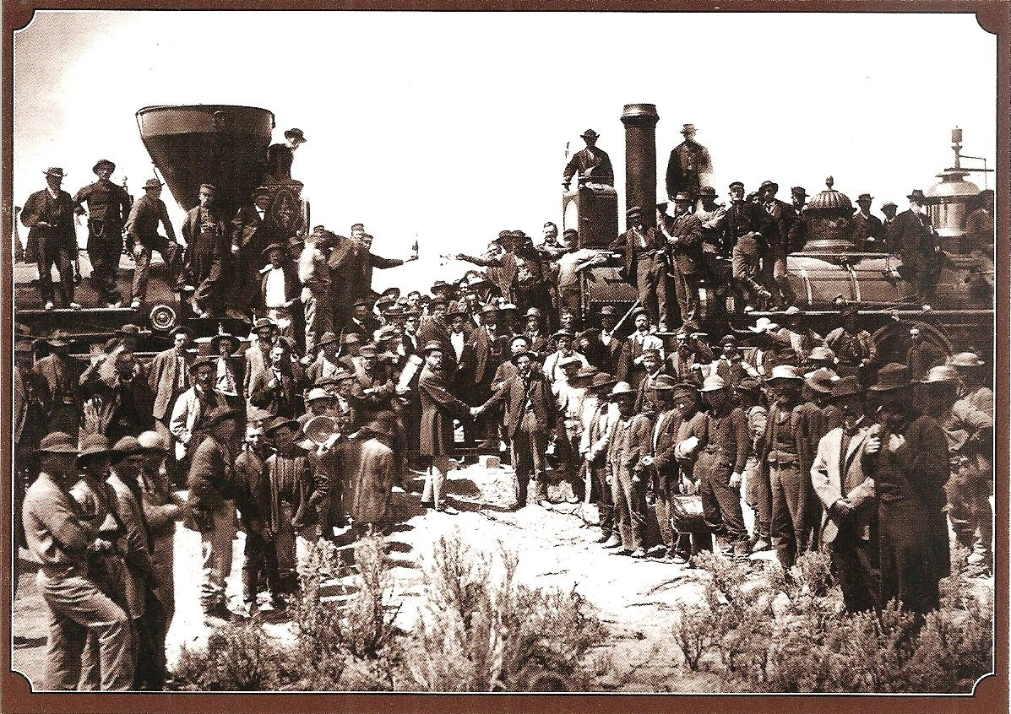
Offer and Acceptance solves the Coordination Problem
But what if they want to back out?

Slide 115
Revocation of Offer
Restatement § 36(1). An offeree’s power of acceptance may be terminated by
(c) revocation by the offeror

Slide 116
Revocation
Offeror mails offer to offeree on Sept. 1

Slide 117
Revocation
Offeror mails offer to offeree on Sept. 1
Offeree receives offer on Sept. 10 and sends letter accepting the offer the same day.

Slide 118
Revocation
Offeror mails offer to offeree on Sept. 1
Offeree receives offer on Sept. 10 and sends letter accepting the offer the same day.
Offeror telephones on Sept. 9 to revoke the offer.

Slide 119
Revocation
Offeror mails offer to offeree on Sept. 1
Offeree receives offer on Sept. 10 and sends letter accepting the offer the same day.
Offeror telephones on Sept. 9 to revoke the offer.
Is there a contract?

Slide 120
Revocation
Restatement § 42. An offeree’s power of acceptance is terminated when the offeree receives from the offeror a manifestation of intent not to enter into the proposed contract.

Slide 121
Revocation
Offeror mails offer to offeree on Sept. 1
Offeree receives offer on Sept. 10 and sends letter accepting the offer the same day.
Offeror telephones on Sept. 9 to revoke the offer.
So no contract

Slide 122
Revocation
Offeror mails offer to offeree on Sept. 1
Offeree receives offer on Sept. 10 and sends letter accepting the offer the same day.
Offeror mails revocation letter on Sept. 9 which offeree receives on Sept. 12.
Is there a contract?

Slide 123
Revocation
Restatement § 42. An offeree’s power of acceptance is terminated when the offeree receives from the offeror a manifestation of intent not to enter into the proposed contract.

Slide 124
Revocation
Restatement § 42. An offeree’s power of acceptance is terminated when the offeree receives from the offeror a manifestation of intent not to enter into the proposed contract.
So a contract

Slide 125
Revocation
Restatement § 42. An offeree’s power of acceptance is terminated when the offeree receives from the offeror a manifestation of intent not to enter into the proposed contract.
Can you see why we need a reception rule for offeror revocations if we have an emission rule for offeree acceptances?

Slide 126
Rejection by offeree
Offeror mails offer to offeree on Sept. 1

Slide 127
Rejection by offeree
Offeror mails offer to offeree on Sept. 1
Offeree receives this on Sept. 8 and mails a rejection letter on Sept. 9.

Slide 128
Rejection by offeree
Offeror mails offer to offeree on Sept. 1
Offeree receives this on Sept. 8 and mails a rejection letter on Sept. 9.
Offeree changes his mind and accepts the offer by phone on Sept. 11.

Slide 129
Rejection by offeree
Offeror mails offer to offeree on Sept. 1
Offeree receives this on Sept. 8 and mails a rejection letter on Sept. 9.
Offeree changes his mind and accepts the offer by phone on Sept. 11.
Offeror receives the rejection letter on Sept. 12. Is there a contract?

Slide 130
Revocation
Restatement § 40. Rejection or counter-offer by mail … does not terminate the power of acceptance until received by the offeror…
So the phoned-in acceptance is valid

Slide 131
Silence as acceptance
I leave my car at your house with a note that I will consider you to have bought it at $5,000 unless within a week you call me to tell me that you have rejected it. You fail to do so. Is there a sale?

Slide 132
Silence as acceptance
I leave my car at your house with a note that I will consider you to have bought it at $5,000 unless within a week you call me to tell me that you have rejected it. You fail to do so. Is there a sale?
What if you take the car for a spin once? A dozen times?

Slide 133
ACCEPTANCE BY SILENCE OR EXERCISE OF DOMINION
Restatement §69. (1) Where an offeree fails to reply to an offer, his silence and inaction operate as an acceptance in the following cases only:
(a) Where an offeree takes the benefit of offered services with reasonable opportunity to reject them and reason to know that they were offered with the expectation of compensation.

Slide 134
ACCEPTANCE BY SILENCE OR EXERCISE OF DOMINION
Restatement §69. (1) Where an offeree fails to reply to an offer, his silence and inaction operate as an acceptance in the following cases only:
(b) Where the offeror has stated or given the offeree reason to understand that assent may be manifested by silence or inaction, and the offeree in remaining silent and inactive intends to accept the offer.
(c) Where because of previous dealings or otherwise, it is reasonable that the offeree should notify the offeror if he does not intend to accept.

