Slide 1
George Mason School of Law
Contracts I
C. Quasi-contract and Restitution
F.H. Buckley
fbuckley@gmu.edu

Slide 2
What do you have to know to be an educated person in 2023?

Slide 3
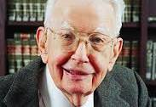
Bargaining Theories
Ronald Coase

Slide 4
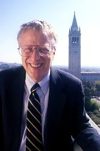
Bargaining Theories
You want to buy a used car. You know that 50 percent
of the are valueless and 50 percent are worth $5,000.
You can’t tell which the car is before you buy it.
The seller knows the car’s quality.
What do you offer to pay for it?
”The Market for Lemons,” 84 QJE 488 (1970)
George Akerlof

Slide 5
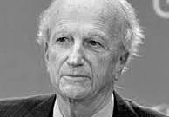
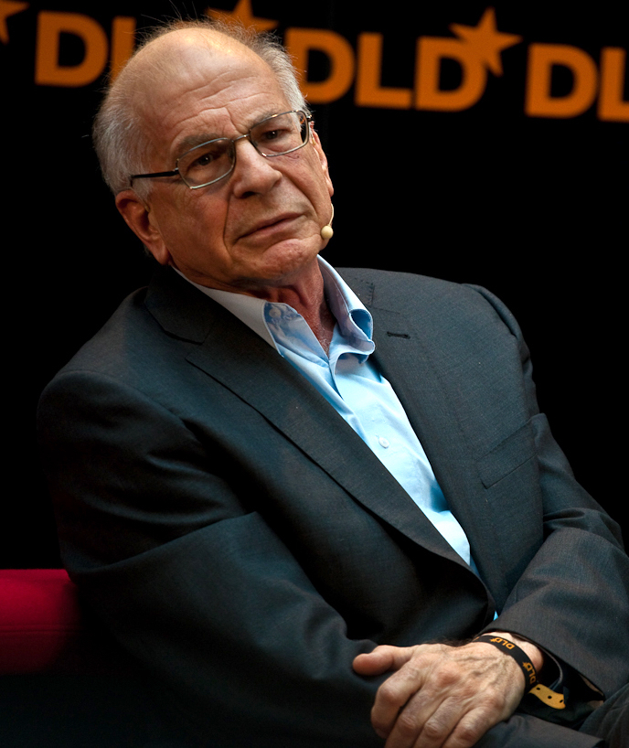
Bargaining Theories
Gary Becker
Daniel Kahneman
Michael Spence

Slide 6
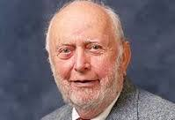
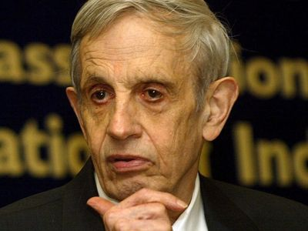
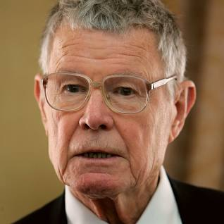
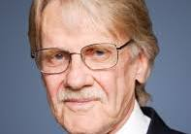
Institutions and Game Theory
Doug North
John Nash
Vern Smith
Tom Schelling

Slide 7
Gordon Tullock and Jim Buchanan

Slide 8
Ideas we’ve covered
Corrective and Distributive Justice
Procedural and Substantive Justice
Ex ante vs. ex post
Sanctity of Contracts
vs. unconscionability

Slide 9
Ideas we’ve covered
Games and PD Games
Tragedy of the Commons
Indifference curves and subjective preferences
Cardinal and Ordinal Utility
Diminishing Marginal Utility
Expectation and Reliance Interests
Detrimental and Beneficial Reliance
Paretian standards

Slide 10
Expanding Contract into Quasi-Contract
The centrality of promises in contract law
Does an action lie for a performance even where there is no promise?
Quasi-contract, unjust enrichment, restitution

Slide 11
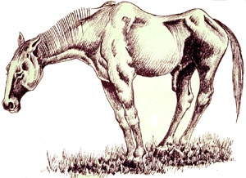
Just what does “ties of natural justice and equity” mean?
In the circumstances of Bailey v. West?

Slide 12
Bailey v. West
Strauss West
Trainer
Kelly (driver)
Bailey

Slide 13
Bailey v. West
Was there a contract “implied in fact”?

Slide 14
Bailey v. West
Restatement § 19 CONDUCT AS MANIFESTATION OF ASSENT
(1) The manifestation of assent may be made wholly or partly by written or spoken words or by other acts

Slide 15
The Five Guys hypothetical p. 12

Slide 16
Does reliance always ground a remedy
Jack hears that Orange Inc., a High-Tech firm, is looking for employees. Working for Orange has always been Jack’s dream. However, Orange won’t hire anyone who hasn’t taken a one-year certificate program on code-writing from a university. So Jack quits his current job and takes the course. After completion he applies to Orange for a job. But Orange turns him down.

Slide 17
Bailey v. West
Restatement § 19 CONDUCT AS MANIFESTATION OF ASSENT
(1) The manifestation of assent may be made wholly or partly by written or spoken words or by other acts or by failure to act.

Slide 18
Day v. Caton p. 14

Slide 19
Bailey v. West
Restatement § 19 CONDUCT AS MANIFESTATION OF ASSENT
(1) The manifestation of assent may be made wholly or partly by written or spoken words or by other acts or by failure to act.
(2) The conduct of a party is not effective as a manifestation of his assent unless he intends to engage in the conduct and knows or has reason to know that the other party may infer from his conduct that he assents.
(3) The conduct of a party may manifest assent even though he does not in fact assent.

Slide 20
Bailey v. West
What if there had been prior dealings between Bailey and West?

Slide 21
What is an implied at law contract?

Slide 22
What is an implied at law contract?
Quasi-contract
Quantum meruit
Unjust Enrichment
Restitution

Slide 23
Bailey v. West
When is quasi-contractual liability imposed?

Slide 24
Bailey v. West
When is quasi-contractual liability imposed?
Benefit conferred on defendant by plaintiff
Appreciation by defendant of the benefit
Acceptance and retention of benefit by defendant where it would be inequitable to retain the benefit without payment

Slide 25
Bailey v. West
When is quasi-contractual liability imposed?
Is consent by the recipient necessary?

Slide 26
Bailey v. West
When is quasi-contractual liability imposed?
Is consent by the recipient necessary?
You ask me as your agent to trade your horse for a cow. I do so, and get a bribe of $100 which I pocket

Slide 27
Bailey v. West
When is quasi-contractual liability imposed?
Is the recipient’s consent irrelevant?

Slide 28
Consent and the definition of a benefit?
I think orange aluminum siding is neat. When you are on holiday, I cover your house with it. This raises the market price of the house.

Slide 29
What is a benefit?
No recovery for “officious” benefits from “volunteers”
What does this mean and just how do you tell?

Slide 30
What is a benefit?
How would you decide the dog case at page 15?

Slide 31
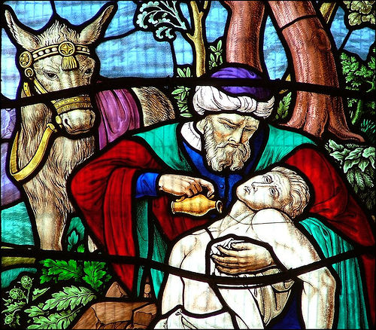
What is a benefit?
What about the Good Samaritan?

Slide 32
What is a benefit?
What’s the difference between aluminum siding and the Good Samaritan?

Slide 33
What is a benefit?
In what way is the aluminum siding example unlike the day laborer in Day v. Caton?

Slide 34
What is a benefit?
In what way is the aluminum siding example unlike the day laborer?
The informational problem
How might the informational problem be cured?

Slide 35
What is a benefit?
So what would you have advised Bailey?

Slide 36
George Mason School of Law
Contracts I
D. Offers
F.H. Buckley
fbuckley@gmu.edu

Slide 37
Offers Basic Questions of Formation on Contract
Who are the parties?
What did they agree to?
Where is the contract?
When was it made?
Why?

Slide 38
Who are the parties? Restatement § 2
(1) A promise is a manifestation of intention to act or refrain from acting in a specified way, so made as to justify a promisee in understanding that a commitment has been made.
(2) The person manifesting the intention is the promisor. [Offeror]
(3) The person to whom the manifestation is addressed is the promisee. [Offeree]
(4) Where performance will benefit a person other than the promisee, that person is a beneficiary.

Slide 39
What to do with third parties
A and B agree that, if A gives B $100, B will give C $100
Can C sue on the promise?
The doctrine of privity of contract

Slide 40
What to do with third parties
Join them as parties
Where you can’t, create a trust
Settlor—trustee--beneficiary
Rely on Restatement § 302?

Slide 41
Third Party Beneficiaries Restatement § 302
(1) Unless otherwise agreed between promisor and promisee, a beneficiary of a promise is an intended beneficiary if recognition of a right to performance in the beneficiary is appropriate to effectuate the intention of the parties and
the performance of the promise will satisfy an obligation of the promisee to pay money to the beneficiary;

Slide 42
Third Party Beneficiaries Restatement § 302
Unless otherwise agreed between promisor and promisee, a beneficiary of a promise is an intended beneficiary if recognition of a right to performance in the beneficiary is appropriate to effectuate the intention of the parties and either
(b) the circumstances indicate that the promisee intends to give the beneficiary the benefit of the promised performance.

Slide 43
What did the parties agree to?
What are the terms of the contract?
Are there conditions to the contract?
Implied conditions, mistake, frustration

Slide 44
Where was it formed? Private International Law
The lex loci contrahendi: where was the contract made in fact
Choice of law clauses: “This contract is deemed to have been made in the state of ____ and is governed by its laws and the laws of the United States applicable therein.”

Slide 45
When was the contract formed?
What counts as a contract
Offer and Acceptance
Pre-contract duties?

Slide 46
Why was the contract made?
The doctrine of consideration

Slide 47
What counts as a contract?
2(1) A promise is a manifestation of intention to act or refrain from acting in a specified way, so made as to justify a promisee in understanding that a commitment has been made.
The need for a “meeting of the minds” in Walker-Thomas

Slide 48
What counts as a contract?
2(1) A promise is a manifestation of intention to act or refrain from acting in a specified way, so made as to justify a promisee in understanding that a commitment has been made.
What does this exclude?

Slide 49
Social promises
(1) A promise is a manifestation of intention to act or refrain from acting in a specified way, so made as to justify a promisee in understanding that a commitment has been made.
“I expect to see you at lunch tomorrow”

Slide 50
Statements of intention, Wishes
(1) A promise is a manifestation of intention to act or refrain from acting in a specified way, so made as to justify a promisee in understanding that a commitment has been made.
I may sell my car to you

Slide 51
Statements of intention, Wishes
(1) A promise is a manifestation of intention to act or refrain from acting in a specified way, so made as to justify a promisee in understanding that a commitment has been made.
I intend to sell my car to you?

Slide 52
Secret reservations
The equivocator: “I will sell you my car tomorrow” (while privately resolving not to do so)

Slide 53
The Objective Standard
Restatement § 2(1) A promise is a manifestation of intention to act or refrain from acting in a specified way, so made as to justify a promisee in understanding that a commitment has been made.
A remedy for “false promising”

Slide 54
Lucy v. Zehmer at p. 16

Slide 55
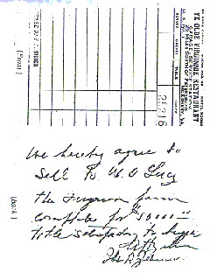
Lucy v. Zehmer at p. 14

Slide 56
Ye Olde Virginia Restaurant

Slide 57
The Ferguson Farm

Slide 58
Why does the drinking matter?

Slide 59
The Capacity to Enter into a Contract
What was the test in Lucy?

Slide 60
The Capacity to Enter into a Contract
What was the test in Lucy?
Did the sellers understand “the nature and consequences of the instrument”?

Slide 61
Why does the drinking matter?
Capacity: Restatement § 16
(1) A person incurs only voidable contractual duties by entering into a transaction if the other party has reason to know that by reason of intoxication (a) he is unable to understand in a reasonable manner the nature and consequences of the transaction,

Slide 62
Why does the drinking matter?
Capacity: Restatement § 16
(1) A person incurs only voidable contractual duties by entering into a transaction if the other party has reason to know that by reason of intoxication (a) he is unable to understand in a reasonable manner the nature and consequences of the transaction, or
(b) he is unable to act in a reasonable manner in relation to the transaction

Slide 63
Capacity isn’t enough
Consent needed in addition to capacity
Recall the need for a “meeting of the minds” in Walker-Thomas

Slide 64
Lucy v. Zehmer
What if Zehmer didn’t really intend to sell?

Slide 65
Lucy v. Zehmer
What if Zehmer didn’t really intend to sell?
An Objective standard
“Nevertheless the evidence shows that Lucy did not … understand it” as a joke

Slide 66
Lucy v. Zehmer
I receive an offer to buy my house. I write “I accept” and sign it, then put the letter in my drawer. Have I accepted the offer?

Slide 67
Lucy v. Zehmer
In face-to-face bargaining, I take up a written offer, write “I accept” on it and sign it. Then I put it on the table. Have I accepted the offer?

Slide 68
Lucy v. Zehmer
In face-to-face bargaining, I take up a written offer, write “I accept” on it and sign it. Then I put it on the table. Have I accepted the offer?
How did Stevie Wonder send his letters?

Slide 69
Lucy v. Zehmer
In face-to-face bargaining, I take up a written offer, write “I accept” on it and sign it. Then I put it on the table.
“Signed, sealed and delivered”

Slide 70
Lucy v. Zehmer
In face-to-face bargaining, I take up a written offer, write “I accept” on it and sign it. Then I put it on the table.
The offeree picks up the paper. Have I accepted the offer?

Slide 71
Lucy v. Zehmer
In face-to-face bargaining, I take up a written offer, write “I accept” on it and sign it. Then I put it on the table.
The offeree picks up the paper. Have I accepted the offer?
“with no request that … he give it back”

Slide 72
Lucy v. Zehmer
Suppose Lucy knew that Zehmer acted in jest?

Slide 73
Lucy v. Zehmer
Suppose Lucy knew that Zehmer acted in jest?
Restatement §20. EFFECT OF MISUNDERSTANDING
(1) There is no manifestation of mutual assent to an exchange if the parties attach materially different meanings to their manifestations and
(a) neither party knows or has reason to know the meaning attached by the other; or
(b) each party knows or each party has reason to know the meaning attached by the other.

Slide 74
Lucy v. Zehmer
Why are instant retractions not permitted?

Slide 75
Lucy v. Zehmer
What remedy is sought and why did that matter?
The role of equity

Slide 76
Lucy v. Zehmer
Why couldn’t Zehmer retract two minutes later?
Has there been either any beneficial or detrimental reliance at that point?

Slide 77
Leonard v. Pepsico at 21

Slide 78
Leonard v. Pepsico at 18
Was this really an offer to sell a jet for 7,000,000 points, or $700,000?

Slide 79
Leonard v. Pepsico at 18
“No objective person could reasonably have concluded that the commercial actually offered consumers a Harrier Jet.”

Slide 80
Leonard v. Pepsico at 18

Slide 81
Bargains: Rest. § 3
A bargain is an agreement to exchange promises or to exchange a promise for a performance or to exchange performances.

Slide 82
Bargains: Rest. § 3
A bargain is an agreement to exchange promises or to exchange a promise for a performance or to exchange performances.
Wholly executory contracts: promise for promise
Wholly executed contracts: performance for performance

Slide 83
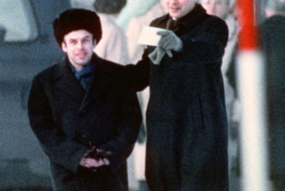
A wholly executed contract: Gleinicke Bridge, Berlin, 1986

