Slide 1
George Mason School of Law
Contracts I
A. Introduction
F.H. Buckley
fbuckley@gmu.edu

Slide 2
Course materials
The Casebook
The Statutory Supplement
The UCC
The Restatement
2

Slide 3
Attendance
This is a professional school
The seating chart and my calling on you
Compulsory attendance and the 20 percent rule (more than three classes)
Let me know if you skip a class, or if you’re ill
3

Slide 4
Office Hours
Thursdays: Noon to 400???
Email me anytime at fbuckley@gmu.edu to ask a question or set up a meeting
After a class, PowerPoint slides will be posted at http://buckleysmix.com

Slide 5
The Exam: Both Practice and Final
Open Code
The grading guidelines: 3.20 to 3.30
Optional upgrade based on classroom performance
5

Slide 6
The Exam: Both Practice and Final
How to prepare
Essay Questions
Issue Spotters
Citing authorities
Shotgun vs. conciseness
6

Slide 7
The Substantive Law
Contracts I Materials
Formation
Offer and Acceptance
Consideration
Statute of Frauds
Mid-term Exam
Relational Contracts
7

Slide 8
1. The Substantive Law
Contracts II Materials
When we shouldn’t enforce a contract
Illegality, Capacity, Fraud, Duress
What’s in the contract
Terms, Conditions
Excuses
Mistake, Frustration
Remedies
8

Slide 9
Integrating Law and Econ
A Law & Econ introduction in class 2
Why and when should contracts be enforceable?
9

Slide 10
Thinking like a Lawyer
Just why is there a casebook?
Why stories?
Why not just study the rules in the UCC and the Restatement?

Slide 11
Why the resistance to rules is good news for you
The iron law of the new economy: anything which can be turned into an algorithm is going to be done by a computer, and not by a person
E.g., document vetting on discovery
11

Slide 12
The Study of Law
It’s not geometry
12

Slide 13
Should Judges be replaced with AI?

Slide 14
How do you learn how to become the person you should be?
Joan Didion: We’re story-telling animals
Can moral requirements be reduced to a set of rules?
Les miserables
How do we learn the virtues?
14

Slide 15
The name of a case (case citation)
Williams v. Walker-Thomas Furniture Co.

Slide 16
Williams at 62
Williams v. Walker-Thomas Furniture Co.
District of Columbia Court of Appeals
198 A.2d 914 (1964)

Slide 17
How did it end up here?
Williams v. Walker-Thomas Furniture Co.
District of Columbia Circuit Court of Appeals
350 F.2d 445 (1965)
A court of national jurisdiction, but the appeals court for DC

Slide 18
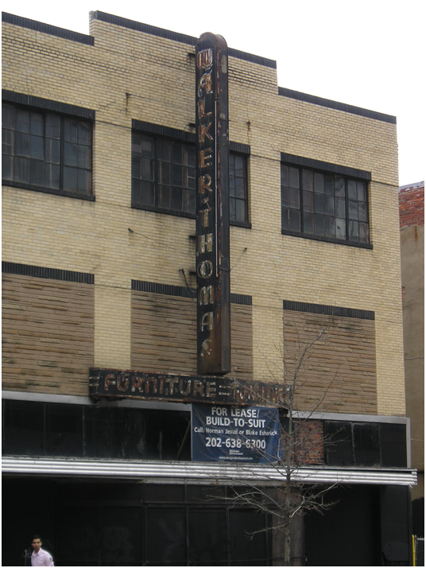
Walker-Thomas Furniture Store 1074 Seventh St. NW (at L)
18

Slide 19
Williams v. Walker-Thomas
19

Slide 20
The procedural aspect
Who sued?
And what remedy is sought?
The forms of action

Slide 21
What gave Walker-Thomas a right of replevin?

Slide 22
What gave Walker-Thomas a right of replevin?
Conditional Sale: Title to remain in seller until all goods paid for

Slide 23
What gave Walker-Thomas a right of replevin?
Today under UCC Article 9:
(Security Interest) (Possession)
Secured Party Debtor

Slide 24
Do we have a problem with this?
Secured lending?
UCC 9-201. General Validity of Security Agreement. Except as otherwise provided by this Act, a security agreement* is effective according to its terms between the parties, against purchasers of the collateral and against creditors.
*A security agreement creates a security interest in collateral

Slide 25
What gave Walker-Thomas a right of replevin?
What was the “rather obscure clause” that permitted Walker-Thomas to repossess Mrs. Williams’ bed.

Slide 26
What gave Walker-Thomas a right of replevin?
How would you have drafted the clause?
How do you think things should work?
Do you have an intuition about the just way to account for the security interest in the collateral?

Slide 27
One Intuition: Security Interest with FIFO
 |  | Sale Price | Cash Payment | Amount Owed | Security Interest Good I | Security Interest Good II
Time 1 | Good I | 100 | 50 | 50 | 50 | ---
Time 2 | Good 2 | 100 | 50 | 100 | 0 | 100
First in, First Out:
Payments applied to discharge
earliest security interests

Slide 28
Security Interest with Cross-Collateral Clause
 |  | Sale Price | Cash Payment | Amount Owed | Security Interest Good I | Security Interest Good II
Time 1 | Good I | 100 | 50 | 50 | 50 | ---
Time 2 | Good 2 | 100 | 50 | 100 | 50 | 50

Slide 29
When there’s a full paydown
 |  | Sale | Payment | Cross-collateral Interest in Good 1 | Cross-collateral Interest in Good 2
Time 1 | Good 1 | 100 | 100 | 0 | ---
Time 2 | Good 2 | 100 | 0 | 0 | 100

Slide 30
Quinn on vitiating factors
What is the difference between “a lack of meeting of the minds” and “contracts against public policy,” per Quinn J.

Slide 31
Substantive vs. Procedural Unconscionability
No “meeting of the minds” a matter of procedural unconscionability
Why did Quinn say there was a meeting of the minds?

Slide 32
Substantive vs. Procedural Unconscionability
No “meeting of the minds” a matter of procedural unconscionability
Why did Quinn say there was a meeting of the minds?
Do you accept this?

Slide 33
Substantive vs. Procedural Unconscionability
But there’s still a question of substantive unconscionability
Substantive: The clause is never enforceable, even if agreed to consciously by a person of full capacity

Slide 34
Substantive Unconscionability
Are there some bargains that are so vicious that they should be outlawed, even if the parties consent to them?

Slide 35
An example of contract law illegality
Cf. 9-204(b)(1) A security interest does not attach under a term constituting an after-acquired property clause to consumer goods
Why might you agree with this?

Slide 36
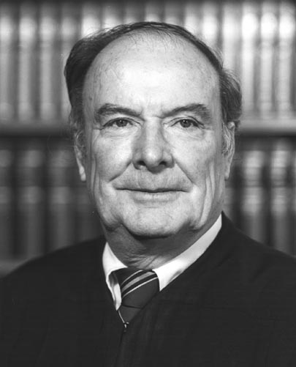
What amounts to procedural unconscionability per Skelly Wright?

Slide 37
What did Skelly Wright say amounts to procedural unconscionability?
Absence of meaningful choice together with unreasonable terms
Gross inequality of bargaining power
Manner of contracting
Education of the parties
Maze of fine print

Slide 38
Was there an “absence of meaningful choice”?

Slide 39
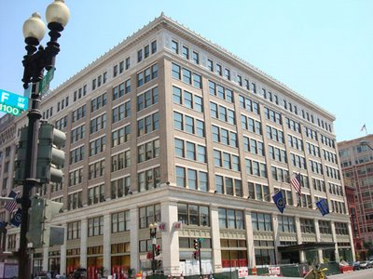
Why didn't she shop at Woodward & Lothrop? 10 blocks from Walker-Thomas

Slide 40
Or Garfinckel’s? 11 Blocks from Walker-Thomas

Slide 41
What happened to Walker-Thomas? 1074 Seventh St. NW (at L)
When did it
go dark,
do you think?
41

Slide 42
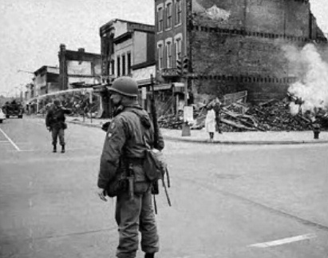
Seventh Street NW, April 5, 1968 What happened the day before?

Slide 43
Seventh Street NW, April 5, 1968 What happened the day before?
Is this relevant to the study of Contracts?
Or to Walker-Thomas?

Slide 44
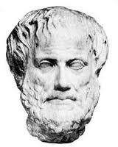
What would Aristotle say about the relevance of the Riots?

Slide 45
What are his two kinds of justice?

Slide 46
Distributive Justice
How would Aristotle allocate goods as a matter of distributive justice?

Slide 47
Distributive Justice
How would Aristotle allocate goods as a matter of distributive justice?
[I]f the persons are not equal they must not have equal shares; in fact this is the very source of all the quarrelling and wrangling in the world,

Slide 48
Distributive Justice
How would Aristotle allocate goods as a matter of distributive justice?
Democrats identify merit with the status of freeman, supporters of oligarchy with wealth (or with noble birth), and supporters of aristocracy with excellence.

Slide 49
Distributive Justice
How would Aristotle allocate goods as a matter of distributive justice?
Where would you look for distributive justice in the law today?

Slide 50
Corrective Justice
The justice in transactions between man and man is a sort of equality indeed, and the injustice a sort of inequality

Slide 51
Corrective Justice How would this apply in tort law?
This kind of injustice being an inequality, the judge tries to equalize it; for in the case also in which one has received and the other has inflicted a wound, or one has slain and the other been slain, the suffering and the action have been unequally distributed; but the judge tries to equalize by means of the penalty, taking away from the gain of the assailant….

Slide 52
Corrective Justice How would this apply in contract law?
If the division is made out of common property, the shares will bear the same proportion to one another as the original contributions did: and the Unjust which is opposite to this Just is that which violates the proportionate.

Slide 53
Corrective Justice How would this apply in contract law?
For it makes no difference whether a good man has defrauded a bad man or a bad man a good one, … the law looks only to the distinctive character of the injury, and treats the parties as equal

Slide 54
What would Aristotle say about the relevance of the Riots?

Slide 55
What did Skelly Wright say amounts to procedural unconscionability?
Absence of meaningful choice together with unreasonable terms
Gross inequality of bargaining power
Manner of contracting
Education of the parties
Maze of fine print

Slide 56
Back to Walker-Thomas
“Gross inequality of bargaining power”
Is the inequality lessened when you purchase at Macy’s?

Slide 57
“Gross inequality of bargaining power”
OMG!!!
$22.99!!!
I think we can do better than that, don’t you?
“An absence of meaningful choice” unless we can dicker?
57

Slide 58
“Gross inequality of bargaining power”
If there is inequality, how would you expect the merchant to exploit his market power?
By raising the price or inserting an unwanted clause in the contract?

Slide 59
How the Sopanos made money from gardening
Paulie wonders where this guy came from

Slide 61
Gross inequality in bargaining power
Who was Ora Lee Williams?
If you had to describe her in one word, what would that word be?

Slide 62
So what was the problem?
Did she understand the nature of the transaction?
Did the signature count?
Did she give her consent to the clause?
Per Danaher?

Slide 63
“Gross inequality of bargaining power”
Do you want to argue that Mrs. Williams was a person of diminished capacity?
If so, please explain…

Slide 64
“Gross inequality of bargaining power”
Please list the categories of people who should not be permitted to enter into contracts

Slide 65
“Gross inequality of bargaining power”
Is her poverty relevant?

Slide 66
“Gross inequality of bargaining power”
Is her poverty relevant?
You mean we let poor people enter into contracts!?!

Slide 67
“Gross inequality of bargaining power”
Is her lack of education relevant?
You mean we let people without university credentials enter into contracts!?!

Slide 68
An informational problem?
Maze of fine print
Commercially unreasonable

Slide 69
Standard Form Contracts
Why do vendors employ them?
69

Slide 70
Standard Form Contracts
Would Skelly Wright enforce any consumer contract based on a standard form?
No “objective manifestation of consent”
70

Slide 71
Did it matter what was purchased?
71

Slide 72
Manner of contracting
“Man does not live by bread alone…
He also needs
strawberry jam.”
Lionel Trilling
72

Slide 73
The Seven Children
Do they come into it?
73

