Slide 1
Structure of Liberty
F.H. Buckley, Scalia Law School
fbuckley@gmu.edu, fhbuckley.com

Slide 2
Your papers

Slide 3
John Dickinson

Slide 4
George Mason

Slide 5
James Madison

Slide 6
James Wilson

Slide 7
Benjamin Franklin

Slide 8
Gouverneur Morris

Slide 9
Alexander Hamilton

Slide 10
Roger Sherman

Slide 11
Oliver Ellsworth

Slide 12
George Washington, 1787

Slide 13
Your Papers

Slide 14
Themes
1. Secession
2. Virtue: Filtration and Nationalism
3. An economic perspective
4. Separation of Powers and the Presidency
5. Slavery
6. Division of Powers, Feds vs States

Slide 15
Secession
Bigness and Badness (or goodness)
What was the status of the Articles?
What are the duties of the seceding state?
What is the government of the RoUSA to do?
How could a secession agreement be worked out?
Nullification and Interposition in 1798 and 1832

Slide 16
Virtue
1. Product Differentiation: Monarchies and Corruption
2. Country and Court Parties in America
3. Disinterested Republican Virtue
4. Extensive Virtue and Bigness
5. Bottom-up (Tea Party) or top-down (filtration)

Slide 17
An Economic Perspective
1. How bad were the Articles? Could principles of comity suffice?
2. How bad was the New Jersey Plan?
3. Did Article One make sense from an economic perspective?
4. Does strong presidentialism make sense?

Slide 18
The Presidency
1. How did we end up with James Wilson’s constitution?
2. Is it such a bad thing? Or are we headed in a bad direction?
3. What happened to all the other presidential regimes?

Slide 19
Slavery
Who was anti-slavery—and who freed their slaves?
How should slaves count for the allocation of representatives, and which system most favored the slaves?

Slide 20
The three-fifths clause: June 11
How are presidents elected?

Slide 21
The “Revolution” of 1800 Jefferson 73 electoral votes (60 w/o the 3/5 clause) Adams 65 electoral votes (63 w/o the 3/5 clause)

Slide 22
Sovereignty
Blackstone on the Sovereignty of Parliament
The nationalists on national supremacy

Slide 23
The National Veto
Madison’s Paradox and the vote against him: June 8
The problem of interstate exploitation and state punitive awards

Slide 24
Division of Powers

Slide 25
The Residual Power
Tenth Amendment: The powers not delegated to the United States by the Constitution, nor prohibited by it to the States, are reserved to the States respectively, or to the people.
BNA § 91. It shall be lawful for the Queen, by and with the Advice and Consent of the Senate and House of Commons, to make Laws for the Peace, Order, and good Government of Canada, in relation to all Matters not coming within the Classes of Subjects by this Act assigned exclusively to the Legislatures of the Provinces;

Slide 26
Enumerated Provincial Powers
BNA § 92(13) In each province the Legislature may exclusively make laws in relation to matters coming within the classes of subjects next herein-after enumerated; that is to say, … Property and Civil Rights in the Province

Slide 27
Sir John A. Macdonald on the American Constitution: “One of the most skilful works which human intelligence ever created; it is one of the most perfect organizations that has ever governed a free people.”

Slide 28
The Virginia Plan and the BNA Act
Virginia Plan
Voters elect House
House chooses Senators
Congress chooses Pres.
National Veto
BNA Act 1867
Voters elect House
House chooses PM
PM chooses Senate
National Veto

Slide 29
The Opposition to the Virginia Plan
1. Exceeding Congressional Authorization
2. The Single President
3. Excessive Centralization

Slide 30
A Runaway Convention?
The vote on May 30: 6 to 1
Conn. No
NY Divided

Slide 31
A Runaway Convention?
Mason on June 4: The Articles have been dissolved by the Convention

Slide 32
The Single President
The fetus of monarchy: Edmond Randolph
A more dangerous monarchy, an elective one: George Mason
The vote on June 4: 7 for a single president, 3 against

Slide 33
How is the president elected?
Roll call 12 on June 2
8 to 2

Slide 34
James Wilson: The Lonely Democrat
June 1: The experience of NY and MA
June 2: PA votes no on Roll Call 12

Slide 35
Excessive Centralization

Slide 36
Sherman on June 6: Small is beautiful

Slide 37
John Dickinson arrives May 29 Delaware binds delegates hands

Slide 38
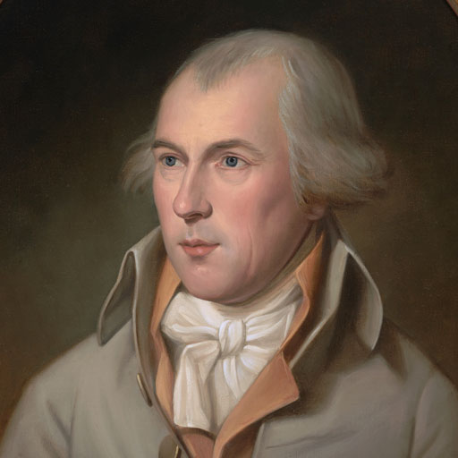
See note on June 15

Slide 39
Dickinson on federalism
“The accidental lucky division of this country”: June 2

Slide 40
How are senators chosen?
1. Who appoints: The House under the Virginia Plan, or the States
2. Equal representation by state or proportional representation by population

Slide 41
Who appoints senators: June 7
Who appoints: The House under the Virginia Plan, or the States
Dickinson wins the first trick: 10 to 0

Slide 42
Dickinson vs. Madison: June 7
2. Equal representation by state or proportional representation by population

Slide 43
New Jersey weighs in: June 9
2. Equal representation by state or proportional representation by population

Slide 44
Sherman weighs in: June 11
2. Equal representation by state or proportional representation by population

Slide 45
Wilson on Secession: June 9
2. Equal representation by state or proportional representation by population

Slide 46
But that’s not how it’s going to end up
Equal representation by state or proportional representation by population
June 11 Vote: 6 to 5 The small states lose on June 11

Slide 47
US 2016 Election
Electoral College
GOP 304
Dems 227
Popular Vote
Dems 65,854,000
GOP 62,985,000

Slide 48
Canadian 2019 Election
Number of Seats in House
Liberals 184
Conservatives 99
Popular Vote
Conservatives 6,239,000
Liberals 6,019,000

