Slide 1
Structure of Liberty
F.H. Buckley, Scalia Law School
fbuckley@gmu.edu, fhbuckley.com

Slide 2
Jefferson’s “assembly of demigods”

Slide 3
Jefferson’s “assembly of demigods”
You may have been taught to respect the Characters of the Members of the late Convention. You may have supposed that they were an assemblage of great men. There is nothing less true. From the Eastern states there were Knaves and Fools, from the states southward of Virginia they were a parcel of Coxcombs and from the middle states Office Hunters not a few.
George Mason in 1788, Farrand Supplement, 295.

Slide 4
What are the building blocks of history?
Facts
The narrative turn

Slide 5
The Arguments for Nationalism
1. Bigness is Goodness
2. Filtration Cures all ills
3. As does the Separation of Powers

Slide 6
1. Bigness as Goodness

Slide 7
Madison: Big is beautiful…in 1787
If an enlargement of the sphere is found to lessen the insecurity of private rights, it is not because the impulse of a common interest or passion is less predominant in this case with the majority; but because a common interest or passion is less apt to be felt and the requisite combinations less easy to be formed by a great than by a small number. The Society becomes broken into a greater variety of interests, of pursuits, of passions, which check each other, whilst those who may feel a common sentiment have less opportunity of communication and concert. It may be inferred that the inconveniences of popular States contrary to the prevailing Theory, are in proportion not to the extent, but to the narrowness of their limits.
--Vices Essay

Slide 8
Montesquieu VIII.16: Bigness is badness
IT is natural for a republic to have only a small territory; otherwise it cannot long subsist. In an extensive republic there are men of large fortunes, and consequently of less moderation: there are trusts too considerable to be placed in any single subject; he has interests of his own; he soon begins to think that he may be happy and glorious by oppressing his fellow-citizens; and that he may raise himself to grandeur on the ruins of his country.
In an extensive republic, the public good is sacrificed to a thousand private views; it is subordinate to exceptions, and depends on accidents. In a small one, the interest of the public is more obvious, better understood, and more within the reach of every citizen; abuses have less extent, and of course are less protected.

Slide 9
2. Filtration as a cure for natural self-interest

Slide 10
Madison on the Impossibility of Private Virtue
How easily are base and selfish measures, masked by pretexts of public good and apparent expediency? How frequently will a repetition of the same arts and industry which succeeded in the first instance, again prevail on the unwary to misplace their confidence?

Slide 11
Madison on the impossibility of Private Virtue
A still more fatal if not more frequent cause lies among the people themselves. All civilized societies are divided into different interests and factions, as they happen to be creditors or debtors—Rich or poor—husbandmen, merchants or manufacturers—members of different religious sects—followers of different political leaders—inhabitants of different districts—owners of different kinds of property &c &c. In republican Government the majority however composed, ultimately give the law. Whenever therefore an apparent interest or common passion unites a majority what is to restrain them from unjust violations of the rights and interests of the minority, or of individuals?

Slide 12
Charles Beard

Slide 13
Hume on filtration
In a large government, which is modelled with masterly skill, there is compass and room enough to refine the democracy, from the lower people, who may be admitted into the first elections or first concoction of the commonwealth, to the higher magistrates, who direct all the movements.

Slide 14
Madison on Filtration
An auxiliary desideratum for the melioration of the Republican form is such a process of elections as will most certainly extract from the mass of the Society the purest and noblest characters which it contains; such as will at once feel most strongly the proper motives to pursue the end of their appointment, and be most capable to devise the proper means of attaining it..

Slide 15
3. Separation of Powers

Slide 16
Madison on how to form a government without Private Virtue
The great desideratum in Government is such a modification of the Sovereignty as will render it sufficiently neutral between the different interests and factions, to controul one part of the Society from invading the rights of another, and at the same time sufficiently controuled itself, from setting up an interest adverse to that of the whole Society.

Slide 17
Do you agree?
“When the legislative and executive powers are united in the same person, or in the same body of magistrates, there can be no
liberty. -- Montesquieu

Slide 18
How would you rank the US on RoL?

Slide 19
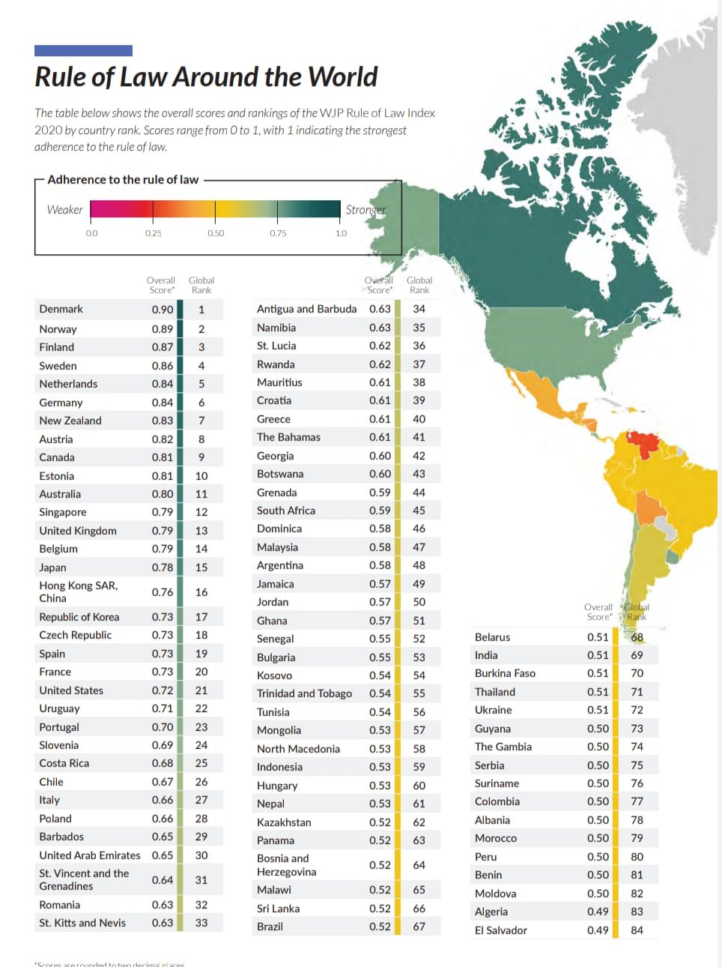
World Justice Project
2020

Slide 20
How would you rank the US on RoL? (There are about 30 first world countries)
Are government powers constrained by legislature ?
Are government powers sanctioned by NGO checks?
Do government officers use office for private gain?
Are laws publicly available in plain language?
Are laws applied w/o discrimination?
Is crime is effectively controlled?
Is civil justice free from political influence?

Slide 21
How would you rank the US on RoL?
Government powers constrained by legislature 28/140
Government powers sanctioned by NGO checks 28/140
Government officers do not use office for private gain 33/140
Laws publicly available in plain language 33/140
Laws applied w/o discrimination 103/140
Crime is effectively controlled 51/140
Civil justice free from political influence 38/140

Slide 22
Pluralism as a political theory
I stand for straight Americanism unconditioned and unqualified, and I stand against every form of hyphenated Americanism. I do not speak of the hyphen when it is employed as a mere convenience, although personally, I like to avoid its use even in such manner. I speak and condemn its use whenever it represents an effort to form political parties along racial lines or to bring pressure to bear on parties and politicians, not for American purposes, but in the interest of some group of voters of a certain national origin, or of the country from which they or their fathers came.
Theodore Roosevelt as an anti-pluralist, 1915

Slide 23
The Virginia Plan
Were the delegates authorized to propose this?
See May 30 discussion and vote

Slide 24
The Virginia Plan
Would you call this a separation of powers?
How does it illustrate the filtration principle?
How does it centralize power in the national govt?

Slide 25
The Virginia Plan
Art. 8: “to call forth the force of the Union agst. any member of the Union failing to fulfil its duties under the articles thereof.”
When do you think the federal government should be permitted to invade a state? 1957? 1861?

Slide 26
When can the federal government invade a state?
James Buchanan
The worst American president?

Slide 27
James Buchanan in Dec. 1860: There is no right of secession
The old Articles of Confederation were entitled “Articles of Confederation and Perpetual Union between the States,” and by the thirteenth article it is expressly declared that “the articles of this Confederation shall be inviolably observed by every State, and the Union shall be perpetual.” The preamble to the Constitution of the United States, having express reference to the Articles of Confederation, recites that it was established “in order to form a more perfect union.” And yet it is contended that this “more perfect union” does not include the essential attribute of perpetuity.

Slide 28
James Buchanan: Secession is illegal, but what am I to do?
What, in the meantime, is the responsibility and true position of the Executive? He is bound by solemn oath, before God and the country, “to take care that the laws be faithfully executed,” and from this obligation he can not be absolved by any human power. But what if the performance of this duty, in whole or in part, has been rendered impracticable by events over which he could have exercised no control? …

Slide 29
James Buchanan: But what am I to do?
The Executive has no authority to decide what shall be the relations between the Federal Government and South Carolina.
The question fairly stated is, Has the Constitution delegated to Congress the power to coerce a State into submission which is attempting to withdraw or has actually withdrawn from the Confederacy? If answered in the affirmative, it must be on the principle that the power has been conferred upon Congress to declare and to make war against a State. After much serious reflection I have arrived at the conclusion that no such power has been delegated to Congress or to any other department of the Federal Government.

Slide 30
And Madison agreed with me Would Madison have thought Virginia had a right to secede?
It appears from the proceedings of that body that on the 31st May, 1787, the clause “authorizing an exertion of the force of the whole against a delinquent State” came up for consideration. Mr. Madison opposed it in a brief but powerful speech, from which I shall extract but a single sentence. He observed:
“The use of force against a State would look more like a declaration of war than an infliction of punishment, and would probably be considered by the party attacked as a dissolution of all previous compacts by which it might be bound.”

Slide 31
Slavery was not on the table The proposed Thirteenth Amendment, 1861
No amendment shall be made to the Constitution which will authorize or give to Congress the power to abolish or interfere, within any State, with the domestic institutions thereof, including that of persons held to labor or service by the laws of said State.

Slide 32
Lincoln’s First Inaugural, March 4, 1861
I understand a proposed amendment to the Constitution--which amendment, however, I have not seen--has passed Congress, to the effect that the Federal Government shall never interfere with the domestic institutions of the States, including that of persons held to service. To avoid misconstruction of what I have said, I depart from my purpose not to speak of particular amendments so far as to say that, holding such a provision to now be implied constitutional law, I have no objection to its being made express and irrevocable.

Slide 33
Lincoln’s First Inaugural, March 4, 1861
I have no purpose, directly or indirectly, to interfere with the institution of slavery in the States where it exists. I believe I have no lawful right to do so, and I have no inclination to do so.
The power confided to me will be used to hold, occupy, and possess the property and places belonging to the Government and to collect the duties and imposts; but beyond what may be necessary for these objects, there will be no invasion, no using of force against or among the people anywhere

Slide 34
But a day after Fort Sumter April 15, 1861

Slide 35
The Virginia Convention votes for secession, two days later on April 17, 1861

Slide 37
Alexandria occupied the next day, May 24, 1961 Historia facit saltus

Slide 38
How the Articles were to be amended
Article XIII. And the Articles of this confederation shall be inviolably observed by every state, and the union shall be perpetual; nor shall any alteration at any time hereafter be made in any of them, unless such alteration be agreed to in a congress of the united states, and be afterwards con-firmed by the legislatures of every state.

Slide 39
How the 1787 Constitution provided it would come into effect
Article VII
The Ratification of the Conventions of nine States, shall be sufficient for the Establishment of this Constitution between the States so ratifying the Same.

Slide 40
Was Washington’s first term a nullity?
The ninth state, New Hampshire, ratifies the Constitution on June 21, 1788
Congress certifies the election of Washington as president, on April 6, 1789
The last state, Rhode Island, ratifies the Constitution on May 29, 1790

Slide 41
The Status of Secession Rights in International Law
Reference re Secession of Quebec, [1998] 2 SCR 217
Securis iudicat orbis terrarum

Slide 42
The Second Branch
The June 1 Discussion

Slide 43
The Second Branch
How many presidents should we have?
Is a single executive the fetus of monarch?
The vote on June 4

Slide 44
Anthony, Octavian, Lepidus

Slide 45
The Second Branch
How elected in the Virginia Plan?
Term limited

Slide 46
The Second Branch
How elected in the Virginia Plan?
Roll call 12 on June 2

Slide 47
The Second Branch
With powers “to enjoy the executive rights” in the Virginia Plan
Cf. Sherman on June 1

Slide 48
The Royal Prerogative

Slide 49
Was Franklin right?
“There is a natural inclination in mankind for kingly government”

Slide 50
Dickinson on federalism
“The accidental lucky division of this country”: June 2

