Slide 1
George Mason School of Law
Contracts II
A. Common Law Illegality
F.H. Buckley
fbuckley@gmu.edu

Slide 2
We’ve discussed why promises should be binding
Now: when should they not be binding?

Slide 3
The next five weeks
Now: when should they not be binding?
Common Law Illegality: Immoral Choices
Self-regarding harms and Paternalism
Other-regarding harms and Externalities
Self-Defeating Choices
Vices of Capacity
Vices of Consent: fraud, duress

Slide 4
John Stuart Mill
On Liberty, 1859; The Subjection of Women, 1861

Slide 5
Mill’s harm principle
“The only purpose for which power can rightfully be exercised over any member of a civilized community, against his will, is to prevent harm to others.”
Self-regarding harms don’t provide a basis for state interference by a paternalist
Eg, drug laws

Slide 6
Mill’s harm principle
“The only purpose for which power can rightfully be exercised over any member of a civilized community, against his will, is to prevent harm to others.”
Was Sir George Jessel a Millian?

Slide 7
The Harm Principle
So what does that leave?
Other-regarding harms: Externalities
Physical harms
Economic harms?
Psychic harms?

Slide 8
The Harm Principle
So what does that leave?
Other-regarding harms: Externalities
Children, etc.…
“The time when mankind have become capable of being improved by free and equal discussion”

Slide 9
Was Mill a Moralist?
Mill rejects moral relativism
It really is of importance, not only what men do, but also what manner of men they are that do it. Among the works of man, which human life is rightly employed in perfecting and beautifying, the first in importance surely is man himself.

Slide 10
The Moral Relativist
The Dude:
Yeah, well, like that’s your opinion, man

Slide 11
The moral landscape
Moral Relativism: Each individual is the source of his personal moral judgment and there is no external basis for morality (relativism)
Moralism: Choices may be second-guessed, even when the individual holds it sincerely

Slide 12
Moral Choices
Morals | Moralism | Moral Relativism

Slide 13
Should the law enforce morality?
Morals | Moralism | Moral Relativism
Law | Common Law Illegality | Neutralism

Slide 14
Mill is a neutralist as well as a Moralist
Morals | Moralism | Moral Relativism
Law | Common Law Illegality | Neutralism

Slide 15
Mill on Abstract Right
What does this mean?
It is proper to state that I forego any advantage which could be derived to my argument from the idea of abstract right as a thing independent of utility. I regard utility as the ultimate appeal on all ethical questions
What argument has Mill given up here?

Slide 16
Mill’s Private Moralism
What does this mean?
It is proper to state that I forego any advantage which could be derived to my argument from the idea of abstract right as a thing independent of utility. I regard utility as the ultimate appeal on all ethical questions
So: Only prudential limits to the enforcement of morals

Slide 17
The Legal Response
Statutory and Common Law Illegality

Slide 18
Statutory and Common Law Illegality
Contracts rendered illegal by statute: Watts v. Malatesta 481
Contracts illegal at common law: Baby M 487

Slide 19
Watts at 481
What happened…

Slide 20
Watts
Π Δ
Lost and paid $37,500
Lost and paid net $100,000
Π sues to recover his losses.
Can Δ offset against this claim
his far greater losses to Π?

Slide 21
Gambling: Criminal Sanctions
VA § 18.2-325.
1. "Illegal gambling" means the making, placing or receipt, of any bet or wager in this Commonwealth of money or other thing of value, made in exchange for a chance to win a prize, stake or other consideration or thing of value, dependent upon the result of any game, contest or any other event the outcome of which is uncertain or a matter of chance…
NY § 991 in Watts

Slide 22
Gambling: Common Law Illegality
VA § 11-14. Gaming contracts void.
Except as otherwise provided in this section, all wagers, conveyances, assurances, and all contracts and securities whereof the whole or any part of the consideration is money or other valuable thing won, laid, or bet, at any game, horse race, sport or pastime, and all contracts to repay any money knowingly lent at the time and place of such game, race, sport or pastime, to any person for the purpose of so gaming, betting, or wagering, or to repay any money so lent to any person who shall, at such time and place, so pay, bet or wager, shall be utterly void.
NY § 992 in Watts

Slide 23
But it’s OK when we do it
§ 11-14. Gaming contracts void.
Except as otherwise provided in this section, all wagers, conveyances, assurances, and all contracts and securities whereof the whole or any part of the consideration is money or other valuable thing won, laid, or bet, at any game, horse race, sport or pastime, and all contracts to repay any money knowingly lent at the time and place of such game, race, sport or pastime, to any person for the purpose of so gaming, betting, or wagering, or to repay any money so lent to any person who shall, at such time and place, so pay, bet or wager, shall be utterly void.
Notwithstanding any other provision of law, a contract governing the distribution of state lottery proceeds shall be valid and enforceable as between the parties to the contract.

Slide 24
Watts
What does Ex turpi causa oritur non actio mean?
24

Slide 25
Watts
What does Ex turpi causa oritur non actio mean?
Contract void as to future performance
No recovery for past debts
25

Slide 26
Watts
How as this changed by NY § 994?
26

Slide 27
Watts
How as this changed by NY § 994?
“any person” can recover gambling losses
But not a professional gambler
27

Slide 28
Watts
What does In pari delicto potior est conditio defendentis mean?
Crane’s dissenting judgment: Both in pari delicto
28

Slide 29
Why should gambling be stigmatized?
Virginia Constitution of 1776
SEC. 15. That no free government, or the blessings of liberty, can be preserved to any people, but by a firm adherence to justice, moderation, temperance, frugality, and virtue, and by frequent recurrence to fundamental principles.
Sumptuary laws?

Slide 30
George Mason School of Law
Contracts II
A. Common Law Illegality
F.H. Buckley
fbuckley@gmu.edu

Slide 31
The real problem
Is every contract made in breach of statute void for illegality?

Slide 32
Simple regulations with no criminal penalty attached
One in three U.S. workers requires a license, up from one in twenty sixty years ago
Dick M. Carpenter and Lisa Knepper, “License to Work: A National Study—Burdens from Occupational Licensing, Institute for Justice” (2012).
If breached, what are the consequences in contract law?

Slide 33
Should yoga studios be licensed?
“Yoga practitioners experience, love abundance and true fulfillment in their lives”: Deepak Chopra

Slide 34
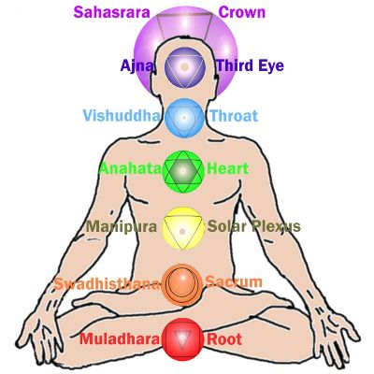
I assume you’ve all had your chakras aligned recently
34

Slide 35
I assume you’ve all had your chakras aligned recently
A customer at a yoga studio runs up a tab of $1,000. The studio is not licensed as it is required to be.
35

Slide 36
Not every breach of a stature makes a contract unenforceable
Restatement § 181. If a party is prohibited from doing an act because of his failure to comply with a licensing, registration or similar requirement, a promise in consideration of his doing that act or of his promise to do it is unenforceable on grounds of public policy if
(a) the requirement has a regulatory purpose, and
(b) the interest in the enforcement of the promise is clearly outweighed by the public policy behind the requirement.

Slide 37
Not every breach of a stature makes a contract unenforceable
What’s the opposite of a regulatory purpose?

Slide 38
Not every breach of a stature makes a contract unenforceable
What’s the opposite of a regulatory purpose?
Taxation
Cartelization

Slide 39
A sells pharmaceuticals to B. The drugs have not received FDA approval.

Slide 40
A sells funeral caskets to B, without complying with a casket fee of $4,000.
St. Joseph Abbey v. Castille, 712 F.3d 215 (5th Cir., 2013), cert. den. 134 S. Ct. 423 (2013).
Restatement 179: A public policy against the enforcement of promises may be derived by the court from the need to protect [the public against restraint of trade]

Slide 41
A special problem in the regulatory state?

Slide 42
Common Law Illegality
That was contracts illegal by statute—but what about contracts illegal at common law?

Slide 43
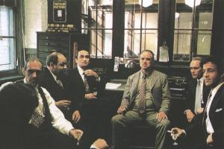
Common Law Illegality
Restatement § 192 ff. Promises to commit a tort

Slide 44
Common Law Illegality Restatement § 178(1): Unenforceability on Grounds of Public Policy
(1) A promise or other term of an agreement is unenforceable on grounds of public policy if legislation provides that it is unenforceable or the interest in its enforcement is clearly outweighed in the circumstances by a public policy against the enforcement of such terms.

Slide 45
Common Law Illegality Restatement § 178(2)
(2) In weighing the interest in the enforcement of a term, account is taken of
(a) the parties' justified expectations,
(b) any forfeiture that would result if enforcement were denied, and
(c) any special public interest in the enforcement of the particular term.

Slide 46
Common Law Illegality Restatement § 178(3): Unenforceability on Grounds of Public Policy
(3) In weighing a public policy against enforcement of a term, account is taken of:
the strength of that policy as manifested by legislation or judicial decisions,
(b) the likelihood that a refusal to enforce the term will further that policy,
(c) the seriousness of any misconduct involved and the extent to which it was deliberate, and
(d) the directness of the connection between that misconduct and the term.

Slide 47
Common Law Illegality: Baby M at 487
What happened?

Slide 48
The Whiteheads
Why did she enter into the contract?

Slide 49
The Sterns
Why did the Sterns not have their own children?

Slide 50
Recall Mill’s harm principle
“The only purpose for which power can rightfully be exercised over any member of a civilized community, against his will, is to prevent harm to others.”
How would Mill have decided Baby M?

Slide 51
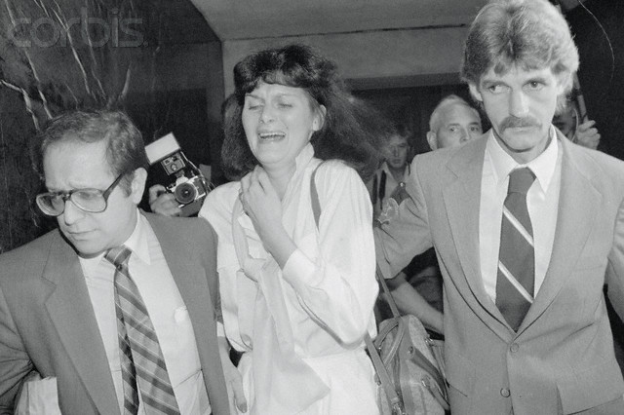
Baby M
Which family would you want to win?

Slide 52
Who wrote this attack on free bargaining?
.
It has pitilessly torn asunder the motley feudal ties that bound man to his “natural superiors,” and has left remaining no other nexus between man and man than naked self-interest, than callous “cash payment.” It has drowned the most heavenly ecstasies of religious fervor, of chivalrous enthusiasm, of philistine sentimentalism, in the icy water of egotistical calculation.

Slide 53
Nothing ever goes away
Exploitation
Class Conflict

Slide 54
Suppose that surrogacy became a major industry, such that more than 20 percent of births, happened in this way. Would that trouble you?

Slide 55
Class Conflict?
Suppose that surrogacy became a major industry, such that more than 20 percent of births, happened in this way. Would that trouble you?
“The highest bidders will presumably become the adoptive parents.”

Slide 56
Class Conflict?
How about the sale of kidneys?
The sale of children?
“There are, in a civilized society, some things that money cannot buy”

Slide 57
So what did the court hold?
Why was it contrary to statute?

Slide 58
So what did the court hold?
Why was it contrary to public policy?

Slide 59
Surrogacy Contracts
Qu if Dr Whitehead had not been the natural father?
Was Mrs. Whitehead a step-mother, from the perspective of evolutionary biology?

Slide 60
How would you draft a surrogacy contract?

Slide 61
How would you draft a surrogacy contract?
The Triumph of the Therapeutic: Philip Reiff
“There is not the slightest suggestion that any inquiry will be made at any time to determine the fitness of the Sterns as adoptive parents, their superiority to Mrs Whitehead…”

Slide 62
George Mason School of Law
Contracts II
A. Common Law Illegality
F.H. Buckley
fbuckley@gmu.edu

Slide 63
The Enforcement of Morals
Imagine a game in which players pay for the privilege of hunting with bows and arrows puppies that are bred for the purpose of being hunted.
Would this harm anyone, apart from the puppies?

Slide 64
Promises detrimental to marriage
Restatement § 190(1): a contract is illegal “if it would change some essential incident in the marriage relationship in a way detrimental to the public interest”
Is that inconsistent with the harm principle?
64
Notes:
64

Slide 65
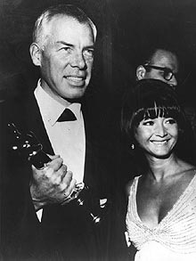
Marriage: Marvin at 499
Does the state have
an interest in promoting
marriage?
Palimony: Lee Marvin and
Michelle Triola
65

Slide 66
Marriage: Hewitt at 499
Does marriage matter?
Glasco (and the casebook) describe the Hewitt’s relationship as “merely lacking legal formality”
Suppose there were tax incentives to being single: Would you suggest a divorce to your spouse, for that reason…
There was this kerfuffle about gay marriage a few year s back. What was that all about?\

Slide 67
What counts as a harm for Mill: Externalities
Externalities are the third-party effects where my actions either confer a benefit or impose a cost on others.
67

Slide 68
Spillover social harms?
I fully admit that the mischief which a person does to himself, may seriously affect, both through their sympathies and their interests, those nearly connected with him, and in a minor degree, society at large.

Slide 69
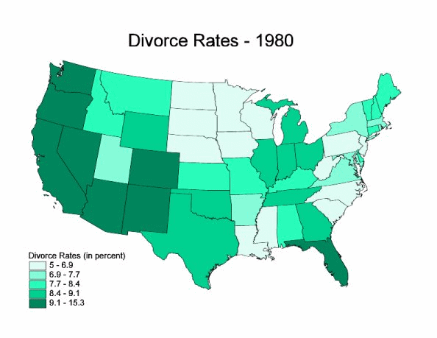
Social Capital: Do norms rub off on other people?
69
Notes:
69

Slide 70
Mill on the argument from social externalities
“So monstrous a principle is far more dangerous than any single interference with liberty; there is no violation of liberty which it would not justify; it acknowledges no right to any freedom whatever, except perhaps to that of holding opinions in secret, without ever disclosing them”
Mill on slippery slopes

Slide 71
Slippery Slopes
In a slippery slope, I want to do A and do not want to do B.
But if I do A I am led into doing B.

Slide 72
Slippery Slopes
In a slippery slope, I want to do A and do not want to do B.
But if I do A I am led into doing B.
Is there a fallacy here?

Slide 73
Slippery Slopes
In a slippery slope, I want to do A and do not want to do B. But if I do A I am led into doing B.
Is there a fallacy here?
If I do A, did I really prefer B to not-B?
Regret is a cheap emotion

Slide 74
Slippery Slopes
In a slippery slope, I want to do A and do not want to do B. But if I do A I am led into doing B.
Is there a fallacy here?
Or is this an informational problem?

Slide 75
Slippery Slopes at the extremes: Perfectionists and Neutralists
The Perfectionist fears that a slight change in moral habits will lead to the Decline and Fall of our civilization.
75
Notes:
75

Slide 76
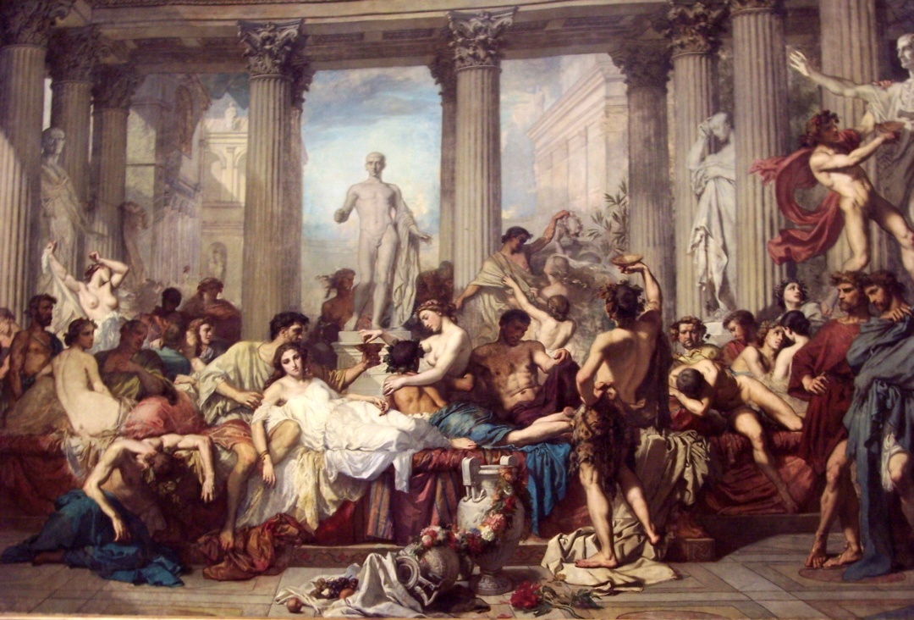
The Extreme Perfectionist looks at Rome Couture, Les Romains de la décadence, 1847
76
Notes:
76

Slide 77
Neutralism and Slippery Slopes
The Extreme Neutralist fears that any enforcement of morals will lead to the most severe restrictions on liberty by the Morality Police.

Slide 78
Mill on social sanctions as a substitute for law
But disinterested benevolence can find other instruments to persuade people to their good, than whips and scourges, either of the literal or the metaphorical sort. I am the last person to undervalue the self-regarding virtues; they are only second in importance, if even second, to the social. It is equally the business of education to cultivate both.

Slide 79
The toleration of harmless eccentrics
There is no exclusiveness in our public life, and in our private business we are not suspicious of one another, nor angry with our neighbor if he does what he likes; we do not put on sour looks at him which, though harmless, are not pleasant. we are prevented from doing wrong by respect for the authorities and for the laws, having a particular regard to those which are ordained for the protection of the injured as well as those unwritten laws which bring upon the transgressor of them the reprobation of the general sentiment. -- Pericles, Funeral Oration
–

Slide 80
The range of social sanctions for legal behavior
 | Harmless Eccentric | Harmful Deviant
Accept | Periclean Liberals | Ultra-liberals
Blame | Prudes | Conservatives

Slide 81
Mill on Social sanctions
But disinterested benevolence can find other instruments to persuade people to their good, than whips and scourges, either of the literal or the metaphorical sort. I am the last person to undervalue the self-regarding virtues; they are only second in importance, if even second, to the social. It is equally the business of education to cultivate both.
But might social sanctions seem too weak?
Do we need anti-discrimination laws?

Slide 82
Can the state be trusted to enforce morals?
“But the strongest of all the arguments against the interference of the public with purely personal conduct, is that when it does interfere, the odds are that it interferes wrongly, and in the wrong place.”

Slide 83
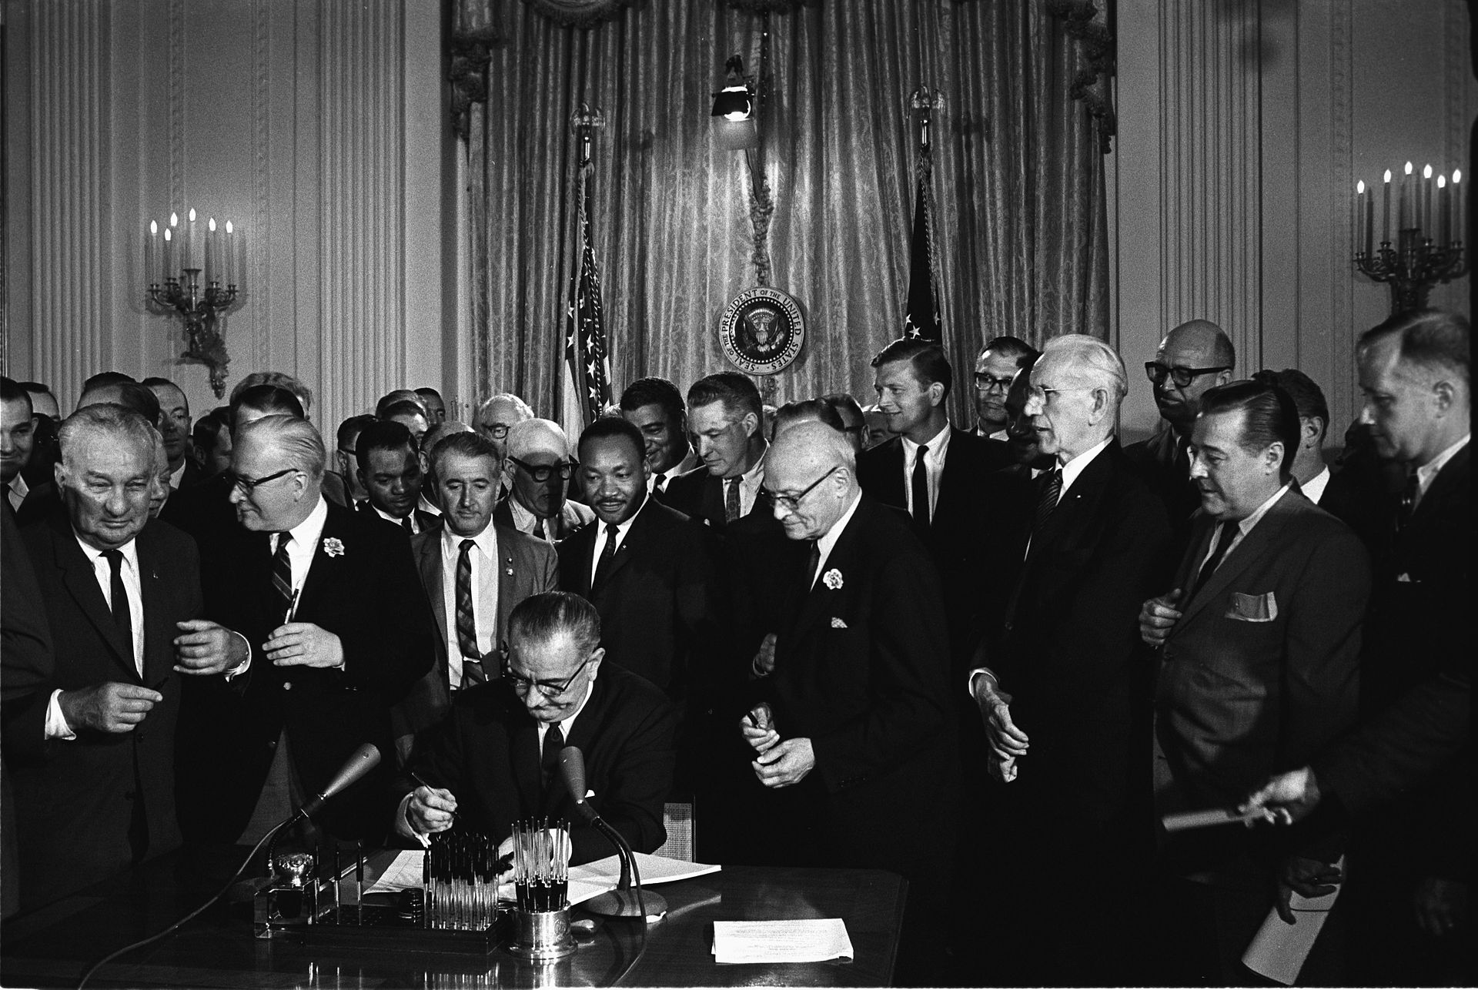
Can the state be trusted to legislate morals?
President Johnson signs the 1964 Civil Rights Act

