Slide 1
George Mason School of Law
Contracts II
J. Warranties
This file may be downloaded only by registered students in my class, and may not be shared by them
F.H. Buckley
fbuckley@gmu.edu

Slide 2
Conditions and Warranties
Promises
Conditions Warranties
Election
Forfeiture
Damages
Damages only

Slide 3
Warranties
With a warranty a seller assumes a risk as to the product
The prior question is whether the risk should be born by the seller or the buyer

Slide 4
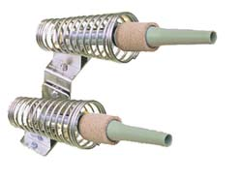
Warranties: Let’s say seller sells a whizbang
$999.99 at Home Depot

Slide 5
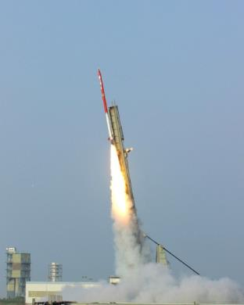
The whizbang
50% chance of a whiz
It might go whiz

Slide 6
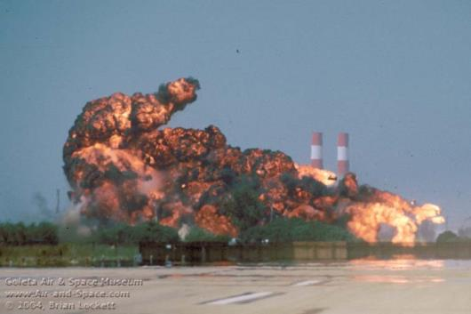
The whizbang
50% chance of a whiz, 50% of a bang
It might go whiz … or it might go bang …

Slide 7
Evaluating risk: Expected Values
The expected monetary value of an accident is p*L

Slide 8
Evaluating risk: Expected Values
The expected monetary value of an accident is p*L
  where p is the probability of occurrence
  And L is the cost of the accident on occurence

Slide 9
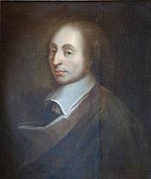
Pascal’s Wager

Slide 10
Pascal’s Wager
 | God Exists | God Doesn’t Exist
I Believe | I go to Heaven | Nothing Happens
I don’t believe | I go to Hell | Nothing Happens

Slide 11
Pascal’s Wager
 | God Exists | God Doesn’t Exist
I believe | p(+ ∞) | (1-p)-10
I don’t believe | p(- ∞) | (1-p)10

Slide 12
Pascal’s Wager
 | God Exists | God Doesn’t Exist
I Believe | + ∞ | - 10
I don’t believe | - ∞ | + 10
Is there a flaw in the reasoning?

Slide 13
Pascal’s Wager
 | God Exists | God Doesn’t Exist
I Believe | + ∞ | - 10
I don’t believe | - ∞ | + 10
If so—he still had to invent
probability theory to make it work

Slide 14
Back to the Whizbang
So the expected monetary value for an accident with a 50 percent probability of a loss of $250 is $125

Slide 15
Back to the Whizbang
So the expected monetary value for an accident with a 50 percent probability of a loss of $250 is $125
We’d want to assign the risk to the least-cost risk avoider
  Whether in contract or tort

Slide 16
Back to the Whizbang
We’d want to assign the risk to the least-cost risk avoider
  Contract or tort joined at the hip historically in the action on the case
    Prosser at 660

Slide 17
Who is the Least-Cost Risk Avoider
There are four ways of thinking about this

Slide 18
Who is the Least-Cost Risk Avoider
There are four ways of thinking about this
  Who can best fix the problem
  Who knows most about it
  Who is risk neutral and who risk averse
  The large-number diversified party

Slide 19
The Least-Cost Risk Avoider
Seller sells a whizbang to Buyer for $1,000, with no warranties (or liability) as to bangs

Slide 20
The Least-Cost Risk Avoider
Seller sells a whizbang to Buyer for $1,000, with no warranties as to bangs
  EMV of a bang is (.5*-$250=) -$125

Slide 21
The Least-Cost Risk Avoider
Seller sells a whizbang to Buyer for $1,000, with no warranties as to bangs
  EMV of a bang is .5*-$125
So Buyer who pays $1000 for a whizbang is out ($1,000 + $125 =) $1125

Slide 22
The Least-Cost Risk Avoider
Seller sells a whizbang to Buyer for $1,000, with no warranties as to bangs
  EMV of a bang is -$125
Assume that seller (but not Buyer) can eliminate this risk at a cost of $100

Slide 23
The Least-Cost Risk Avoider
Seller sells a whizbang to Buyer for $1,000, with no warranties as to bangs
  EMV of a bang is -$125
Seller (but not Buyer) can eliminate this risk at a cost of $100
Do we see a Coasian bargain here?
  How will the parties assign the risk?

Slide 24
The Least-Cost Risk Avoider
Seller sells a whizbang to Buyer for $1,000, with no warranties as to bangs
  EMV of a bang is -$125
Seller (but not Buyer) can eliminate this risk at a cost of $100
Seller is the least-cost risk avoider and buyer will pay seller to assume the risk

Slide 25
The Least-Cost Risk Avoider
Assume that the expect cost of a bang is $125
Seller (but not Buyer) can eliminate this risk at a cost of $100
How will the parties assign the risk?
  Buyer will pay seller to assume the risk
  And what will this do to the purchase price?

Slide 26
The Least-Cost Risk Avoider
Assume that the expect cost of a bang is $125
Seller (but not Buyer) can eliminate this risk at a cost of $100
How will the parties assign the risk?
  Buyer will pay seller to assume the risk
  What is the range of prices between which the parties will bargain?

Slide 27
The Least-Cost Risk Avoider
Assume that the expect cost of a bang is $125
Seller (but not Buyer) can eliminate this risk at a cost of $100
How will the parties assign the risk?
  Buyer will pay seller to assume the risk
  Seller will not accept less than $100 and (risk-neutral) buyer will not pay more than $125

Slide 28
The Least-Cost Risk Avoider
Assume that the expect cost of a bang is $125
Seller (but not Buyer) can eliminate this risk at a cost of $100
Let’s say that seller offers a warranty for the risk at a price of $110
  Buyer pays an extra $110 and saves ($1125 – $1110 =) $15

Slide 29
The Least-Cost Risk Avoider
How it looks to buyer:
  Cost with no warranty: $1,000 + $125 = $1125
  Cost with the warranty: $1110

Slide 30
Let’s flip this
Buyer as Least-Cost Risk Avoider
Seller sells a whizbang to Buyer for $1,000, with no warranties as to bangs
Assume that the expected cost of a bang is $125
Buyer (but not Seller) can eliminate this risk at a cost of $100
  What happens now?

Slide 31
Let’s flip this
Buyer as Least-Cost Risk Avoider
Seller sells a whizbang to Buyer for $1,000, with no warranties as to bangs
Assume that the expected cost of a bang is $125
Buyer (but not Seller) can eliminate this risk at a cost of $100
  Buyer will spend $100 to eliminate a risk with an EMV of $125

Slide 32
Let’s flip this
Buyer as Least-Cost Risk Avoider
Buyer’s options;
  Take no care: $1000 + $125 = $1125
  Take care: $1000 + $100 = $1100

Slide 33
The Least-Cost Risk Avoider
The parties will seek to assign the risk to the party who can most efficiently eliminate it.
What if the the law implied a warranty from the seller?

Slide 34
The Least-Cost Risk Avoider
The parties will seek to assign the risk to the party who can most efficiently eliminate it.
An application of the Coase Theorem: If bargaining is costless, does it matter how the law assigns the risk?

Slide 35
The Least-Cost Risk Avoider
The parties will seek to assign the risk to the party who can most efficiently eliminate it.
An application of the Coase Theorem
  And if bargaining isn’t costless?

Slide 36
The Least-Cost Risk Avoider
You’re a judge. You have a pretty good idea who the least-cost risk avoider is. The parties have left the question of risk silent in their contract. How do you assign the risk?

Slide 37
The Least-Cost Risk Avoider
“Mimicking the market”

Slide 38
A second way of thinking about Least-Cost Risk Avoiders
Same example. But now neither party can eliminate the risk for less than $125.
  On whom should the risk fall? Does it matter?

Slide 39
A second way of thinking about Least-Cost Risk Avoiders
Same example. But now neither party can eliminate the risk for less than $125.
  Suppose one party is in a better position to put a value on the loss?

Slide 40
A second way of thinking about Least-Cost Risk Avoiders
Same example. But now neither party can eliminate the risk for less than $125.
  Suppose one party is in a better position to value the loss?
  As between a manufacturer and a consumer, who is this likely to be?

Slide 41
A second way of thinking about Least-Cost Risk Avoiders
Same example. But now neither party can eliminate the risk for less than $125.
  Suppose one party is in a better position to value the loss?
  Why does the ability to value the loss matter?

Slide 42
A third way of thinking about Least-Cost Risk Avoiders
Suppose that seller is a large corporation and buyer is an impecunious consumer. Does that make a difference?

Slide 43
A third way of thinking about Least-Cost Risk Avoiders
Suppose that seller is a large corporation and buyer is an impecunious consumer. Does that make a difference?
Do risk preferences matter?

Slide 44
Are you an EMV’er?
An EMV’er always selects the payoff with the highest expected monetary value (p*O)

Slide 45
Are you an EMV’er?
An EMV’er always selects the payoff with the highest expected monetary value (p*O)
Suppose I offer you a lottery ticket with a .5 probability of $0 and a .5 probability of $2. Would you pay me $.50 for the ticket?

Slide 46
Are you an EMV’er?
An EMV’er always selects the payoff with the highest expected monetary value (p*O)
Suppose I offer you a lottery ticket with a .5 probability of 0 and a .5 probability of $2. Would you pay me 50¢ for the ticket?
  EMV = .5($2) = $1.00

Slide 47
Are you an EMV’er?
An EMV’er always selects the payoff with the highest expected monetary value (p*O)
Suppose I offer you a lottery ticket with a .5 probability of 0 and a .5 probability of $10,002. Would you pay me $5,000.50 for the ticket?

Slide 48
Are you an EMV’er?
An EMV’er always selects the payoff with the highest expect monetary value (p*O)
Suppose I offer you a lottery ticket with a .5 probability of 0 and a .5 probability of $10,002. Would you pay me $5,000.50 for the ticket?
  EMV = .5($10,002) = $5,001

Slide 49
Three kinds of people
EMV’ers are risk neutral
  They always take the gamble with the highest EMV

Slide 50
Three kinds of people
EMV’ers are risk neutral
Most people are risk averse
  They’ll pass on some opportunities with a positive EMV

Slide 51
Three kinds of people
EMV’ers are risk neutral
Most people are risk averse
Risk lovers are risk prone
  They will accept some gambles with a negative EMV

Slide 52
Recall what we said about utility
Utility is the economist’s measure of well-being (cf. utilitarianism)
Ordinal Utility measures preferences without weighing them (first, second, third are ordinal numbers)
Cardinal Utility (Bentham’s “utils”) weighs utility (one, two, three are cardinal numbers)

Slide 53
Cardinal Utility plotted against EMV
Utility
For EMV’ers,
utility is linear with money
$EMV

Slide 54
Cardinal Utility
For the risk averse, the marginal utility
of money declines (more money generates
increasingly smaller increases in utility).
Utility
$EMV

Slide 55
Cardinal Utility
Start with a risk averse person with 1,000
Utility
$
1,000

Slide 56
Cardinal Utility
Would he be willing to take a fair bet of $250? [.5(0) + .5(250)]
Utility
$
1,000

Slide 57
Cardinal Utility
Would he be willing to bet $250?
Utility
$
750
1,000
1250

Slide 58
Cardinal Utility
Mapping this into utilities
Utility
$
750
1,000
1250

Slide 59
Cardinal Utility
What is the utility if he rejects the gamble?
Utility
$
750
1,000
1250

Slide 60
Cardinal Utility
What is his expected utility if he takes the gamble?
Utility
$
750
1,000
1250

Slide 61
Cardinal Utility
What is his expected utility if he takes the gamble?
Utility
$
750
1,000
1250

Slide 62
Cardinal Utility
So there is a utility loss from the gamble
Utility
$
750
1,000
1250

Slide 63
This suggests a third way of thinking about Least-Cost Risk Avoiders
Would you assume that firms are risk-neutral and consumers risk averse as to a loss of $250?

Slide 64
This suggests a third way of thinking about Least-Cost Risk Avoiders
There is a 50 percent probability of a loss of $250
Same example. But now neither party can eliminate the risk for less than $125
  Would you assume the firms are risk-neutral and consumers risk averse?
  Would you expect the risk to be born by the wealthier party?

Slide 65
Now--A fourth way of thinking about Least-Cost Risk Avoiders
Suppose that seller sells 10,000 whizbangs and buyer buys only one? Does that make a difference?

Slide 66
Probability distribution for buyer
%
.5
$EMV
750
1,000
Mean = 875

Slide 67
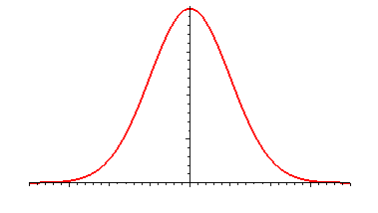
Probability distribution for seller of 60 whizbangs
%
1.0
875

Slide 68
Probability distribution for seller of 200 whizbangs
%
1.0
875
All Curves have the same mean value ($875)
but different risk (dispersion from the mean).

Slide 69
Probability distribution for seller of 10,000 whizbangs
%
1.0
875
$EMV

Slide 70
The “insurance idea” in tort and contract law
The large volume seller is better able to self-insure (diversify) away risk than a consumer buyer.

Slide 71
Let’s add the possibility of third party insurance
There’s something called State Farm…

Slide 72
Let’s add the possibility of third party insurance
There’s something called State Farm…
Who then would you expect to bear a loss, as between:
  Seller (manufacturer)
  Buyer (self-insurance)
  Third party insurance company

Slide 73
Where insurance is possible
Who would you expect to bear the loss for:
  Liability for a faulty transmission?
  Emotional Distress
  Personal Injury
  World War III?

Slide 74
Four kinds of Least-Cost Risk Avoiders
Where one party is better able to reduce the risk or the harm
Where one party is better able to value the loss
Assuming risk aversion, where one party is wealthier than the other
Assuming risk aversion, where one party is a better insurer because he can diversify the risk

Slide 75
Warranties
Express
  UCC 2-313(1)
Implied
  UCC 2-314 (merchantability)
  UCC 2-315 (fitness for purpose)

Slide 76
Express Warranties: UCC 2-313(1)
Express warranties by the seller are created as follows: (a) Any affirmation of fact or promise made by the seller to the buyer which relates to the goods and becomes part of the basis of the bargain creates an express warranty that the goods shall conform to the affirmation or promise model.

Slide 77
Express Warranties: UCC 2-313(1)
Express warranties by the seller are created as follows: (b) Any description of the goods which is made part of the basis of the bargain creates an express warranty that the goods shall conform to the description.

Slide 78
Express Warranties: UCC 2-313(2): Mere Puffs
an affirmation merely of the value of the goods or a statement purporting to be merely the seller's opinion or commendation of the goods does not create a warranty.

Slide 79
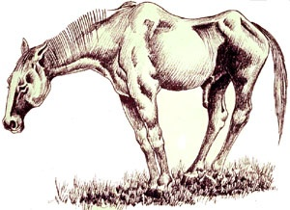
Sessa v. Riegle at 650
What were the alleged express warranties?
Riegle
Sessa

Slide 80
Express Warranties: UCC 2-313(1)
Express warranties by the seller are created as follows: (a) Any affirmation of fact or promise made by the seller to the buyer which relates to the goods and becomes part of the basis of the bargain creates an express warranty that the goods shall conform to the affirmation or promise model.

Slide 81
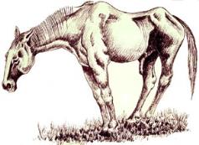
Sessa v. Riegle
Riegle: “The horse is sound”

Slide 82
Sessa v. Riegle
Riegle: “The horse is sound”
A mere puff
  “bland statements”

Slide 83
Sessa v. Riegle
Riegle: “The horse is sound”
A mere puff
A special rule for horse traders?
  “Horses are fragile creatures”

Slide 84
Sessa v. Riegle
Riegle: “The horse is sound”
Why did the court doubt that the statements were “part of the basis of the bargain”?

Slide 85
Sessa v. Riegle
Riegle: “The horse is sound”
Why did the court doubt that the statements were “part of the basis of the bargain”?
  Materiality or reliance?
    The draftsmen’s intention?

Slide 86
Sessa v. Riegle
Can you distinguish Frederickson from McNeir at p. 654?

Slide 87
Sessa v. Riegle
Was there a finding that the horse that was sold was defective?

Slide 88
Sessa v. Riegle
Was there a finding that the horse that was sold was defective?
  Claudication looks like a pre-existing condition
  Tendenitis might have resulted from the shipping
    In the later case, buyer took the risk

Slide 89
Royal Business Machines at 654
Representations: Copy machine…
  Was of high quality
  Frequency of repair was very low
  Would remain so
  Will bring buyer substantial profits

Slide 90
Royal Business Machines at 654
Representations: Copy machine…
  Was tested and ready to be marketed

Slide 91

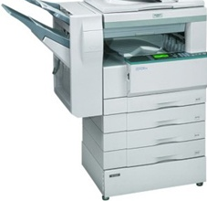
Royal Business Machines at 654
Copy machine:
  Oh yeah, the old “machines will not cause fire” warranty

Slide 92
Specificity: 656
Searls v. Glasser: “recession resistant”?
Keith: “sure-footed seaworthiness”?

Slide 93
Implied Warranties
Merchantability: 2-314
Fitness: 2-315
Title: 2-312

Slide 94
Merchantability
UCC§ 2-314(1) Unless excluded or modified (Section 2-316), a warranty that the goods shall be merchantable is implied in a contract for their sale if the seller is a merchant with respect to goods of that kind.

Slide 95
Merchantability
UCC§ 2-314(1) Unless excluded or modified (Section 2-316), a warranty that the goods shall be merchantable is implied in a contract for their sale if the seller is a merchant with respect to goods of that kind.

Slide 96
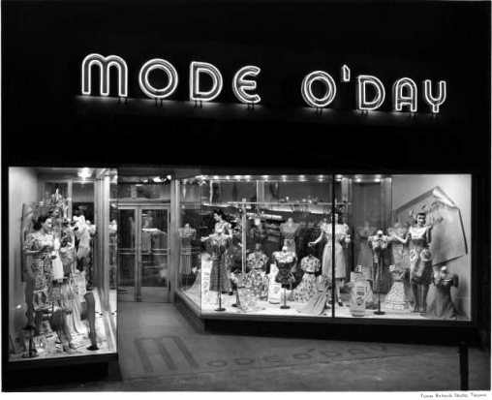
Flippo at 657
Implied warranty in UCC 2-314?

Slide 97
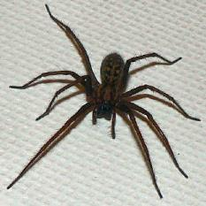
Flippo
Why were the goods merchantable in Flippo?

Slide 98
Flippo
Why were the goods merchantable in Flippo?
  “Fit for ordinary purposes for which such goods are used”

Slide 99
Merchantability
Is merchantability the same thing as strict liability?
  Qu. expected impurities in Coffer at 660

Slide 100
Merchantability
Latent vs. Patent Defects
  UCC § 2-314, cmt. 13
    Action by the buyer following an examination of the goods which ought to have indicated the defect complained of can be shown as matter bearing on whether the breach itself was the cause of the injury.

Slide 101
Implied Warranties
Qu. Non-UCC cases
  Cf. Gulash at 663

Slide 102
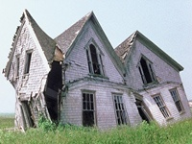
Warranty of Workmanlike Performance
Construction and services contracts
  Crawley at 661

Slide 103
Warranty of Workmanlike Performance
Construction and services contracts
  Crawley at 661
  What is an “end result warranty”?
    Obligations of result vs. obligations of means

Slide 104
UCC Implied Warranties
Merchantability: 2-314
Fitness: 2-315
Title: 2-312

Slide 105
Fitness for Purpose: UCC § 2-315
Where the seller at the time of contracting has reason to know any particular purpose for which the goods are required and that the buyer is relying on the seller's skill or judgment to select or furnish suitable goods, there is unless excluded or modified under the next section an implied warranty that the goods shall be fit for such purpose.

Slide 106
Fitness for Purpose: UCC § 2-315
Where the seller at the time of contracting has reason to know any particular purpose for which the goods are required and that the buyer is relying on the seller's skill or judgment to select or furnish suitable goods, there is unless excluded or modified under the next section an implied warranty that the goods shall be fit for such purpose.

Slide 107
Implied UCC Warranties
What does fitness add to merchantability, and how does the warranty change the buyer’s incentives?

Slide 108
Implied UCC Warranties
What does fitness add to merchantability, and how does the warranty change the buyer’s incentives?
The incentive to force out information

Slide 109
Exemption Clauses
UCC§ 2-316(1)(a) Words or conduct relevant to the creation of an express warranty and words or conduct tending to negate or limit warranty shall be construed wherever reasonable as consistent with each other; but subject to the provisions of this Article on parol or extrinsic evidence (Section 2-202) negation or limitation is inoperative to the extent that such construction is unreasonable.

Slide 110
Exemption Clauses
UCC§ 2-316(2). Subject to subsection (3), to exclude or modify the implied warranty of merchantability or any part of it the language must mention merchantability and in case of a writing must be conspicuous, and to exclude or modify any implied warranty of fitness the exclusion must be by a writing and conspicuous.

Slide 111
Exemption Clauses
UCC§ 2-316(3)(a) …unless the circumstances indicate otherwise, all implied warranties are excluded by expressions like "as is", "with all faults" or other language which in common understanding calls the buyer's attention to the exclusion of warranties and makes plain that there is no implied warranty

Slide 112
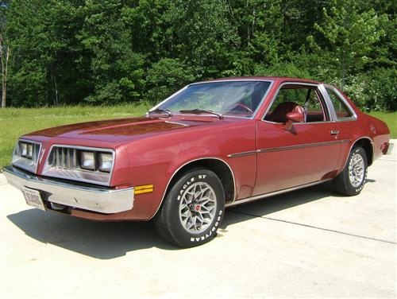
Exemption Clauses
Pelc v. Simmonds at 664
1978 Sunbird

Slide 113
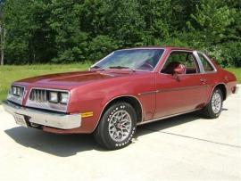
Exemption Clauses
Pelc v. Simmonds at 664
  Oral statements by Simmons
    Only thing wrong is the a/c
    Good little car, above average

Slide 114
Exemption Clauses
Pelc v. Simmonds at 664
  History of the car

Slide 115
Exemption Clauses
115
Pelc v. Simmonds
  Oral statements by Simmons
    Only thing wrong is the a/c
    Good little car, above average
  “As is” clause. UCC § 2-316(3)(a)

Slide 116
Exemption Clauses
116
Jones v. Kellner
  “As is” clause and “A-1 condition mechanically”
  UCC§ 2-316(1)(a) Words or conduct relevant to the creation of an express warranty and words or conduct tending to negate or limit warranty shall be construed wherever reasonable as consistent with each other; but subject to the provisions of this Article on parol or extrinsic evidence (Section 2-202) negation or limitation is inoperative to the extent that such construction is unreasonable.

Slide 117
Exemption Clauses
What if there is an allegation of fraudulent concealment?
    Morris at 666: Where was the fraud?

Slide 118
Exemption Clauses
What if there is an allegation of fraudulent concealment?
    Morris at 666: Where was the fraud?
    Recall Obde

Slide 119
Restatement § 160: Silence vs. Concealment
119
Action intended or known to be likely to prevent another from learning a fact is equivalent to an assertion that a fact does not exist
Notes:
119

Slide 120
Restatement § 161: When non-disclosure is equivalent to an assertion
120
A person's non-disclosure of a fact known to him is equivalent to an assertion that the fact does not exist in the following cases only:
(b) where he knows that disclosure of the fact would correct a mistake of the other party as to a basic assumption on which the party is making the contract and if non-disclosure of the fact amounts to a failure to act in good faith and in accordance with reasonable standards of fair dealing.
Notes:
120

Slide 121
George Mason School of Law
Contracts II
J. Warranties
This file may be downloaded only by registered students in my class, and may not be shared by them
F.H. Buckley
fbuckley@gmu.edu

Slide 122
Different kinds of promises
How to tell them apart?
Promissory Conditions
Warranties
122

Slide 123
What if the performance is slightly defective?
When are rejection rights triggered?
  Non-sales Law: Substantial breaches only
  Sales Law: Any defect: Perfect Tender Rule

Slide 124
Non-sales law presumptions in the Restatement
124
Restatement § 227(2) Unless the contract is of a type under which only one party generally undertakes duties, when it is doubtful whether (a) a duty is imposed on an obligee that an event occur, or (b) the event is made a condition of the obligor's duty, or (c) the event is made a condition of the obligor's duty and a duty is imposed on the obligee that the event occur, the first interpretation is preferred if the event is within the obligee's control.
  I.e., bare promise

Slide 125
Non-sales Law
The bias against forfeiture
125
Restatement § 227(1) In resolving doubts as to whether an event is made a condition of an obligor's duty, and as to the nature of such an event, an interpretation is preferred that will reduce the obligee's risk of forfeiture, unless the event is within the obligee's control or the circumstances indicate that he has assumed the risk.

Slide 126
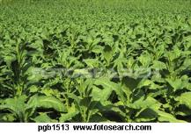
Howard
126
What are the options?
    Held a Bare promise

Slide 127
Non-sales Law:
Criterion of a promissory condition: Substantial Performance
Restatement § 237: It is a condition of each party’s remaining duties to render performances … that there be no uncured material failure

Slide 128
Non-sales Law: Substantial Performance
Materiality: Restatement § 241
  Deprived of the benefit?
  Damages are adequate compensation
  Forfeiture
  Likelihood of cure
  Standards of faith and fair dealing

Slide 129
Substantial Performance in Jacob & Young at 66

Slide 130
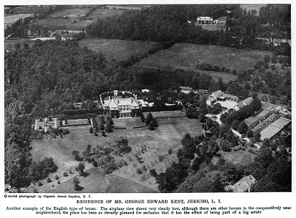
Jacob & Youngs v. Kent at 66
130

Slide 131
Substantial Performance
Jacob & Youngs v. Kent at 66
  Was there a breach?
131

Slide 132
Substantial Performance
Jacob & Youngs v. Kent
  Was there a breach?
  How serious was it?
132

Slide 133
Substantial Performance
Jacob & Youngs v. Kent
  What remedy does the Π seek?
133

Slide 134
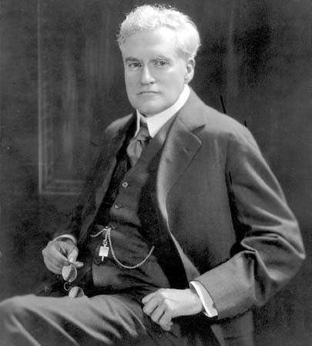
Substantial Performance
What are Dependent vs. Independent Promises, and why did it matter?
Benjamin Cardozo
134

Slide 135
Substantial Performance
What are Dependent vs. Independent Promises?
  Dependent promises as “conditions”
    Tender of price and of delivery under Article 2
  Independent promises as mere “promises”
135

Slide 136
Substantial Performance
Examples of Dependent Promises
  UCC 2-507, 2-511
136

Slide 137
Substantial Performance
What are Dependent vs. Independent Promises?
  Dependent promises as “conditions”
    Tender of price and of delivery under Article 2
  Independent promises as mere “promises”
  I know Cardozo called it a “promise” but I’m going to call it a “warranty”.
137

Slide 138
Conditions and Warranties
Promises
Conditions Warranties
(Dependent Promises) (Independent Promises)
Forfeiture
Damages
Damages only

Slide 139
Substantial Performance
So how does one tell whether it’s a condition or warranty?
139

Slide 140
Substantial Performance
How does one tell?
  “Intention not otherwise revealed may be presumed to hold in contemplation the reasonable and probable.”
140

Slide 141
Substantial Performance
How does one tell?
  Do considerations of “equity and fairness” get one to the same place?
141

Slide 142
Substantial Performance
Could the parties to a building contract bargain for perfect tender?
  “This is not to say that the parties are not free …”

Slide 143
Substantial Performance
Could the parties to a building contract bargain for perfect tender?
Did they in Jacob & Young?

Slide 144
Substantial Performance
Could the parties to a building contract bargain for perfect tender?
Did they in Jacob & Young?
Could you draft a clause that would have given Kent a right to rescind?

Slide 145
Substantial Performance
Could the parties to a building contract bargain for perfect tender?
Did the dissent have the better of the argument?

Slide 146
Substantial Performance
Assume:
      Value of house with Reading pipe is $77,000
      Value of house with Cohoes pipe is $76,900
      Cost of replacement is $10,000
  So will the pipe be replaced?
146

Slide 147
Substantial Performance
Assume:
      Value of house with Reading pipe is $77,000
      Value of house with Cohoes pipe is $76,900
      Cost of replacement is $10,000
  So what would a Coasian bargain look like, given those numbers?
147

Slide 148
Substantial Performance
What would the following remedies for breach do to the builder’s level of care (and the cost of construction)?
      Damages for diminution of value
      Specific performance
      A firing squad?
148

Slide 149
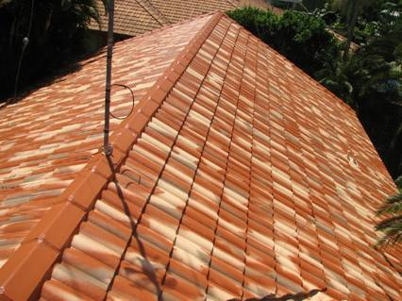
Substantial Performance
Is Grun Roofing at 670 consistent with Jacob and Youngs?

Slide 150
Substantial Performance
Grun Roofing
  The test for substantial breach
    “goes to the root of the matter or essence of the contract”
    The “desire to be gratified, … the cruelty of enforcing strict adherence”

Slide 151
Haymore v. Levinson at 673
What was the alleged breach?

Slide 152
Haymore v. Levinson
What was the alleged breach?
  A “satisfactory completion” standard
    So does owner get to insist on completion until he is satisfied?

Slide 153
Haymore v. Levinson
What was the alleged breach?
  The two standards: Which do you think was intended by the parties?
    Subjective: Owner gets to decide
    Objective

Slide 154
Willful deviations
Cf Grun Roofing at 672
  “Contractor must have in good faith intended to comply”
Material Movers at 675
  Can you justify this on efficiency grounds?

Slide 155
  Measure of damages: Cost of repair or diminished value?
Remedies in Plante v. Jacobs at 676
  Cost of repair vs. diminished value
  What is the difference in monetary terms?

Slide 156
  Measure of damages: Cost of repair or diminished value?
Remedies in Plante v. Jacobs at 688
In what respect is cost of repair akin to a promissory condition and diminished value like a warranty?

Slide 157
  Measure of damages: Cost of repair or diminished value?
Remedies in Plante v. Jacobs at 688
What is the difference in monetary terms between the two measures?
Is it correct to say that diminished value is more economically efficient?

Slide 158
Recall the Four kinds of Least-Cost Risk Avoiders
Where one party is better able to reduce the risk or the harm
Where one party is better able to value the loss
Assuming risk aversion, where one party is wealthier than the other
Assuming risk aversion, where one party is a better insurer because he can diversify the risk

Slide 159
Now: Warranties as a signaling strategy
Warranties also signal product quality
  The informational asymmetry between seller and buyer

Slide 160
Recall the Four kinds of Least-Cost Risk Avoiders
Warranties also signal product quality
  As between two sellers, one of whom offers a warranty and the other of whom doesn’t, you have more information about the former

Slide 161
Warranties as a signalling strategy
If a dealer offers you an extended warranty at a premium price, why does Consumers Reports tell you to reject this?

Slide 162
Warranties as a signalling strategy
If a dealer offers you an extended warranty at a premium price, why does Consumers Reports tell you to reject this?
  The offer of the extended warranty gives you the information, even if you don’t take it up

Slide 163
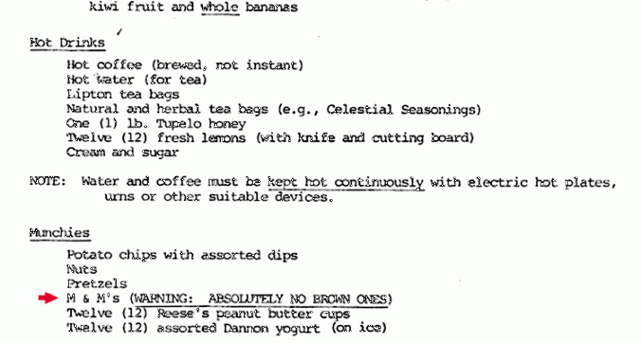
Van Halen Standard Contract

Slide 164
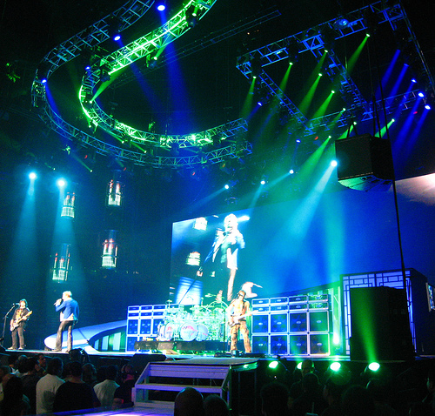
Why did Van Halen ban brown M & Ms?

Slide 165
If a warranty can operate as a signal, what about a breach?
An argument for the perfect tender rule?

Slide 166
What if the performance is slightly defective?
When are rejection rights triggered?
  Non-sales Law: Substantial breaches only
  Sales Law: Any defect: Perfect Tender Rule

Slide 167
Non sales law presumptions
167
Restatement § 227(1) In resolving doubts as to whether an event is made a condition of an obligor's duty, and as to the nature of such an event, an interpretation is preferred that will reduce the obligee's risk of forfeiture, unless the event is within the obligee's control or the circumstances indicate that he has assumed the risk.
  So a presumption against promissory and non-promissory conditions

Slide 168
Non-sales Law: Substantial Performance
Restatement § 237: It is a condition of each party’s remaining duties to render performances … that there be no uncured material failure

Slide 169
Sales Law: The Perfect Tender Rule of UCC § 2-601
Subject to the provisions of this Article on breach in installment contracts (Section 2-612) and unless otherwise agreed under the sections on contractual limitations of remedy (Sections 2-718 and 2-719), if the goods or the tender of delivery fail in any respect to conform to the contract, the buyer may
(a) reject the whole; or
(b) accept the whole; or
(c) accept any commercial unit or units and reject the rest.

Slide 170
Perfect Tender in Sales Law
Promises
Conditions Warranties
Perfect Tender Substantive Performance
Forfeiture
Damages
Damages only
170

Slide 171
Buyer’s Remedies in the UCC
But the rejection right may be lost through:
  waiver
  estoppel
  acceptance
  cure

Slide 172
Buyer’s Remedies in the UCC
2-601 Perfect Tender required
Accept 2-606 Reject 2-601

Slide 173
Perfect Tender Lost on Acceptance
On acceptance, buyer’s only remedy is damages
UCC 2-607(2) Acceptance of goods by the buyer precludes rejection of the goods accepted and if made with knowledge of a non-conformity cannot be revoked because of it unless the acceptance was on the reasonable assumption that the non-conformity would be seasonably cured but acceptance does not of itself impair any other remedy provided by this Article for non-conformity

Slide 174
Acceptance: But qu. Latent defects
§ 2-606. What Constitutes Acceptance of Goods.
(1) Acceptance of goods occurs when the buyer
(a) after a reasonable opportunity to inspect the goods signifies to the seller that the goods are conforming or that he will take or retain them in spite of their non-conformity; or
(b) fails to make an effective rejection, but such acceptance does not occur until the buyer has had a reasonable opportunity to inspect them; or
(c) does any act inconsistent with the seller's ownership; but if such act is wrongful as against the seller it is an acceptance only if ratified by him.

Slide 175
Acceptance: But qu. Latent defects
§ 2-606. What Constitutes Acceptance of Goods.
(1) Acceptance of goods occurs when the buyer
(a) after a reasonable opportunity to inspect the goods signifies to the seller that the goods are conforming or that he will take or retain them in spite of their non-conformity; or
(b) fails to make an effective rejection, but such acceptance does not occur until the buyer has had a reasonable opportunity to inspect them; or
(c) does any act inconsistent with the seller's ownership; but if such act is wrongful as against the seller it is an acceptance only if ratified by him.
Where does that leave latent defects?

Slide 176
Buyer’s Remedies in the UCC
§ 2-714(1) Where the buyer has accepted goods and given notification he may recover as damages for any non-conformity of tender the loss resulting in the ordinary course of events from the seller's breach as determined in any manner which is reasonable.

Slide 177
Buyer’s Remedies in the UCC
2-601 Perfect Tender required
Accept 2-606 Reject 2-602
Damages 2-714

Slide 178
Revocation of Acceptance
After acceptance, buyer might nevertheless be permitted to revoke his acceptance

Slide 179
Buyer’s Remedies in the UCC
2-601 Perfect Tender required
Accept 2-606 Reject 2-602
Damages 2-714 Revocation of Acceptance 2-608

Slide 180
§ 2-608. Revocation of Acceptance
(1) The buyer may revoke his acceptance of a lot or commercial unit whose non-conformity substantially impairs its value to him if he has accepted it
(a) on the reasonable assumption that its non-conformity would be cured and it has not been seasonably cured; or
(b) without discovery of such non-conformity if his acceptance was reasonably induced either by the difficulty of discovery before acceptance or by the seller's assurances

Slide 181
§ 2-608. Revocation of Acceptance
(1) The buyer may revoke his acceptance of a lot or commercial unit whose non-conformity substantially impairs its value to him if he has accepted it
(a) on the reasonable assumption that its non-conformity would be cured and it has not been seasonably cured; or
(b) without discovery of such non-conformity if his acceptance was reasonably induced either by the difficulty of discovery before acceptance or by the seller's assurances
So that’s how we cover latent defects

Slide 182
Revocation of Acceptance
But now a substantial breach standard
(1) The buyer may revoke his acceptance of a lot or commercial unit whose non-conformity substantially impairs its value to him if he has accepted it
(a) on the reasonable assumption that its non-conformity would be cured and it has not been seasonably cured; or
(b) without discovery of such non-conformity if his acceptance was reasonably induced either by the difficulty of discovery before acceptance or by the seller's assurances

Slide 183
§ 2-608. Revocation of Acceptance
After revocation of acceptance, buyer may “cancel”

Slide 184
Buyer’s right to cancel
§ 2-711(1) Where the seller fails to make delivery or repudiates or the buyer rightfully rejects or justifiably revokes acceptance then with respect to any goods involved, and with respect to the whole if the breach goes to the whole contract (Section 2-612), the buyer may cancel and whether or not he has done so may in addition to recovering so much of the price as has been paid
(a) "cover" and have damages under the next section as to all the goods affected whether or not they have been identified to the contract; or
(b) recover damages for non-delivery as provided in this Article

Slide 185
Buyer’s Remedies in the UCC
2-601 Perfect Tender required
Accept 2-606 Reject 2-602
Damages 2-714, 2-715 Revocation of Acceptance 2-608
Cancel for substantial impairment
2-711, 2-106(4)

Slide 186
Buyer’s action for the price
§ 2-711(1) Where the seller fails to make delivery or repudiates or the buyer rightfully rejects or justifiably revokes acceptance then with respect to any goods involved, and with respect to the whole if the breach goes to the whole contract (Section 2-612), the buyer may cancel and whether or not he has done so may in addition to recovering so much of the price as has been paid

Slide 187
Buyer’s right to “cover”
§ 2-711(1) Where the seller fails to make delivery or repudiates or the buyer rightfully rejects or justifiably revokes acceptance then with respect to any goods involved, and with respect to the whole if the breach goes to the whole contract (Section 2-612), the buyer may cancel and whether or not he has done so may in addition to recovering so much of the price as has been paid
(a) "cover" and have damages under the next section as to all the goods affected whether or not they have been identified to the contract; or
(b) recover damages for non-delivery as provided in this Article

Slide 188
Buyer’s right to damages
§ 2-711(1) Where the seller fails to make delivery or repudiates or the buyer rightfully rejects or justifiably revokes acceptance then with respect to any goods involved, and with respect to the whole if the breach goes to the whole contract (Section 2-612), the buyer may cancel and whether or not he has done so may in addition to recovering so much of the price as has been paid
(a) "cover" and have damages under the next section as to all the goods affected whether or not they have been identified to the contract; or
(b) recover damages for non-delivery as provided in this Article

Slide 189
Buyer’s Remedies in the UCC
2-601 Perfect Tender required
Accept 2-606 Reject 2-602
Action for price paid 2-711
Cover 2-711
Incidental Damages 2-711

Slide 190
Now—Seller’s Remedies

Slide 191
Seller’s Remedies Before Delivery
Goods not delivered Goods delivered
Withhold delivery 2-703
Stoppage in transitu 2-705
Damages 2-703, 2-708

Slide 192
Seller’s Remedies Before Delivery
U.C.C. Sect. 2-703. … the aggrieved seller may:
  (a) withhold delivery of such goods;
  (b) stop delivery by any bailee as hereafter provided (Section 2-705);
  (d) resell and recover damages as hereafter provided (Section 2-706);
  (e) recover damages for nonacceptance (Section 2-708) or in a proper case the price (Section 2-709);
  (f) cancel.

Slide 193
Seller’s Remedies after Delivery
Goods not delivered Goods delivered
Action for the price 2-709

Slide 194
Seller’s Action for the Price
§ 2-709(1) When the buyer fails to pay the price as it becomes due the seller may recover, together with any incidental damages under the next section, the price
(a) of goods accepted or of conforming goods lost or damaged within a commercially reasonable time after risk of their loss has passed to the buyer; and
(b) of goods identified to the contract if the seller is unable after reasonable effort to resell them at a reasonable price or the circumstances reasonably indicate that such effort will be unavailing.

Slide 195
Buyer’s Remedies in the UCC
But the rejection right may be lost through:
  waiver
  estoppel
  acceptance
  cure

Slide 196
Cure by Seller after Delivery
2-601 Perfect Tender required
Accept 2-606 Reject 2-602
Seller Cures 2-508 No cure

Slide 197
Cure before delivery date
§ 2-508(1) Where any tender or delivery by the seller is rejected because non-conforming and the time for performance has not yet expired, the seller may seasonably notify the buyer of his intention to cure and may then within the contract time make a conforming delivery.

Slide 198
Cure before delivery date
What if first tender is junk?

Slide 199
Cure before delivery date
What if first tender is junk?
  Ramirez at 681: an unconditional right to cure before the delivery date

Slide 200
Cure after delivery date?
§ 2-508(2) Where the buyer rejects a non-conforming tender which the seller had reasonable grounds to believe would be acceptable with or without money allowance the seller may if he seasonably notifies the buyer have a further reasonable time to substitute a conforming tender.

Slide 201
Cure after Delivery Date
Can seller cure after the delivery date if the defect is substantial and not trivial?

Slide 202
Cure after delivery date?
§ 2-508(2) Where the buyer rejects a non-conforming tender which the seller had reasonable grounds to believe would be acceptable with or without money allowance the seller may if he seasonably notifies the buyer have a further reasonable time to substitute a conforming tender.

Slide 203
Cure after delivery date
Can seller cure after the delivery date if the defect is substantial and not trivial?
    “we need not decide” at 681
    Zabriskie at 684

Slide 204
Cure and Buyer Opportunism
If the delivery date has passed, might cure be unfair to the buyer?

Slide 205
Cure and Buyer Opportunism
If the delivery date has passed, in what way might this be unfair to the buyer?
  The delay by itself?
  Seller’s incentive problem

Slide 206
Ramirez at 679
Did buyers accept the goods in 2-606?

Slide 207
Ramirez
Did buyers accept the goods in 2-606?
  Semble not, so no need to revoke acceptance
  Perfect Tender rule … but for cure

Slide 208
How perfect tender rights may be lost
Seller’s right to cure even if no acceptance
    “In an age of assembly lines … buyers no longer expect a perfect tender…"

Slide 209
When is buyer opportunism most a problem, and when are cure rights most needed?

Slide 210
When is buyer opportunism most a problem, and cure rights most needed?
Idiosyncratic, custom-made goods

Slide 211
When is buyer opportunism most a problem, and cure rights most needed?
Volatile markets

Slide 212
How might sellers behave opportunistically, given cure rights?

Slide 213
How might sellers behave opportunistically, given cure rights?
Sloppiness as to delivery?
Sloppy repair: Ramirez, Zabriskie at 684

