Slide 1
George Mason School of Law
Contracts II
F. Unconscionability
Not to be shared
© F.H. Buckley
fbuckley@gmu.edu
1

Slide 2
Forms of Unconsionability
UCC § 2-302. Unconscionable Contract or Clause
(1) If the court as a matter of law finds the contract or any clause of the contract to have been unconscionable at the time it was made the court may refuse to enforce the contract, or it may enforce the remainder of the contract without the unconscionable clause, or it may so limit the application of any unconscionable clause as to avoid any unconscionable result.

Slide 3
Forms of Unconsionability
UCC § 2-302.
The “fraudlets”
  Is the message here that there are forms of actionable misbehavior missed by the doctrines of capacity, fraud and duress?

Slide 4
Williams v. Walker-Thomas
Is the whole greater than the sum of its parts?

Slide 5
Forms of Unconsionability
Substantive Unconscionability
  The “just price” doctrine
Procedural Unconscionability
  “bargaining naughtiness”

Slide 6
Forms of Unconsionability
Substantive Unconscionability
  Where some bargains are made illegal, is that a recognition of the failure of traditional common law defenses?

Slide 7
Forms of Unconsionability
Substantive Unconscionability
  Where some bargains are made illegal, is that a recognition of the failure of traditional common law defenses?
    Usury laws?
    Security interests in consumer goods?

Slide 8
Still, does ‘70s consumerism have a class bias?
Can you be pro-consumer without being anti-producer?
  Who do you see as a typical consumer?
  And the typical producer?
  Contrast Carlill v. Carbolic vs. Green v. Ever-Tite

Slide 9
Restatement § 15: Mental Illness
(1) A person incurs only voidable contractual duties by entering into a transaction if by reason of mental illness or defect
(b) he is unable to act in a reasonable manner in relation to the transaction and the other party has reason to know of his condition.

Slide 10
Can unconscionability laws benefit merchants as well as consumers?
The starving millionaire and status obligations?
  Dover vs. Hastings
  The law of salvage and ex ante rescuer costs

Slide 11
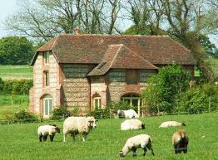
Lloyds Bank v. Bundy

Slide 12
Lloyds Bank v. Bundy
What did the bank manager (Head) do that was wrong?
Did he owe any duties to the borrower (Michael)?
Did he owe any duties to Herbert?
If there was a conflict of interest—isn’t there always that?

Slide 13
Lloyds Bank v. Bundy
If there was a relationship of trust and confidence—how to rebut that?
In what sense was the consideration inadequate?
  What did Head know?

Slide 14
Denning’s Categories
“Duress of goods”: Inequality of bargaining power
  Hochman at 407
  Austin v. Loral

Slide 15
Denning’s Categories
The expectant heir

Slide 16
Denning’s Categories
Undue influence
  Fiduciary relationship
  Cf. D&C Builders v. Rees
  D&C accepts £300 as full payment of a debt of £482 when it desperately needed money to fend off bankruptcy, and Rees knew this

Slide 17
Denning’s Categories
Undue pressure
  Wolf v. Marlton
  Elderlaw

Slide 18
Denning’s Categories
Salvage Agreements
  Post v. Jones

Slide 19
A General Principle of Inequality of Bargaining Power?
“English law gives relief to one who, without independent advice, enters into a contract or transfers property for a consideration which is grossly inadequate, when his bargaining power is grievously impaired by reason of his own needs or desires, or by his own ignorance or infirmity, coupled with undue influences or pressures brought to bear on him by or for the benefit of the other.”

Slide 20
A General Principle of Inequality of Bargaining Power?
“without independent advice”

Slide 21
A General Principle of Inequality of Bargaining Power?
“a consideration which is grossly inadequate”
Was it? Explain.

Slide 22
A General Principle of Inequality of Bargaining Power?
“coupled with undue influences or pressures”
Was it?

Slide 23
A General Principle of Inequality of Bargaining Power?
“his bargaining power is grievously impaired by reason of his own needs or desires”
Was it?

Slide 24
Why look at an English case?
Maryland is a foreign jurisdiction to Virginians…

Slide 25
Why look at an English case?
The importance of style:
  Broadchalke is one of the most pleasing villages in England. Old Herbert Bundy was a farmer there. His home was at Yew Tree Farm. It went back for 300 years. His family had been there for generations. It was his only asset. But he did a very foolish thing. He mortgaged it to the bank. Up to the very hilt.

Slide 26
Why look at an English case?
The Analogic Imagination:
  Gathering all together, I would suggest that through all these instances there runs a single thread. They rest on "inequality of bargaining power".

Slide 27
What’s going on here?
Are we punishing a grasping bank?

Slide 28
What’s going on here?
Are we punishing a grasping bank?
Is there an informational problem?
Usury: Why might a consumer agree to “excessive” interest rates?

Slide 29
Why might a consumer agree to “excessive” interest rates?
An informational problem
  Thornborrow v. Whitacre, 92 Eng.Rep. 270 (1705): W. borrows £5 and in return promises to pay two grains of rye-corn in the first week, four in the second, eight in the third, and so on for a year. The court refused to enforce the contract when it appeared that there was not enough grain in the whole world to satisfy this.

Slide 30
Why might a consumer agree to “excessive” interest rates?
A moral hazard problem
    What does bankruptcy law and the welfare safety net do to our investment decisions?

Slide 31
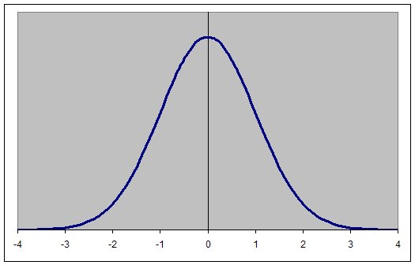
Moral Hazard
A range of outcomes associated with an investment opportunity

Slide 32
Moral Hazard
How is one’s economic calculus affected if costs
are curtailed at 0 on the left side of the curve?

Slide 33
Moral Hazard
In that case, it’s all upside:
Heads I win, tails you lose

Slide 34
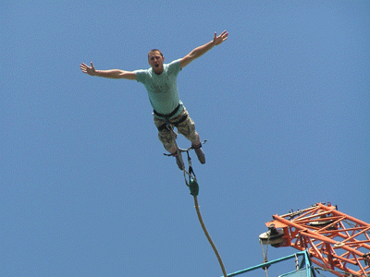
Moral Hazard: We make risker choices when we don’t pay for downsides
Thank God I have insurance!

Slide 35
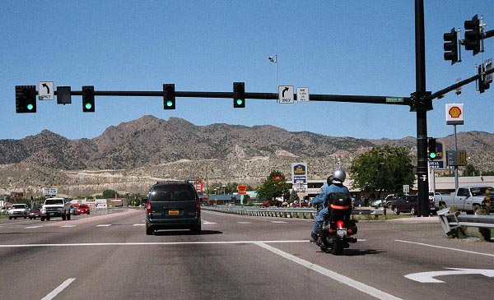
Moral Hazard
Do traffic signals cause accidents?

Slide 36
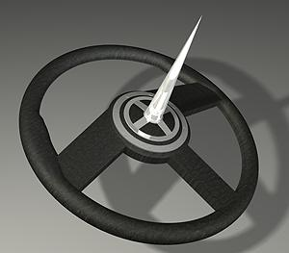
How to reduce speed levels…

Slide 37
Moral Hazard
So a consumer might be more willing to court default with a high risk loan because of the welfare safety net.

Slide 38
Moral Hazard
So a consumer might be more willing to court default with a high risk loan because of the welfare safety net.
But what’s the optimal level of risk-taking?
    Is there such a thing as “excessive risk aversion”

Slide 39
Why might a consumer agree to “excessive” interest rates?
Signalling

Slide 40
Signalling
Two borrowers approach a lender. One is high risk, the other low risk. The borrowers know their quality but the lender cannot tell them apart. How can he distinguish them?

Slide 41
Signalling
Two borrowers approach a lender. One is high risk, the other low risk. The borrowers know their quality but the lender cannot tell them apart. How can he distinguish them?
Assume that default is costly for both borrowers. However, the low risk borrower has a lower probability of default and a lower cost of default

Slide 42
Signalling
A signalling equilibria if a “non-mimicry” constraint
    By their willingness to accept the cost of a high interest loan one can tell them apart and they don’t have an incentive to switch

Slide 43
Signalling
Compare the benefit of a loan ($$$) versus the cost (probability of default times the cost of default)

Slide 44
Signalling
Separating equilibrium:
      Benefit > Cost*_{High Quality Borrower}
      Benefit < Cost*_{Low Quality Borrower}

Slide 45
Signalling
Signalling doesn’t work if a pooling equilibrium
    Low quality can mimic high quality

Slide 46
Signalling
Pooling equilibrium
      Benefit > Cost_{High Quality Borrower}
      Benefit > Cost_{Low Quality Borrower}

Slide 47

Cheap Talk as a Pooling Equilibrium
Hobbes: He which performeth
first doth but betray himself
to his enemy.

Slide 48
Signalling
A separating equilibrium if the low risk borrower is unwilling to accept a penalty on default?

Slide 49
Signalling
Separating equilibrium:
      Benefit > Cost*_{High Quality Borrower}
      Benefit < Cost*_{Low Quality Borrower}

Slide 50
Forms of Unconsionability
UCC § 2-302. Unconscionable Contract or Clause
(1) If the court as a matter of law finds the contract or any clause of the contract to have been unconscionable at the time it was made the court may refuse to enforce the contract, or it may enforce the remainder of the contract without the unconscionable clause, or it may so limit the application of any unconscionable clause as to avoid any unconscionable result.

Slide 51
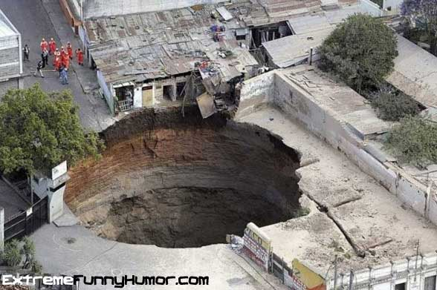
Seabrook: 502
Apartment to be ready three months later
Unfinished Apartment Building
51

Slide 52
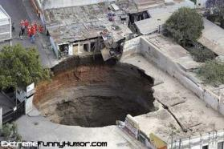
Seabrook
How long was the delay?
52

Slide 53
Seabrook
Do you think counsel for Commuter Housing was trying to pull a fast one in clauses 33 and 19?
53

Slide 54
Seabrook
Do you think counsel for Commuter Housing was trying to pull a fast one in clauses 33 and 19?
What did the court say was missing?
54

Slide 55
Seabrook
Do you think counsel for Commuter Housing was trying to pull a fast one in clauses 33 and 19?
What did the court say was missing?
Why not strike the clause and imply a reasonable time (and might that be four months?
55

Slide 56
Seabrook
56
56
Can you articulate the legal principle behind the case?

Slide 57
Seabrook
57
57
Can you articulate the legal principle behind the case?
  “absence of meaningful choice”
  “Once the consumer enters to merchant’s trap … he is caught in a web”
  Land a “scarce commodity”
  “The concept of laissez-faire ... Has no place in our enlightened society”

Slide 58

Here’s one legal principle …
58

Slide 59
Seabrook
Did the lessee have “no choice but to sign an unconscionable lease agreement”
  “does not have the option of shopping around”
59

Slide 60
Seabrook
60
Did the lessee have “no choice but to sign an unconscionable lease agreement”
  Were there other rental properties in NYC?

Slide 61
Seabrook
Just what was unconscionable?
  Did the lessee know that the building was not completed when he signed the lease?
61

Slide 62
Seabrook
62
Just what was unconscionable?
  Do you think the lessee might have considered that there was a possibility that the building would be completed four months late?
  Was that an unreasonable delay?

Slide 63
Seabrook
63
Just what was unconscionable?
  Do you think the lessee might have considered that there was a possibility that the building would not be completed three months later?
  What do you think he would have expected to happen in that case?

Slide 64
Seabrook
64
If you thought that the lessor should have provided for a maximum period, is that the hindsight bias at work?

Slide 65
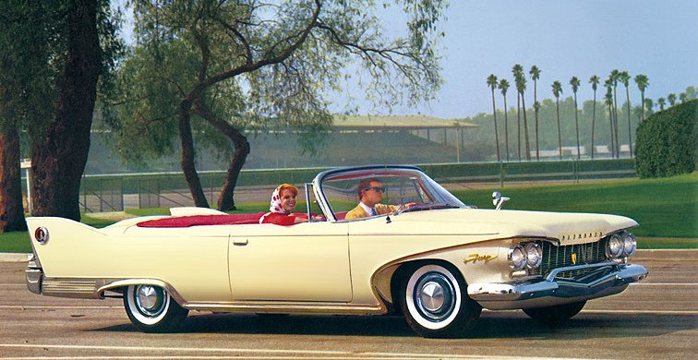
Henningsen at 504
1960 Plymouth
65

Slide 66
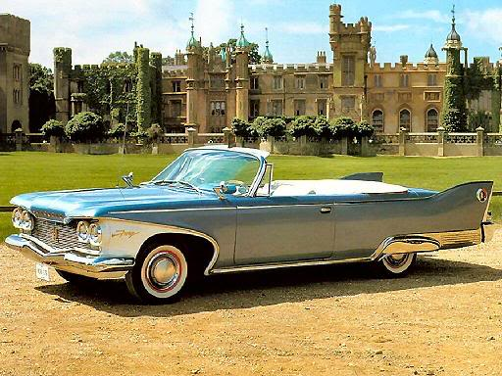
Henningsen
1960 Plymouth … in two-tone!
66

Slide 67
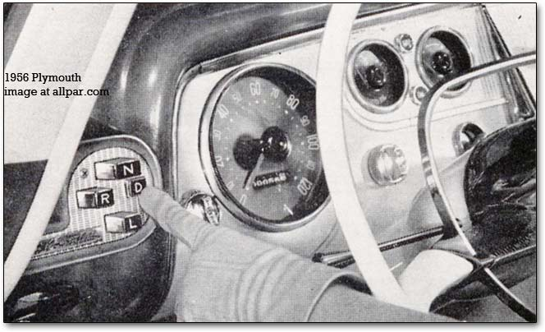
Henningsen
With a push-button tranmission!
67

Slide 68
Henningsen
1960 Plymouth
Look: Fins!!!
68

Slide 69
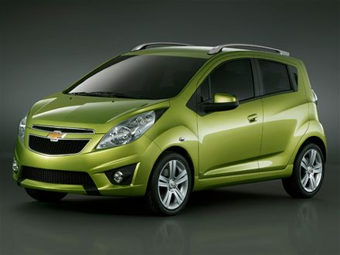
And today?
Chevrolet Spark

Slide 70
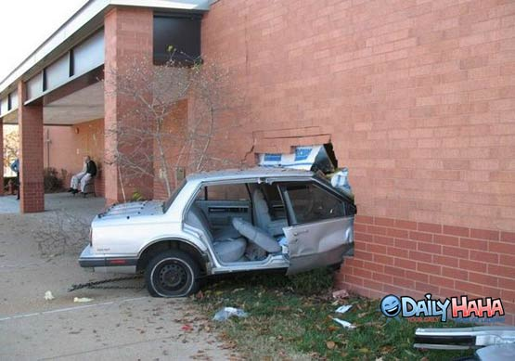
Henningsen
And what did they do with their car!!
70

Slide 71

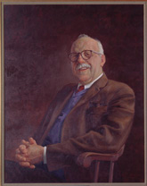
Henningsen
71
Are exemption clauses intrinsically suspect?

Slide 72

Henningsen
$3.99? I think we can do better, don’t you?
“No bargaining is engaged
with respect to it”
72
A right to dicker?

Slide 73
Henningsen
73
Why only a three months warranty on parts?

Slide 74
Henningsen
74
Were the Big Three immune from competition?
  Look at the list of manufacturers on 506

Slide 75
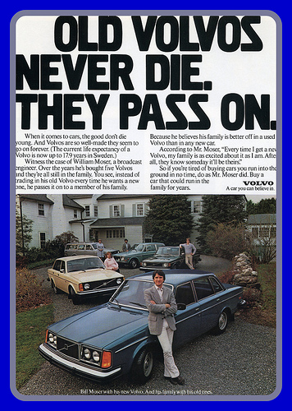
Henningsen
75
Were the Big Three immune from competition?

Slide 76
Henningsen
76
Were the Big Three immune from competition?
  If so, why do you think that was?

Slide 77
Henningsen
Were the Big Three immune from competition?
Is a similarity in prices or terms across a market evidence of cartelization or of a competitive market?
77

Slide 78
Henningsen
Were the Big Three immune from competition?
Is a similarity in prices or terms across a market evidence of cartelization?
Would you expect to a monopolist exploit his clout with prices and not terms?
78

Slide 79
Henningsen
Would you expect to a monopolist exploit his clout with prices and not terms?
Is it different if the information about warranties is difficult to understand?
79

Slide 80
Henningsen
Were the Big Three immune from competition?
Is a similarity in prices or terms across a market evidence of cartelization?
Does competition as to terms assume that all consumers screen?
  Free riding?
80

Slide 81
Henningsen
Were the Big Three immune from competition?
Is a similarity in prices or terms across a market evidence of cartelization?
Does competition as to terms assume that all consumers screen?
  Suppose you heard that one firm had an extortionate contract?
81

Slide 82
Litigation or Regulation?
OIRA’s Mandate: Federal agencies should promulgate only such regulations as are required by law, are necessary to interpret the law, or are made necessary by compelling public need, such as material failures of private markets to protect or improve the health and safety of the public, the environment, or the well-being of the American people. In deciding whether and how to regulate, agencies should assess all costs and benefits of available regulatory alternatives, including the alternative of not regulating.
82

Slide 83
Fairness in the two-person bargaining game
The Edgeworth Box Function provided a bargaining model based on ordinal utility (indifference curves)
83

Slide 84
Recall the Contract Curve
Indifference curve in commodity space
Bess
•
E
A
•
C
•
F
•
•
G
B
•
D
•
Mary
84

Slide 85
The two-person bargaining game
85
The Edgeworth Box Function teaches us that bargaining is a non-zero sum game

Slide 86
The two-person bargaining game
86
The Edgeworth Box Function teaches us that bargaining is a non-zero sum game
But at the heart of the bargaining game is a zero-sum game

Slide 87
Ordinal and Cardinal Utility
87
Ordinal numbers: First, second, third…
Cardinal numbers: 1, 2, 3 …

Slide 88
Are you a cardinalist?
88
Yes, if you think interpersonal utility comparisons are meaningful

Slide 89
Are you a cardinalist?
89
You are charged with designing a country’s welfare policy. Should wealth transfers be from rich to poor or the other way around?

Slide 90
The ultimatum game
We have $1,000 to divide between us.
I first decide how the money is to divided.
90

Slide 91
The ultimatum game
91
We have $1,000 to divide between us.
I first decide how the money is to divided.
In the second stage you decide whether or not to accept the split I propose.
Notes:
91

Slide 92
The ultimatum game
92
We have $1,000 to divide between us.
I first decide how the money is to divided.
In the second stage you decide whether or not to accept the split I propose.
If you accept the split we both take our respective shares.
If you reject the split neither of us get anything.
Notes:
92

Slide 93
The ultimatum game
93
In the first round of a one-shot game I choose $950, leaving you $50
Take it or leave it?
Notes:
93

Slide 94
Do we have built-in fairness constraints?
94
You see that Safeway refuses to charge a premium for a shovel during a snow storm
  Is it being irrational?
Notes:
94

